Slide 1



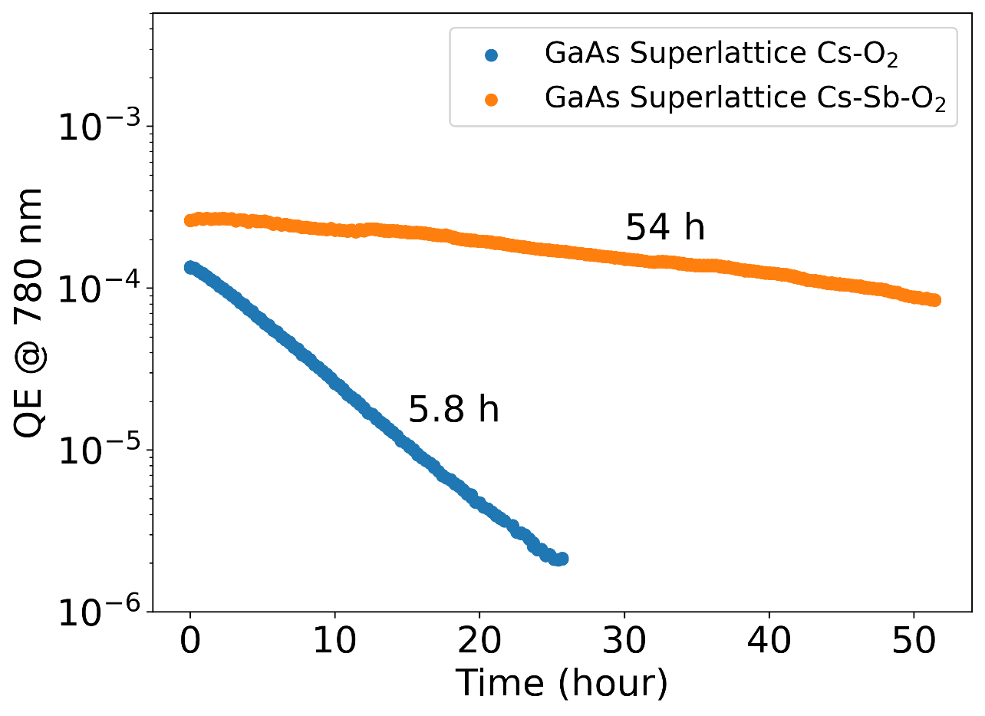
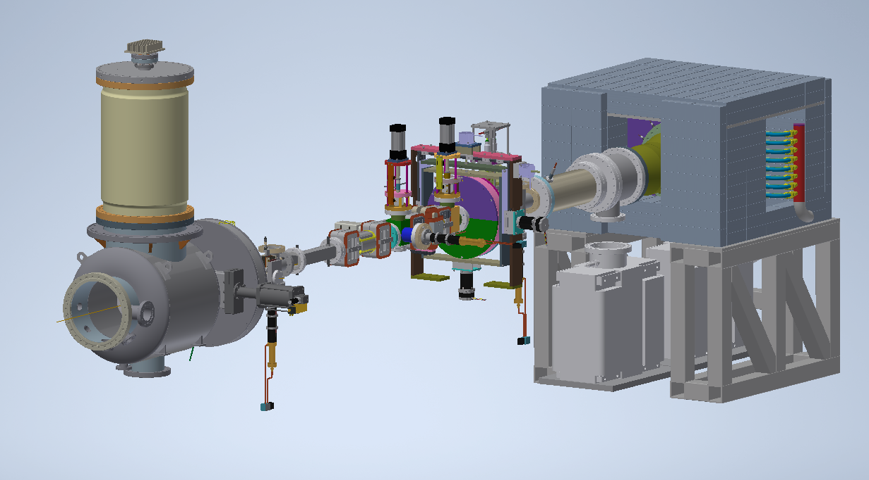
Improving lifetime of GaAs photocathodes by activating with Cs, Sb, O

Slide 2



Improving lifetime of GaAs photocathode by activating with Cs, Sb, O
Jai Kwan Bae
Cornell University
Luca Cultrera, Alice Galdi, Matt Andorf, Jared Maxson, Ivan Bazarov

Slide 3


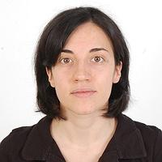
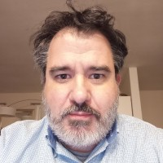
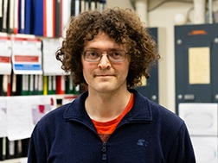
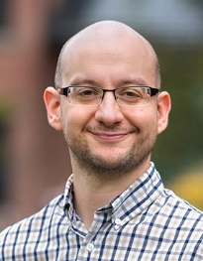
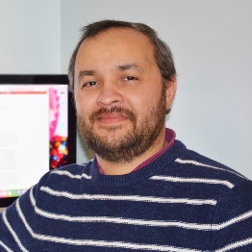


Acknowledgment
This work was supported by the Department of Energy and National Science Foundation.
In collaboration with
  Alice Galdi
  Luca Cultrera
  Matthew Andorf
  Md Abdullah Mamun
  Marcy Stutzman
  Joe Grames
  Jared Maxson
  Ivan Bazarov

Slide 4
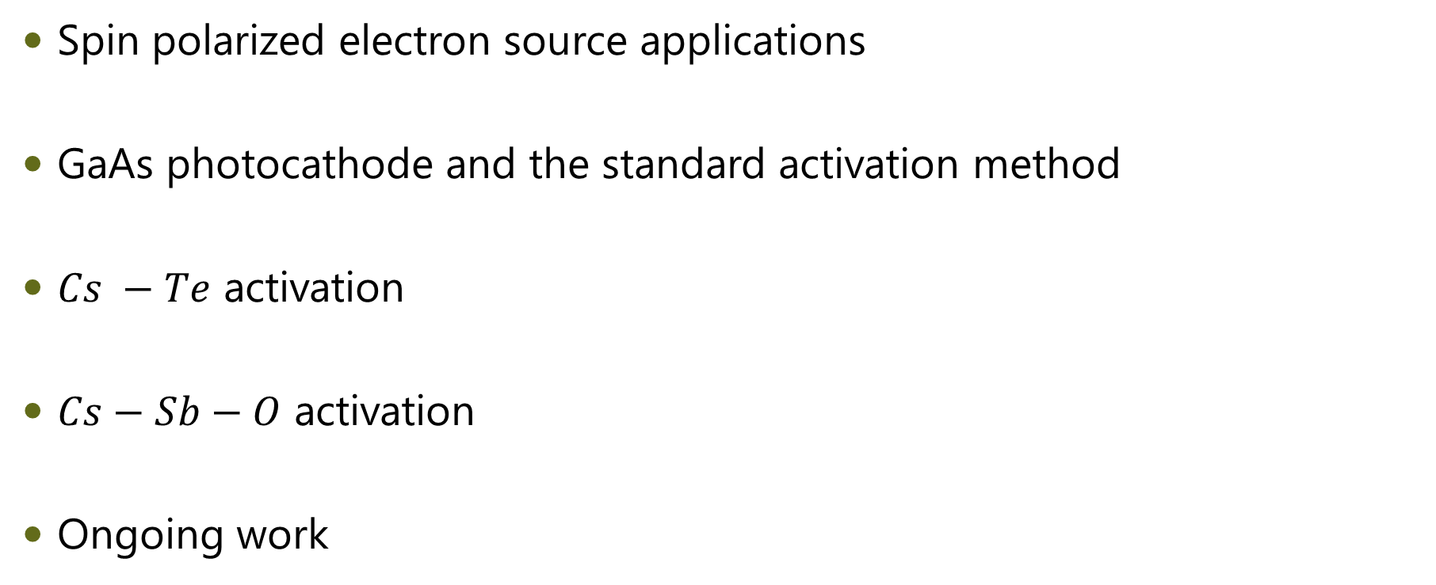
Outline
Spin polarized electron source applications
GaAs photocathode and the standard activation method
$Cs −Te$ activation
$Cs−Sb−O$ activation
Ongoing work

Slide 5
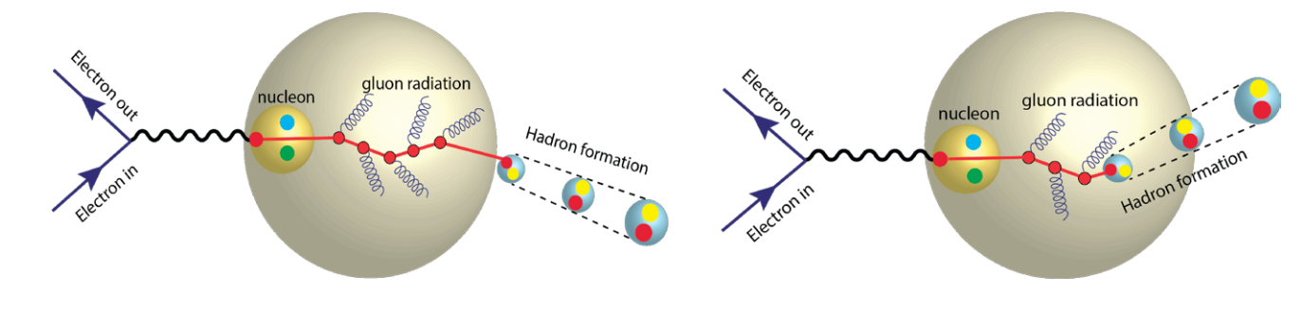
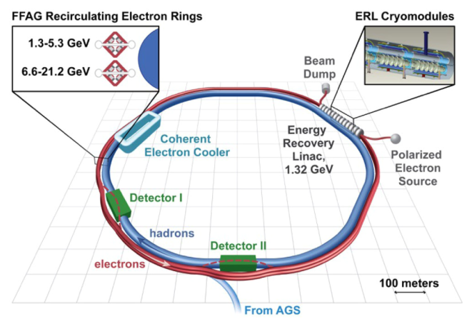
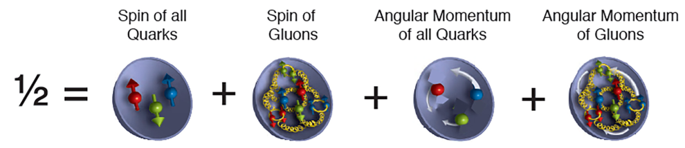
Spin polarized electron source application (1)
Electron-Ion collider
  Deep Inelastic scattering (hadron-lepton scattering)
    Contribution of gluons to the total spin of a proton
    Spatial distribution of gluons, quarks in nuclei
“The 2015 Long Range Plan for Nuclear Science” Report

Slide 6
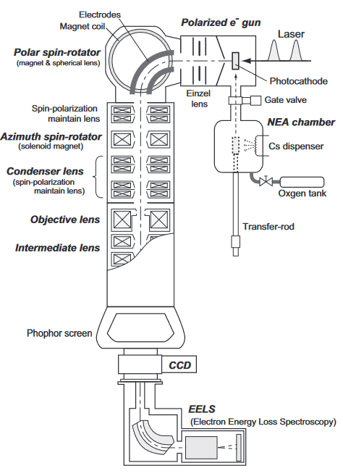
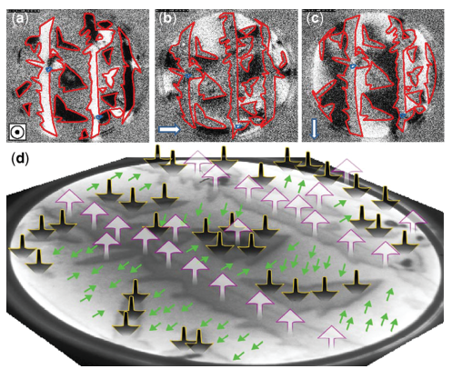
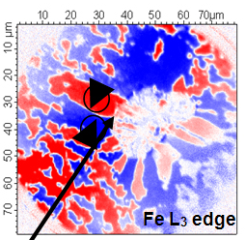
Spin polarized electron source application (2)
Spin polarized low energy electron diffraction (<30 eV)
Spin polarized Transmission Electron Microscope (10s - 100s keV)
Spin polarized Photoelectron Microscopy (10s keV)
Co/Ru(0001). N'diaye et al. Characterization of Materials (2002): 1-14.
Kuwahara et al. APL 105, 193101 (2014)
Gloskovskii et al, J. Phys. D: Appl. Phys. 40 (2007) 1570–1575

Slide 7
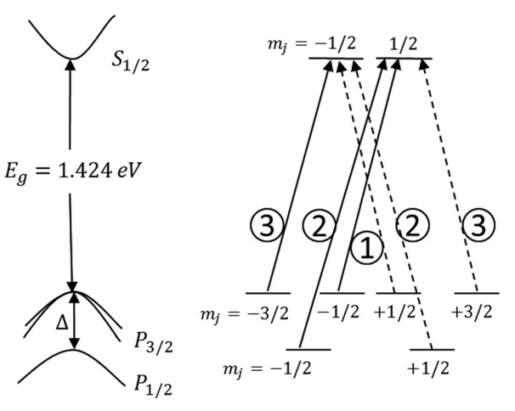
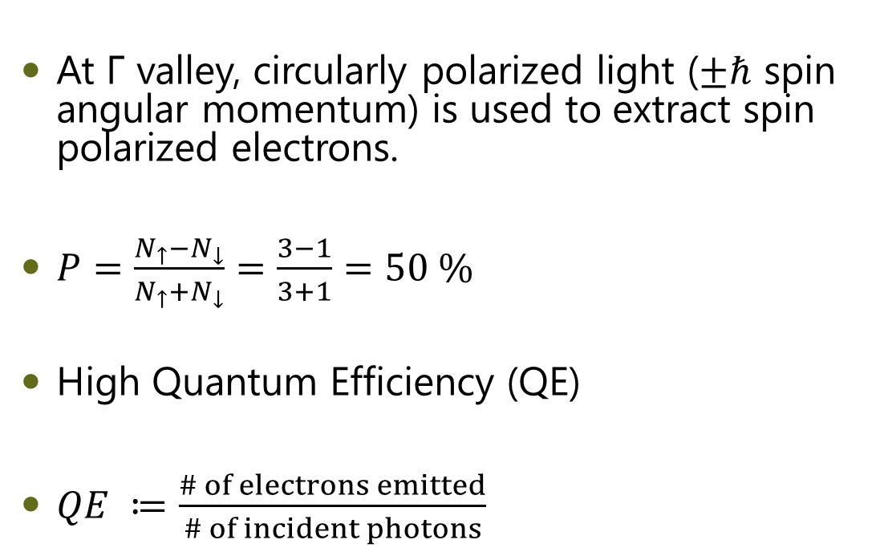
GaAs photocathode
At Γ valley, circularly polarized light ($±ℏ$ spin angular momentum) is used to extract spin polarized electrons.
$P=\frac{N_{↑}−N_{↓}}{N_{↑}+N_{↓}}=\frac{3−1}{3+1}=50 \%$
High Quantum Efficiency (QE)
$QE ≔\frac{\# of electrons emitted}{\# of incident photons}$

Slide 8
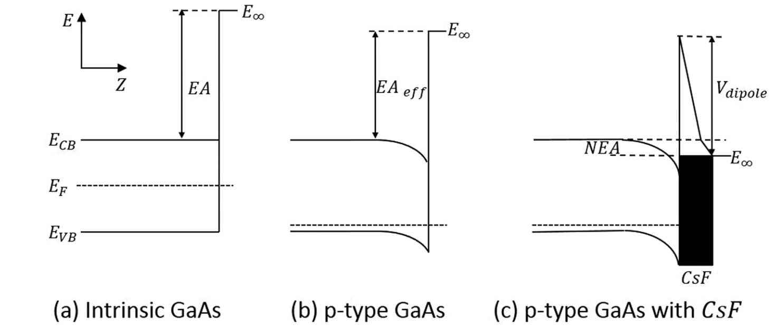
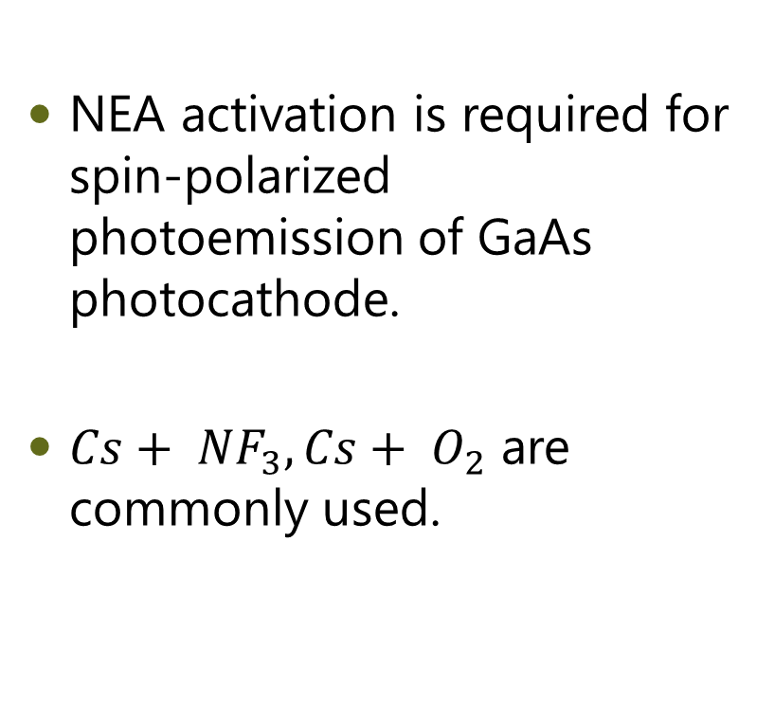
Negative Electron Affinity (NEA)
NEA activation is required for spin-polarized photoemission of GaAs photocathode.
$Cs+ {NF}_{3}, Cs+ O_{2}$ are commonly used.
Liu et al. J. Appl. Phys. 122, 035703 (2017)

Slide 9
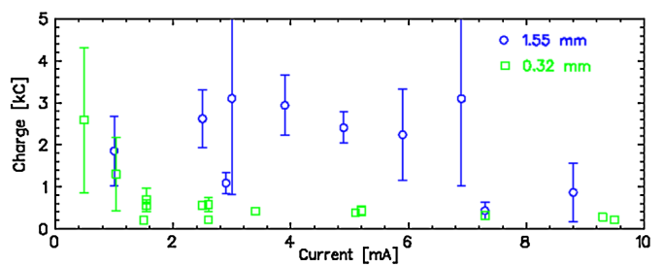

Application Demands
Current (~50 mA)
State-of-art charge extraction lifetime (~1000 C) only allows ~10 hours of operational lifetime.
Spin polarization (~80%)
  $$QE\left(q\right)\sim e^{−q/τ_{c}}$$
Grames et al. Phys. Rev. ST Accel. Beams 14, 043501 (2011)

Slide 10
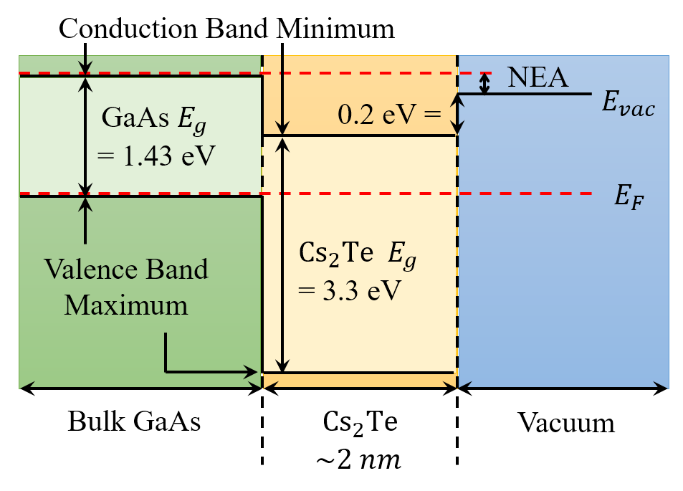
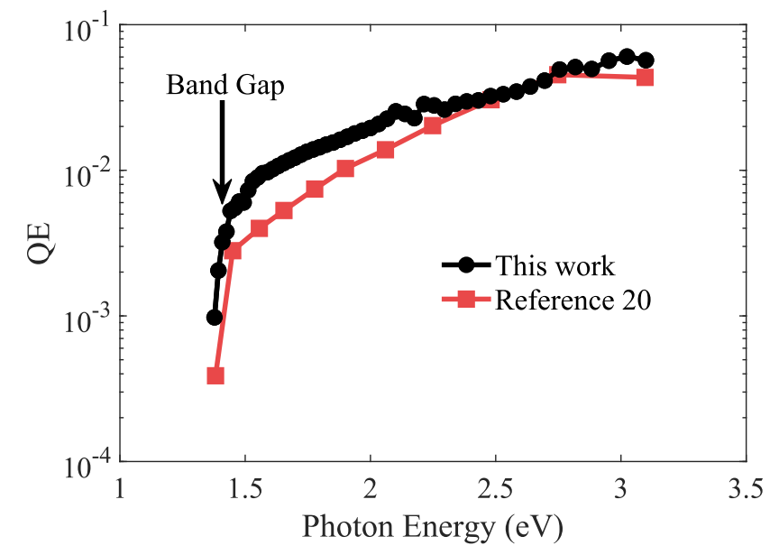
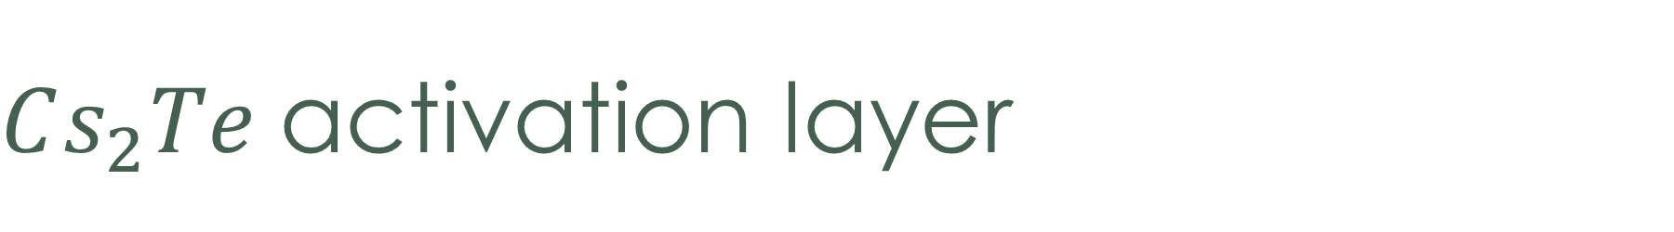
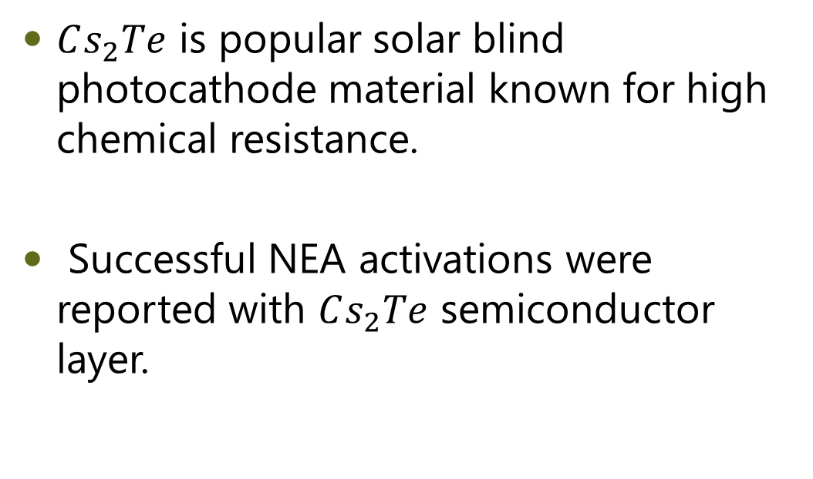
$Cs_{2}Te$activation layer
$Cs_{2}Te$ is popular solar blind photocathode material known for high chemical resistance.
Successful NEA activations were reported with $Cs_{2}Te$ semiconductor layer.
KEK
Bae, et al. Applied Physics Letters 112.15 (2018): 154101.

Slide 11
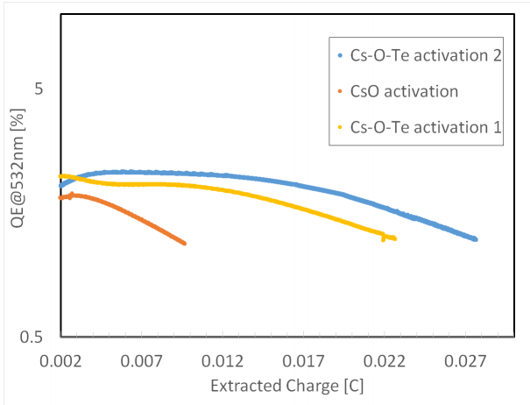
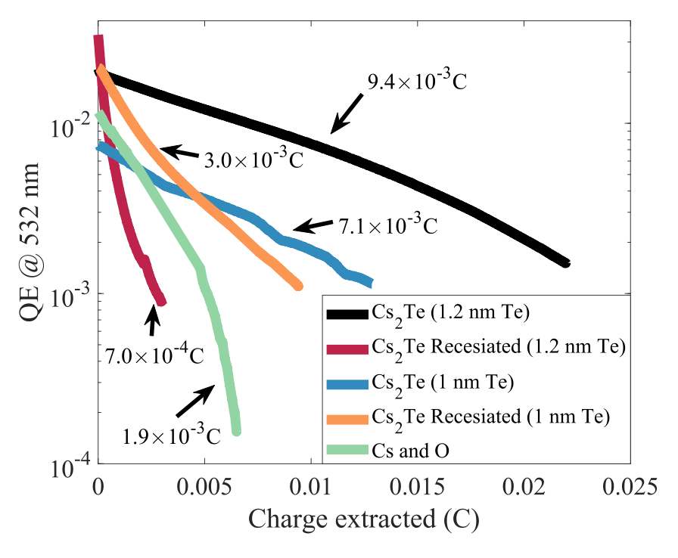
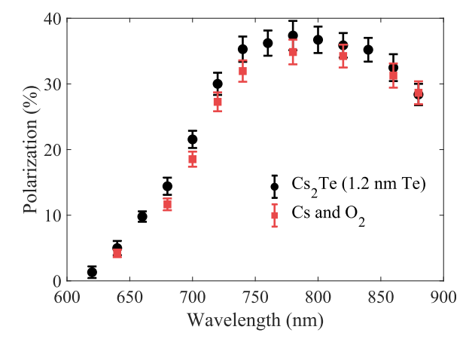
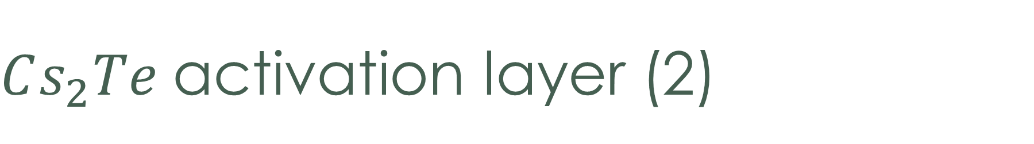
$Cs_{2}Te$activation layer (2)
O. Rahman et al., IPAC 2019, TUPTS102
5X LIFETIME!
J. Bae et al., Appl. Phys. Lett. 112 (2018) 154101
M. Kuriki et al., IPAC 2019, TUPTS026

Slide 12
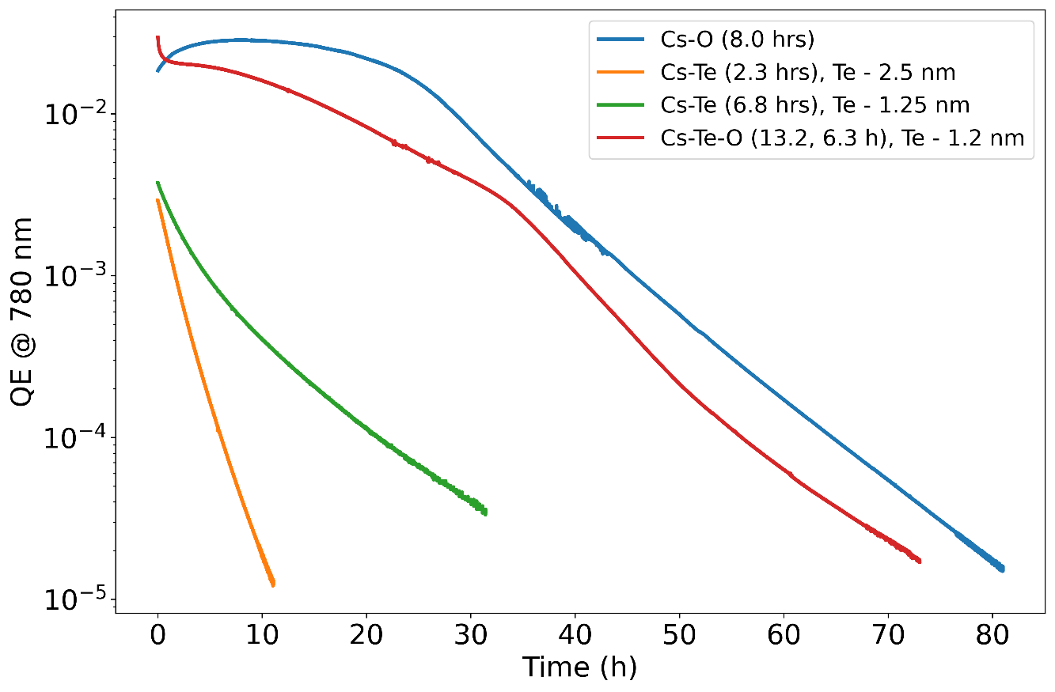
Cs-Te-O growth recipe
Different thickness of Te and usage of oxygen was attempted for the growth.

Slide 13
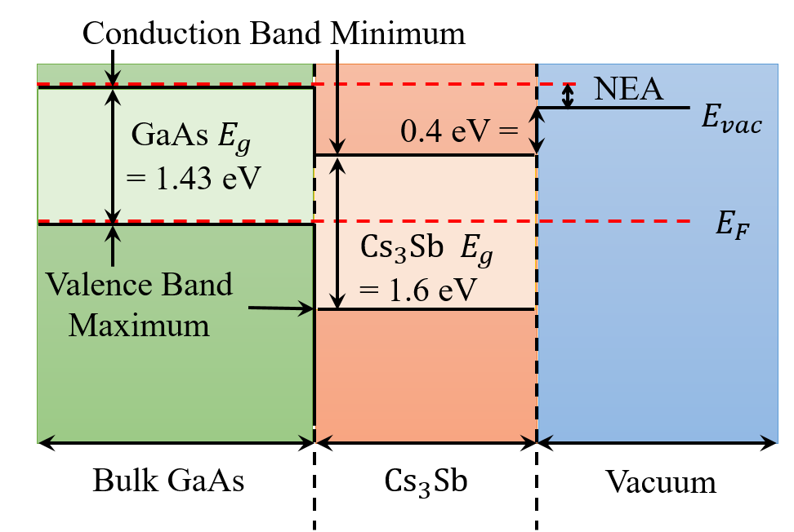

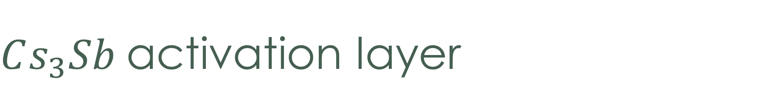
$Cs_{3}Sb$activation layer
$E_{vac}−E_{F}<GaAs E_{g}$
Band gap of activation layer > GaAs band gap
Doping control is not needed to achieve NEA.
Spicer et al. J. Appl. Phys. 31, 2077 (1960)

Slide 14
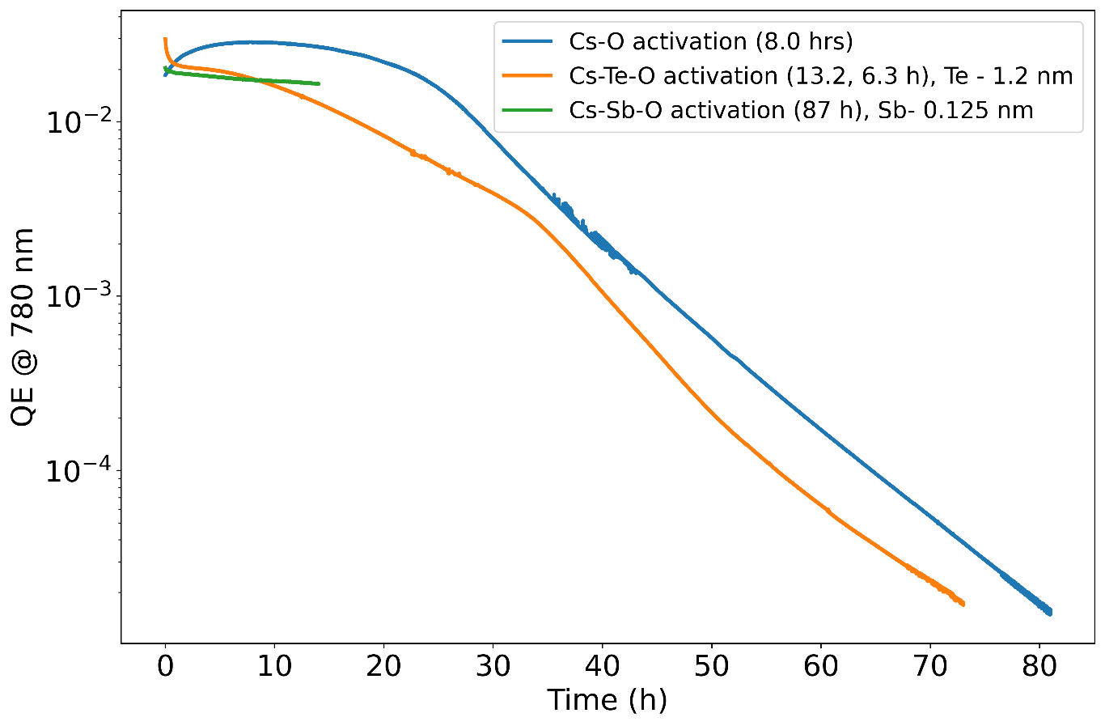
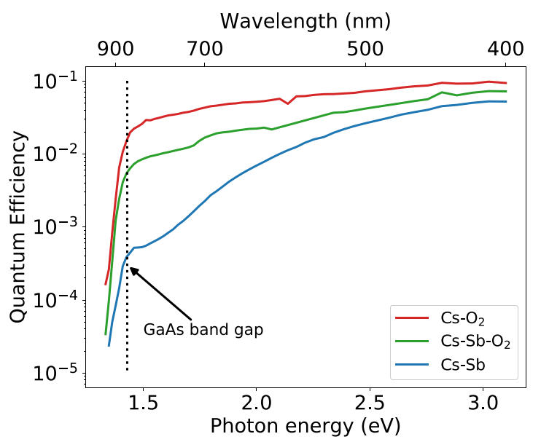
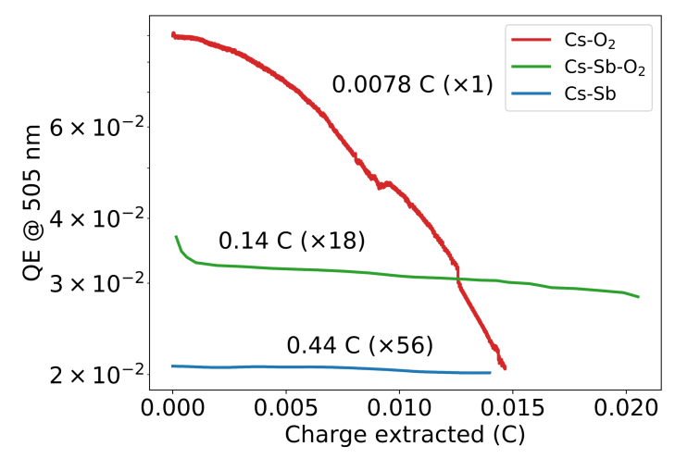
Cs-Sb-O activation
Bae et al, NAPAC 2019, MOPLH17
Bae et al, Journal of Applied Physics. 127, 124901 (2020)
Steep drop of QE at 1.43 eV implies NEA achieved.
Lifetimes are improved by orders of magnitude.

Slide 15
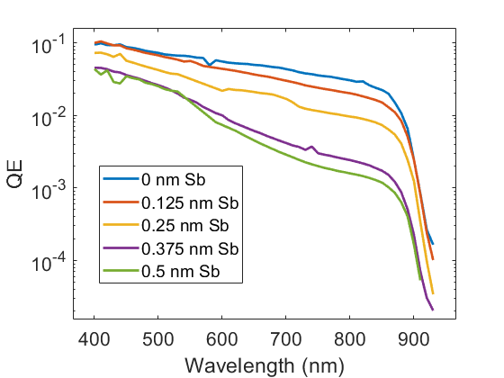
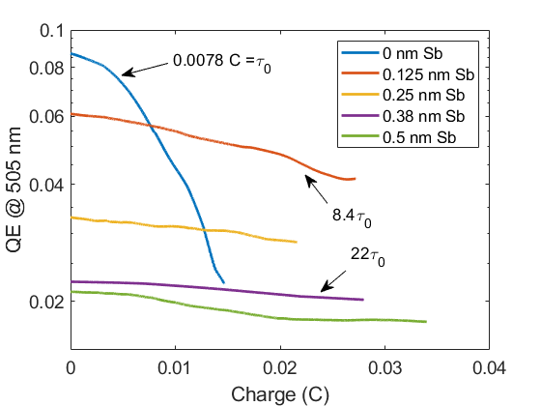
Thickness variation
QE and lifetime tend to decrease and increase as the activation layer gets thicker, respectively.
Cultrera et al, PHYS. REV. ACCEL. BEAMS 23, 023401 (2020)

Slide 16
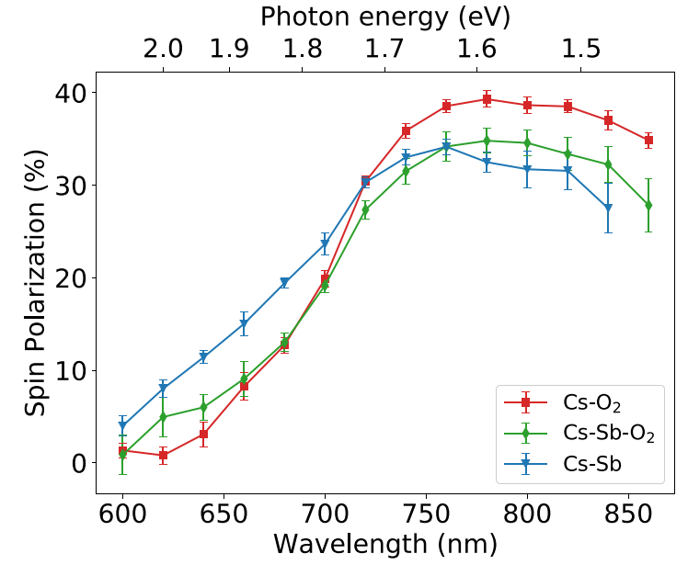
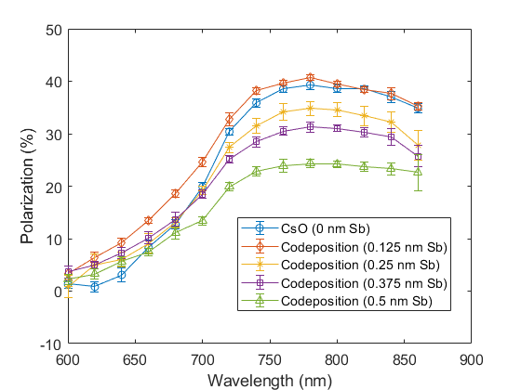
Depolarization
Femtosecond scale spin relaxation (~ 10 fs) was observed.
Cultrera et al, PHYS. REV. ACCEL. BEAMS 23, 023401 (2020)
J. Bae et al, NAPAC 2019, MOPLH17

Slide 17
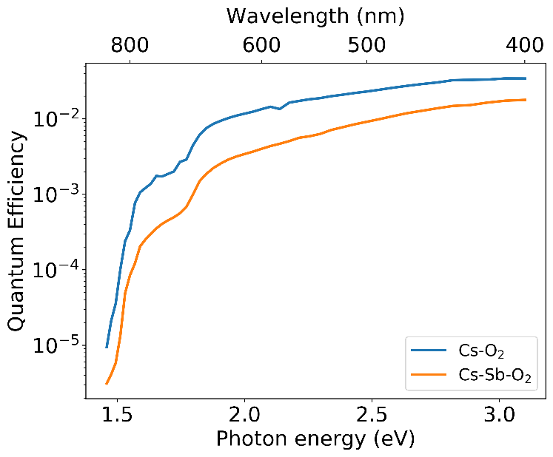
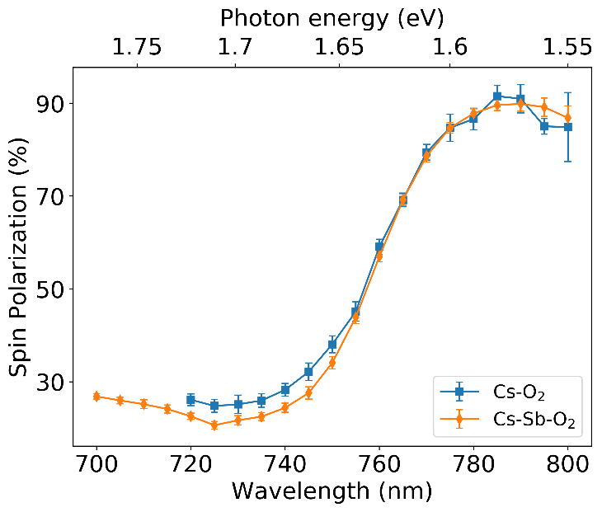

Superlattice GaAs
Superlattice GaAs are used to produce highly spin polarized (~90%) electrons.
We attempted to activate superlattice sample with our method.
Same ESP @ 780 nm
1/3 QE @ 780 nm
0.12% to 0.04%
Bae et al, Journal of Applied Physics. 127, 124901 (2020)

Slide 18
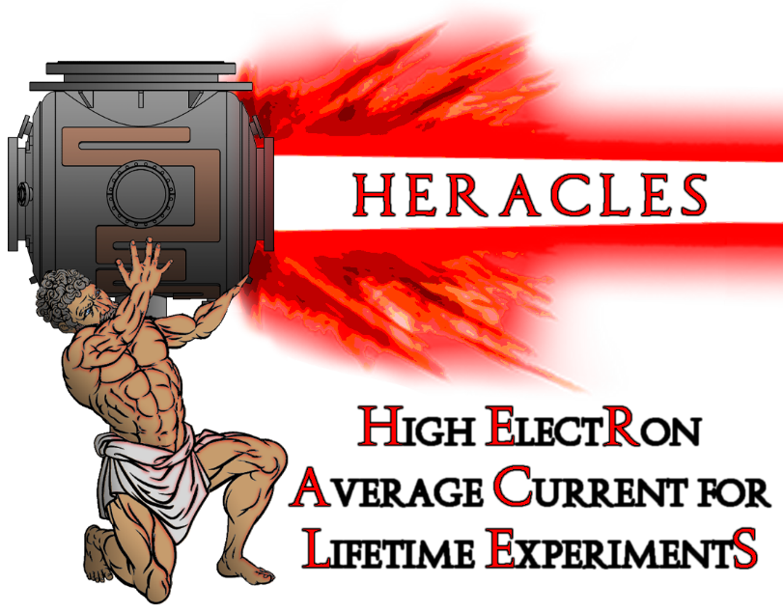
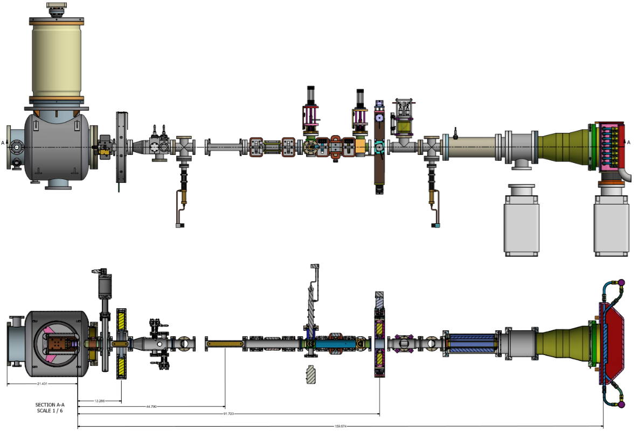
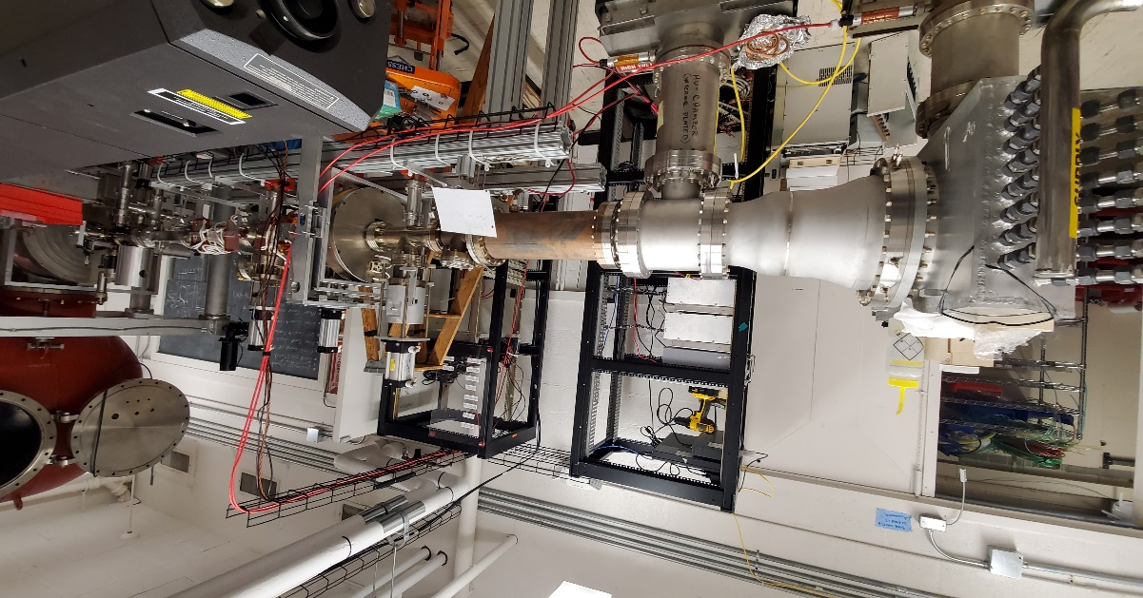
Ongoing work (1)
We are completing the installation of a dedicated beamline:
Old CU-ERL gun 400kV @ 100 mA
Ion clearing electrodes
High power lasers
75 kW beam dump

Slide 19
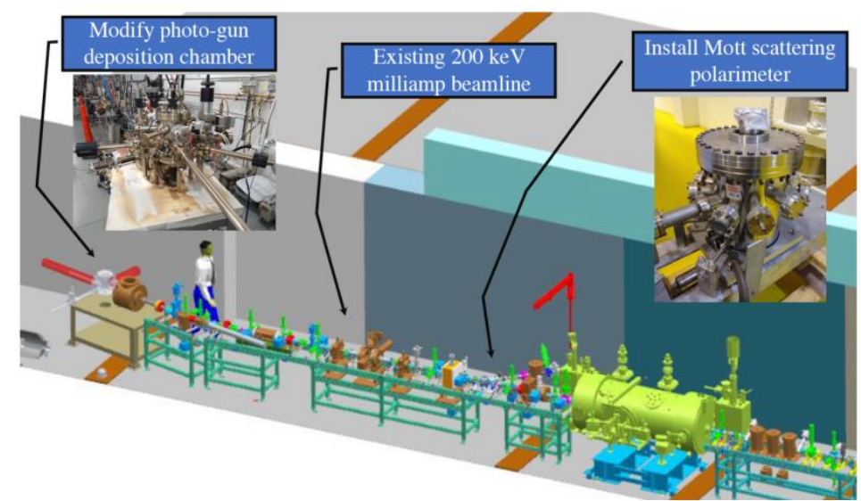
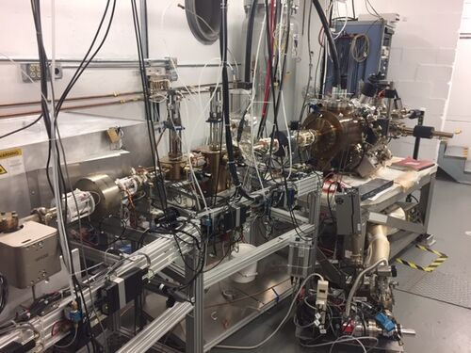
Ongoing work (2)
collaboration:
Cs-Sb-O photocathode growth trials at UITF is scheduled for January 2022
A keV-Mott polarimeter and vertical Wien filter is in preparation phase for operating in 100-300 kV range

Slide 20
Conclusion
GaAs is the state-of-art photocathode material for spin-polarized electron applications.
The main drawback of GaAs photocathode is a short operational lifetime.
We found using Cs-Sb-O during activation improves the lifetime nearly one order of magnitude.
We plan to test these cathodes in high voltage gun environments.

Slide 21
Backup slides

Slide 22
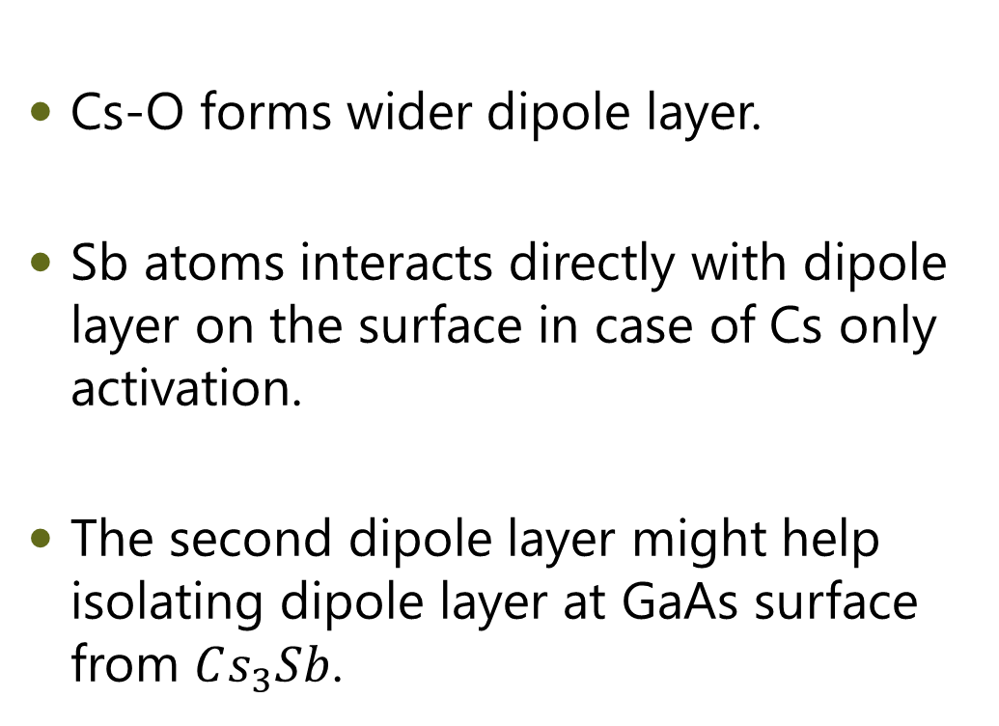
Speculation:
Double dipole layer
Cs
Sb
GaAs
Cs-O forms wider dipole layer.
Sb atoms interacts directly with dipole layer on the surface in case of Cs only activation.
The second dipole layer might help isolating dipole layer at GaAs surface from $Cs_{3}Sb$.
-
+
O
As
O
Cs
Cs
O
Cs
Sb
Ga
~1 nm
-
+
-
+
Su, C. Y., W. En Spicer, and I. Lindau. Journal of Applied Physics 54.3 (1983): 1413-1422.

Slide 23
Next steps
Surface studies (XPS, STM, Auger …) are needed for Cs-Sb-O layer.
  Vacuum suit case allows transferring samples to Hines lab.
MTE of cesiated GaAs is determined by thermal limit near the photoemission threshold. MTE measurement of coated GaAs is important for high brightness photoinjector applications.
NEA allows electrons to escape after relaxation down to the bottom of the conduction band, and it results in long response time. Coating layer might help filtering out the long tail.

Slide 24
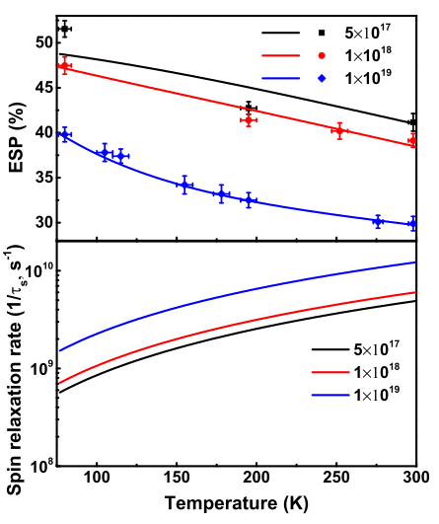
Future work
Liu et al. J. Appl. Phys. 122, 035703 (2017)
Spin polarization can be improved at low temperature

Slide 25
GaAs photocathode
Electron-Ion collider
  High Spin polarization
  High Current
High brightness photoinjector
  High Current ( ~10 % QE at 532 nm (green) )
  Small MTE (~100 meV at green, 30 meV near threshold (860 nm) )
“The 2015 Long Range Plan for Nuclear Science” Report
$$Brightness ∝ \frac{I}{σ_{x}σ_{y} MTE}$$
Bazarov, Ivan V., et al Journal of Applied Physics 103.5 (2008): 054901.

Slide 26
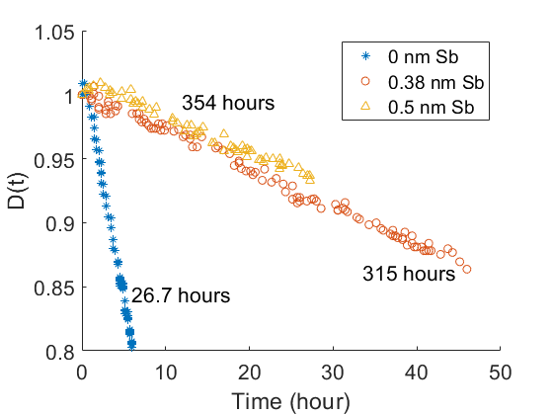
Lifetime metric (1)
Dark lifetime
  Thermal desorption
  Chemical poisoning
  $QE\left(t\right) \sim e^{−t/τ_{d}} ≡D(t)$

Slide 27
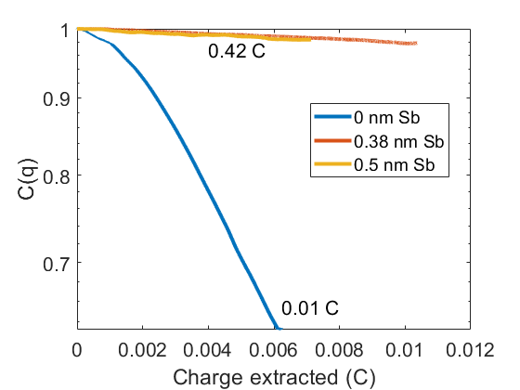
Lifetime metric (2)
Charge extraction lifetime
  Ion back bombardment
  $QE\left(q\right)\sim e^{−q/τ_{c}} ≡C(q)$
$QE(q,t)=QE\left(t=0\right) C\left(q\right) D(t)$
Compared to CsO, $τ_{c}$ and $τ_{d}$ are improved by factors of 40 and 13, respectively.

Slide 28
Spin polarization
At Γ valley, circularly polarized light ($±ℏ$ spin angular momentum) is used to extract spin polarized electrons.
$P=\frac{N_{↑}−N_{↓}}{N_{↑}+N_{↓}}=\frac{3−1}{3+1}=50 \%$
Liu et al. J. Appl. Phys. 122, 035703 (2017)

Slide 29
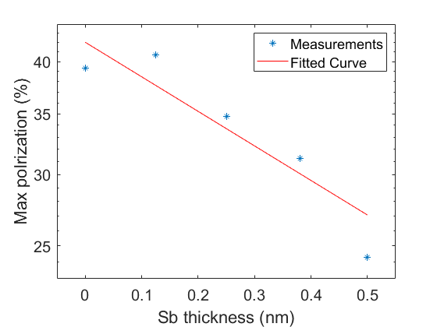
Polarization
$P=P_{o}e^{−t/{τ_{s}}}$ where $τ_{s}$ is spin relaxation time.
Significant depolarization was observed.
$τ_{s}$ ~ 50 fs
This value is a 4 orders of magnitude lower than that of bulk GaAs.

Slide 30
Possible stoichiometry
Stoichiometry | Sb density ($g/cm^{3}$) | Thickness (nm) | Spin relaxation time (fs)
$$Sb$$ | 6.7 | 0.25 | 5.3
$$Cs_{3}Sb$$ | 0.99 | 1.7 | 36
$$Cs_{4}Sb_{2}O_{5}$$ | 1.3 | 1.3 | 28
$$Cs_{3}SbO_{3}$$ | 0.62 | 2.8 | 58
$$Cs_{3}Sb_{5}O_{14}$$ | 2.8 | 0.6 | 13
$$Cs_{3}SbO_{4}$$ | 0.93 | 1.8 | 38
In Mott insulator $Nd_{2}CuO_{4}$, spin relaxation time is 18 fs by magnetic-polaron formation.
Miyamoto, T., et al. Nature communications 9.1 (2018): 3948.
Notes:
Spin relaxation ~ 50 fs implies spin flipping every ~10 nm ( in the order of grain boundary size?)

Slide 31

Surfactant effect (1)
  Technique used in epitaxial growth community
  In case of semiconductors, a monolayer of surfactants are used to cover the substrate
  Suppress Strain effects
  Polarity effects
  Modify energetics
  Enhance diffusion on the surface and suppress under surfactant layer
Kandel, Daniel, and Efthimios Kaxiras. "The surfactant effect in semiconductor thin film growth." arXiv preprint cond-mat/9901177 (1999).

Slide 32



Surfactant effect (2)
  Kinematic Monte Carlo simulations have shown island-edge passivation is important for suppressing islands.
  Group V atoms are effective in passivating steps and island edges by forming three strong covalent bonds with neighbors
Kandel, Daniel, and Efthimios Kaxiras. "The surfactant effect in semiconductor thin film growth." arXiv preprint cond-mat/9901177 (1999).

Slide 33

Ionization cross section

Slide 34

Fermi level as a function of doping

Slide 35

Spin polarization (3)
Experimentally, spin polarization is measured as ~35 % due to spin relaxation during transport.
$P=P_{0}\frac{1}{1+\frac{τ}{τ_{s}}}$
$\frac{1}{τ_{s}(BAP)} ∝{\left(Temperature\right)}^{}$
Exchange interaction between electrons and holes
43% polarization at 110K was measured.
Liu et al. J. Appl. Phys. 122, 035703 (2017)
Pierce et al. Rev. Sci. Instrum., 51, 4, 1980

