Slide 1
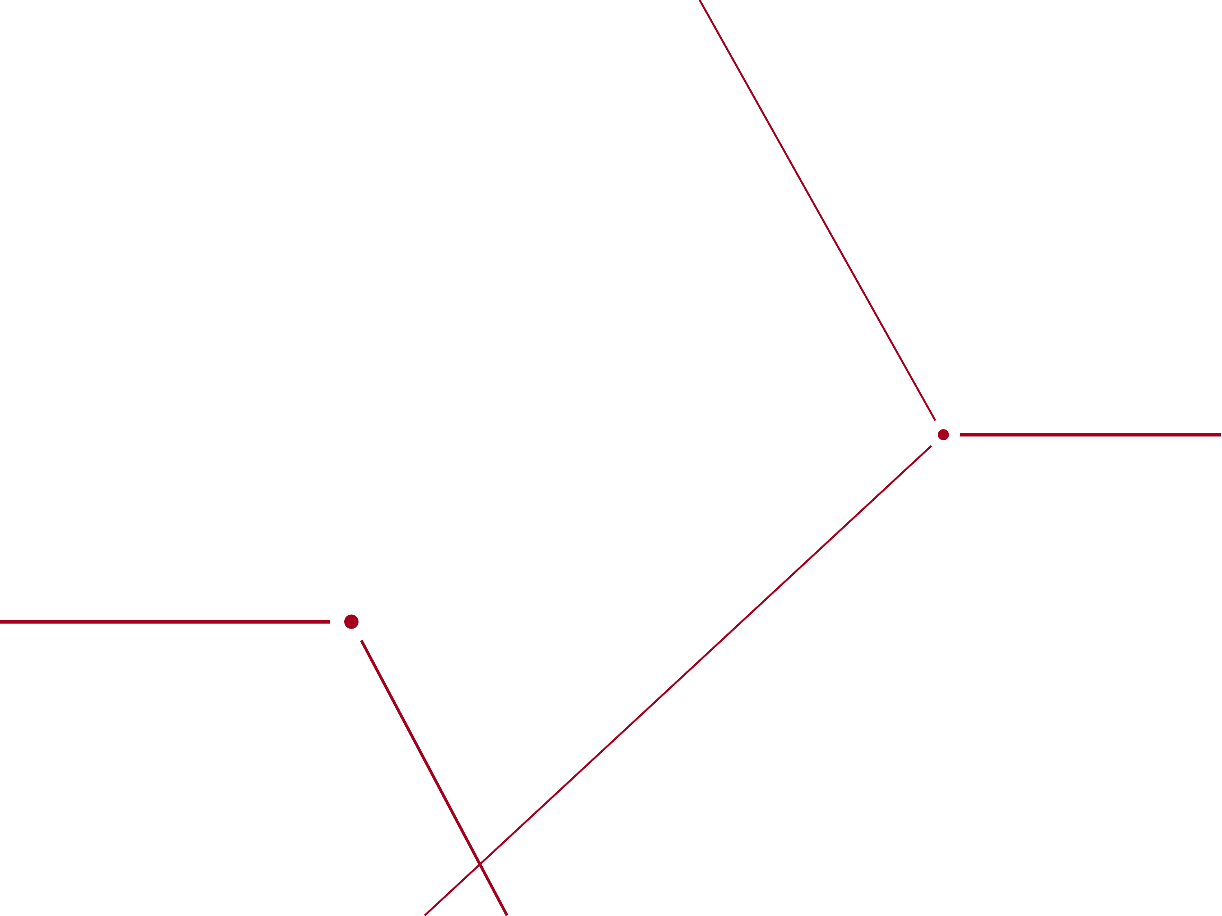
QW SRF Gun Development for LCLS-II-HE
J.W. Lewellen, C. Adolphsen and T. Xu for the SRF Gun Team

Slide 2
Intro and Acknowledgements
Work done by and slides stolen from
SLAC: C. Adolphsen,, R. Coy, J. Fuaho, G. Hays, R. Legg, D. Li, G. Lixin, C. Mayes, C. Mitchell, M. Murphy, C-K Ng, Y. Nosochkov, T. Raubenheimer, M. Ross, M. Santana, X. Wang, M. Woodley, F. Zhou
MSU/FRIB: A. Arnold, C. Compton, Y. Choi, W. Hartung, S-h. Kim, S. Lidia, S.J. Miller, J. Popielarski, L. Popielarski, K. Saito, T. Xu
HZDR: P. Evtushenko, J. Teichert, R. Xiang
Argonne: M. Kelly, P. Piot
Particular thanks to Bruce Dunham and Theo Vecchione for insightful discussions.
Caveats
Most of this work was done by other people; mistakes are mine, not theirs
LEI CDR (including parameters therein) should be reviewed by FAC mid-Dec.; all preliminary at this point in time

Slide 3
Outline
Walking upstream:
Beam needs for a machine like LCLS-II-HE
Why QW? Why SRF?
Design parameters for the LCLS-II-HE QW SRF gun
MSU/FRIB/HE collaboration
Schedule
Status
Conclusions

Slide 4
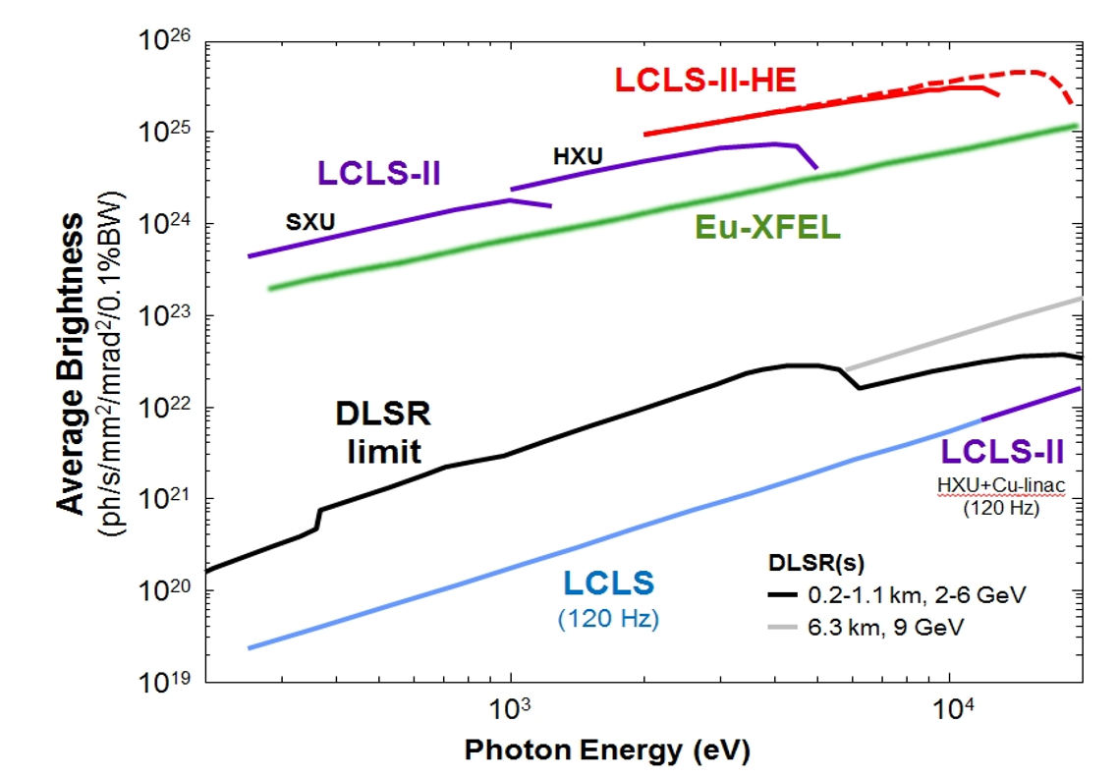
Consider X-ray source performance…
With LCLS-II-HE
Low-Emittance
Injector
With LCLS-II injector
Need ~4x lower
emittance to move
from solid to dashed
The LEI will provide ~50% greater brightness & ~67% higher X-ray energy reach

Slide 5
Low Emittance Injector (LEI) Cartoon
New tunnel for LEI
Dogleg from LEI to main linac tunnel
100-MeV injection into
LCLS-II-HE linac
Original SLAC
tunnel
LCLS-II-HE
MSU SRF gun
LCLS-II APEX-type gun

Slide 6
LEI performance parameters (nominal)
Injector Electron Beam Parameters | symbo | nominal | range | units
Final electron energy (operational) | E_{f} | 100 | 95 - 120 | MeV
Electron bunch charge (limited by beam power) | Q_{b} | 0.10 | 0.01 - 0.30 | nC
Bunch repetition rate in linac (CW) | f_{b} | 0.30 | 0 - 0.929 | MHz
Average electron beam power at Injector end (limit) | P_{av} | 3 | 0 – 6 | kW
Normalized 95% rms transverse slice emittance (nom. charge) | γε_{⊥-s} | 0.10 | 0.05 - 0.3 | μm
Final peak current from Injector | I_{pk} | 10 | 1 - 50 | A
Final rms bunch length from Injector | σ_{zf} | 1 | 0.3 - 10 | mm
Final slice energy spread (rms) from Injector | σ_{Es} | 1 | 1 – 5 | keV
The gun needs to provide a beam commensurate with achieving these parameters at 100 MeV

Slide 7
Recipe for increasing beam brightness / lowering emittance
Make a better gun
Higher fields
More linear fields
Higher exit beam energy
Cathode with lower MTE
Smaller emission spot
N.B.: None of these can take us all the way there.

Slide 8
But we are constrained…
Gun
Must be CW
Support long cathode life
Achievable gradient
Energy / transit time tradeoffs
Acceptable dark current
“zero-MTE” emittance
Cathode (at gradient)
Acceptable QE
Reliable / repeatable
Must not poison the gun
Uniform over emission area
Useful lifetime
Short response time
Acceptable dark current
Beam Emission
Feasible emission profile
Reasonable spot size
Useful bunch length
Useful charge per bunch

Slide 9
So why a low-frequency QW SRF gun?
Gun
Must be CW
  SRF, low frequency → low RF losses
Support long cathode life
  SRF → intrinsically good vacuum
Achievable gradient
  SRF → low RF losses
Energy / transit time tradeoffs
  SRF, low frequency → “DC-like” during beam transit
  Good “zero-MTE” emittance

Slide 10
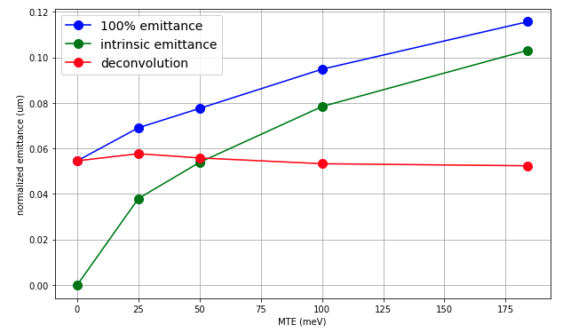

Beam Emittance vs. MTE for LEI*
$$ε_{x, N}≈\sqrt{ε_{x, th}^{2}+ ε_{x, rf}^{2}+ ε_{x, sc}^{2}}$$
MTE | 0 meV | 25 meV | 50 meV | 100 meV | 184 meV
100% emit | 0.054 um | 0.069 um | 0.078 um | 0.095 um | 0.115 um
95% emit | 0.037 um | 0.052 um | 0.059 um | 0.075 um | 0.093 um
* Using 100 pC, 30 MV/m, “complex” injector config, doublet solenoid

Slide 11
Some selected nominal design parameters…
Parameter | Value |  | Parameter | Value
Frequency | 185.7 MHz |  | Beam exit KE | 1.8 MeV
Temperature | 4.2 K |  | Implied TTF | 0.86
K-A gap | 7 cm |  | I_{beam,max} | 60 μA
Exit pipe dia. | 4 cm |  | f_{rep,max} | 0.929 MHz
E_{cath,emit} | 30 MV/m
E_{surf,max} | 33 MV/m |  | QE | > 1%
B_{peak}/E_{cath} | 1.4 mT/(MV/m) |  | Laser λ | visible
Nom. Active losses | 20 W |  | Cathode MTE | < 184 meV
 |  |  | Cathode lifetime | > 1 week
Dark current | < 400 nA |  | r_{emit} | 2.5 mm
 |  |  | t_{emit} (flattop) | 10 – 30 ps

Slide 12
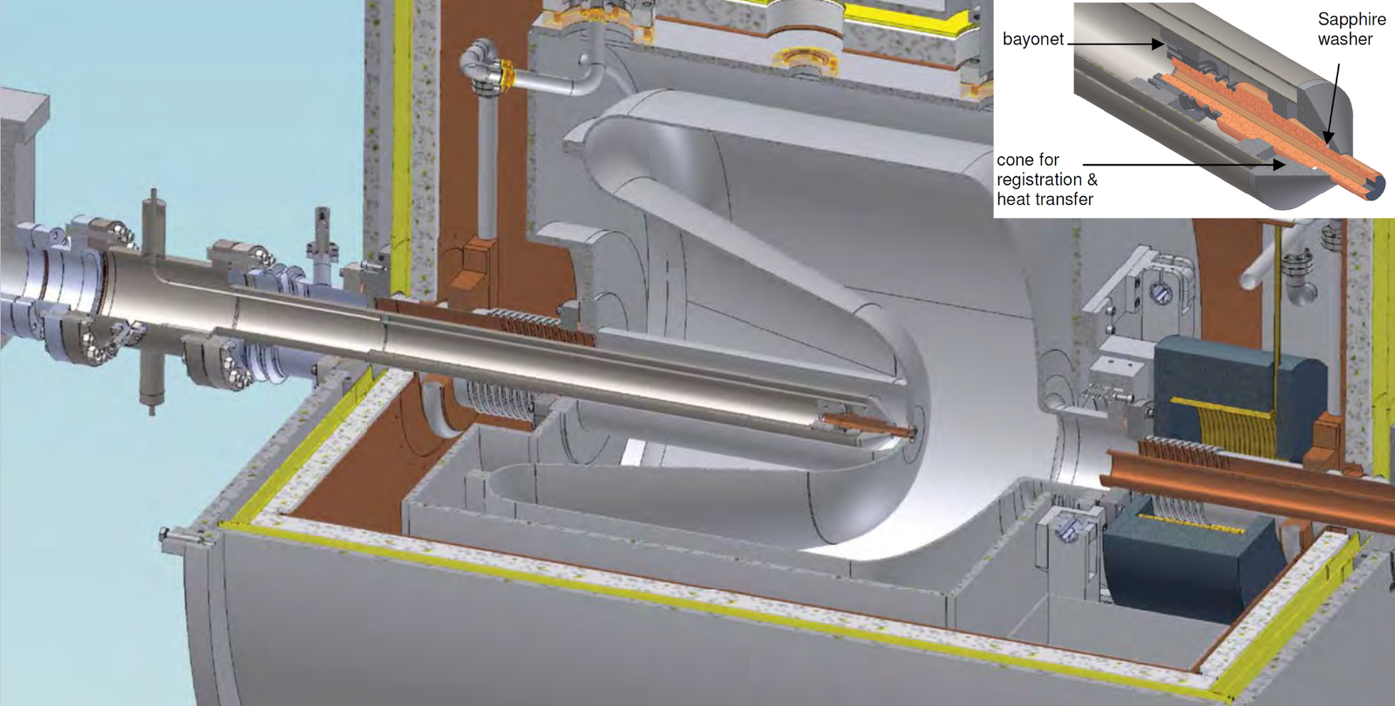
WiFEL gun cross-section: a good starting point

Slide 13
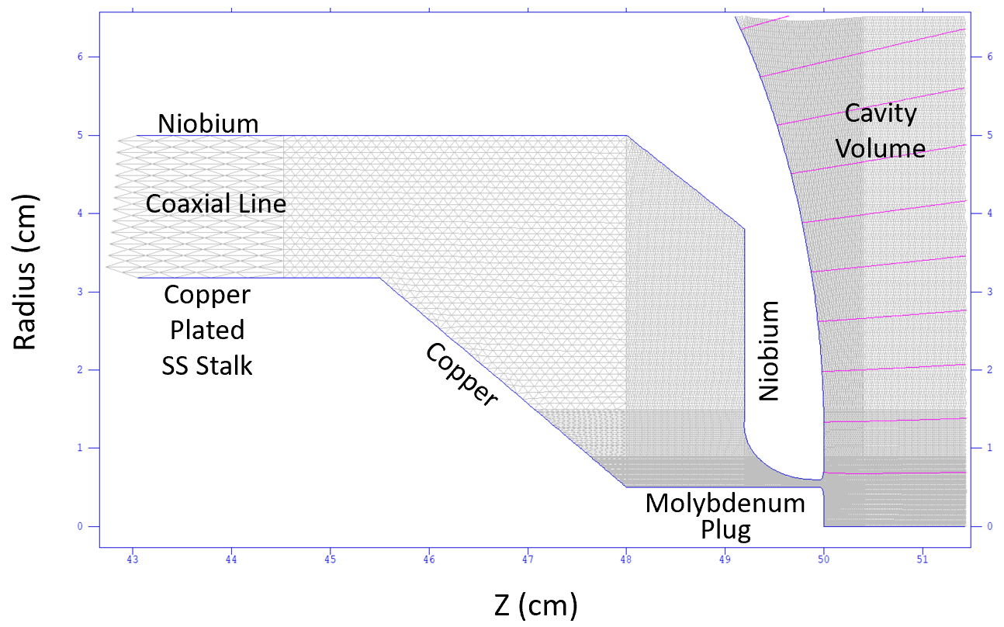
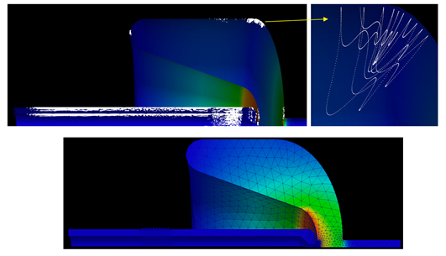
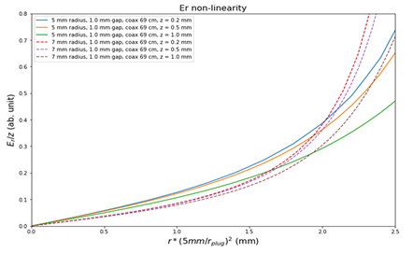
Initial injector design
Initial studies & optimization on the gun include:
  Beam dynamics
  Multipacting evaluation
  Cavity field ratios
  RF loss optimization, incl. on cathode stalk
  Dark current tracking
  And integration / optimization with whole injector beamline
Stalk/cavity
transition optimization
Radial field linearity
near cathode
Multipacting
studies

Slide 14
MSU/FRIB – LCLS-II-HE SRF Gun Project
MSU/FRIB – Tremendous experience in this frequency range:
RF structure design, fabrication, commissioning, esp. quarter- and half-wave resonators
Cryomodule design, fabrication, operation
Partnering with Argonne, HZDR
Quasi-“build to spec” effort to develop the LEI QW SRF gun
Keep beam gap region fixed (e.g. same fields)
Try to set requirements on “what” more than “how”
Collaborative work to confirm design choices

Slide 15
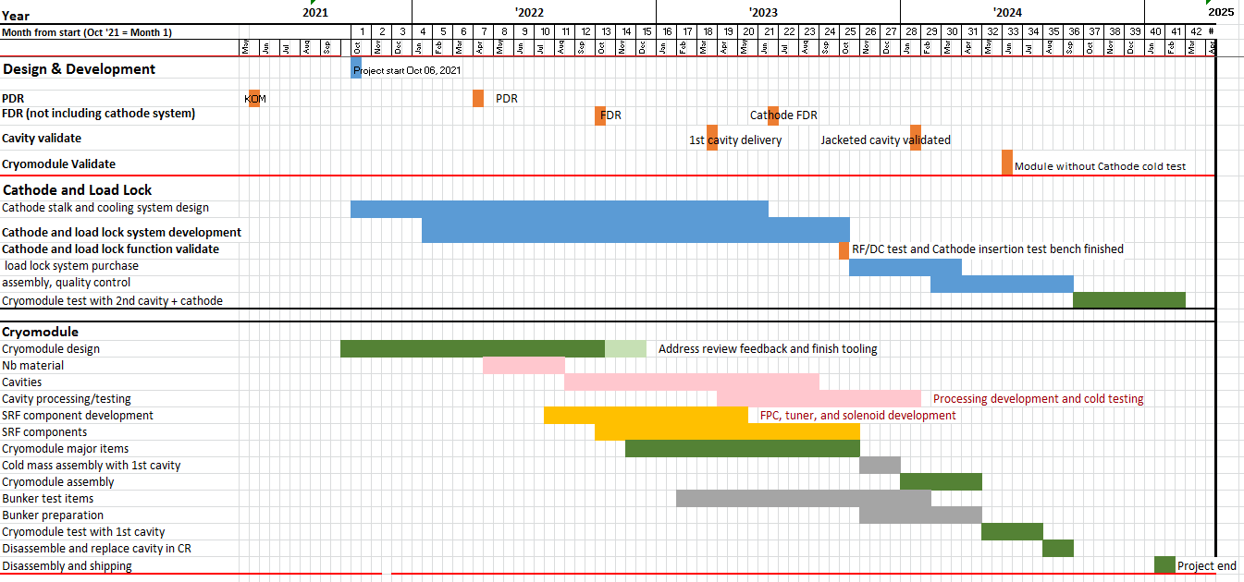
Overall project schedule
Cathode stalk development
Cavity & CM
development
Nominal timeline: 3½ years.

Slide 16
Some schedule highlights
We are here
cathode stalk system bench testing
cavity test
w/ cathode
stalk
“cathodeless”
cavity test

Slide 17
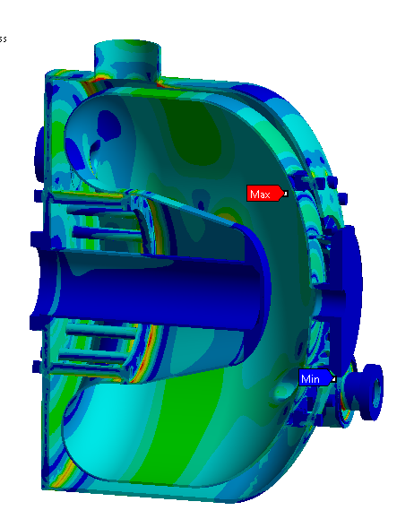
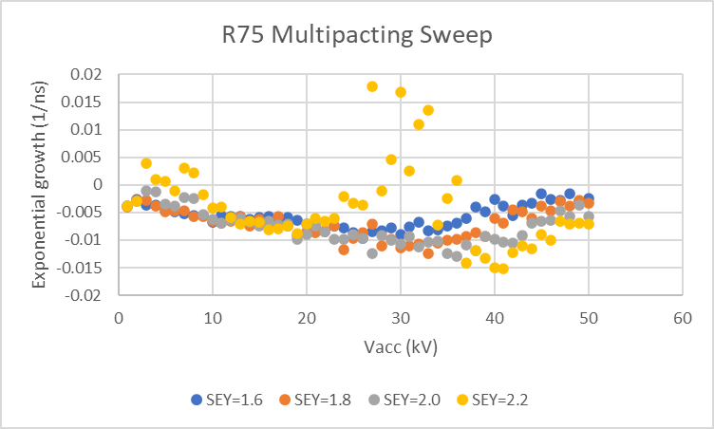
Cavity shape studies @ MSU
Improve manufacturability
Maintain or improve multipacting performance
Tuner force optimization
Stress calculations
Beam gap
unaltered

Slide 18
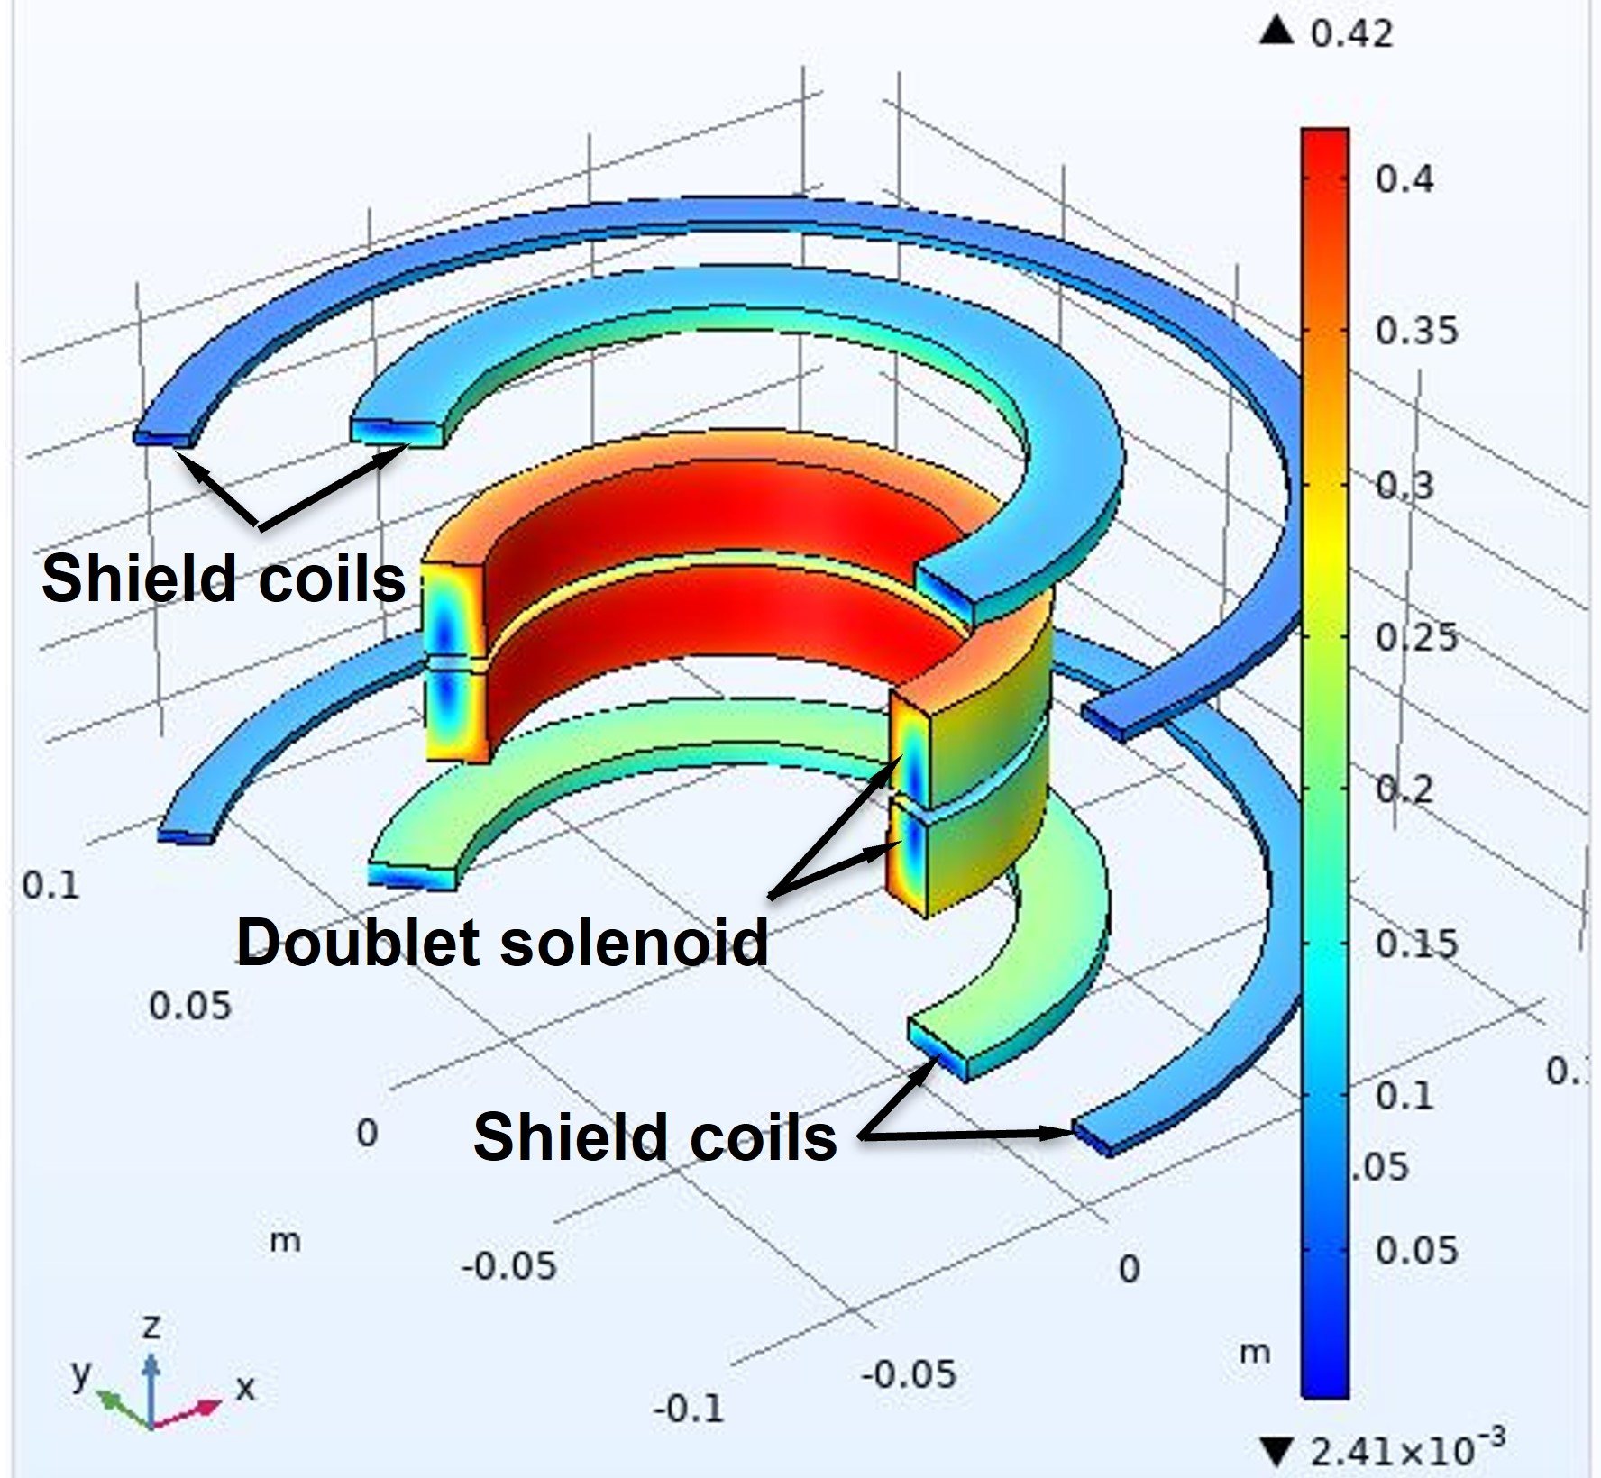
Magnet package design
Low emittance:
  Doublet design employed to accommodate wider range of cathode gradients (20~30 MV/m)
Shielding Enhancement:
  Two sets of separated shield coils designed to effectively reduce fringe field line radially as well as vertically at expected cavity area < 20 G
1/8” gap at midplane
z
Beam direction

Slide 19
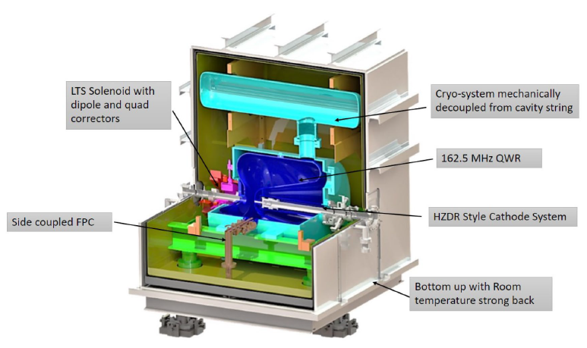
Integration into FRIB-type CM
(This does not reflect most recent cavity design, but it was easy to grab as an exemplar)

Slide 20
Wrap-Up
The MSU/FRIB – LCLS-II-HE SRF gun development effort is off and running, as of 6 October.
Seeing good progress already on multiple fronts
Staged approach provides “separation of problems”
Cathode system bench tested for different aspects (particle-free, RF dissipation and HV isolation)
“Cathodeless” cavity allows verification of performance of the design as a cavity, CM commissioning w/ “simple” structure
Schedule should have us completing RF testing of SRF gun, sans active cathode, at end of 2025.

Slide 21
Coda: what keeps John awake at night?
Cathode system
Historically a real problem for SRF guns; mitigated by having a great, experienced team working the problem
Cathode selection
What’s the preferred cathode?
Is the preferred cathode usable? (e.g. field emission)
Can the cathode and gun survive each other?
… and that brings us right back to this workshop.

Slide 22
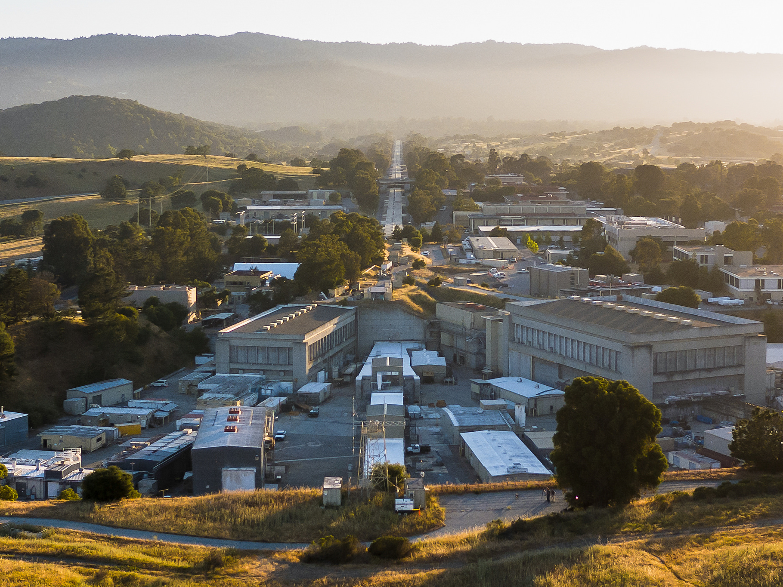


Future home of SRF gun

Slide 23
Supplemental slide:
What are we missing?
The development program ends with an RF test of the full gun.
We are currently considering options for beam testing
At 2 MeV
  Verify gun / cathode compatibility
  Dark current, MTE vs. gradient
  Scaling with space charge
At 70 – 100 MeV
  Beam capture
  Beam characterization (e.g. emittance, energy spread, peak current; ideally 6d mapping)

Slide 24
Cathode poll
KCsSb – enter 1
NaKSb (MTE 35-55 meV) – enter 2
Cs3Sb (MTE ~40 meV) – enter 3
Oxide (Rb2O, K2O, etc.) – enter 4
Other – enter 5

