Slide 1
Performance Characterisation of Multiple Cs-Te Photocathodes
L.A.J. Soomary²³, C. Benjamin¹⁴, H.M. Churn¹², L.B. Jones¹², T.C.Q. Noakes¹²
H. Panuganti⁵, V. Fedosseev⁵, E. Chevallay⁵, E. Granados⁵, M. Himmerlich⁵
¹STFC ASTeC, Daresbury, United Kingdom
²Cockcroft Institute of Accelerator Science, Daresbury, United Kingdom
³The University of Liverpool, Liverpool, United Kingdom ⁴The University of Warwick, Warwick, United Kingdom
⁵CERN, Geneva, Switzerland

Slide 2
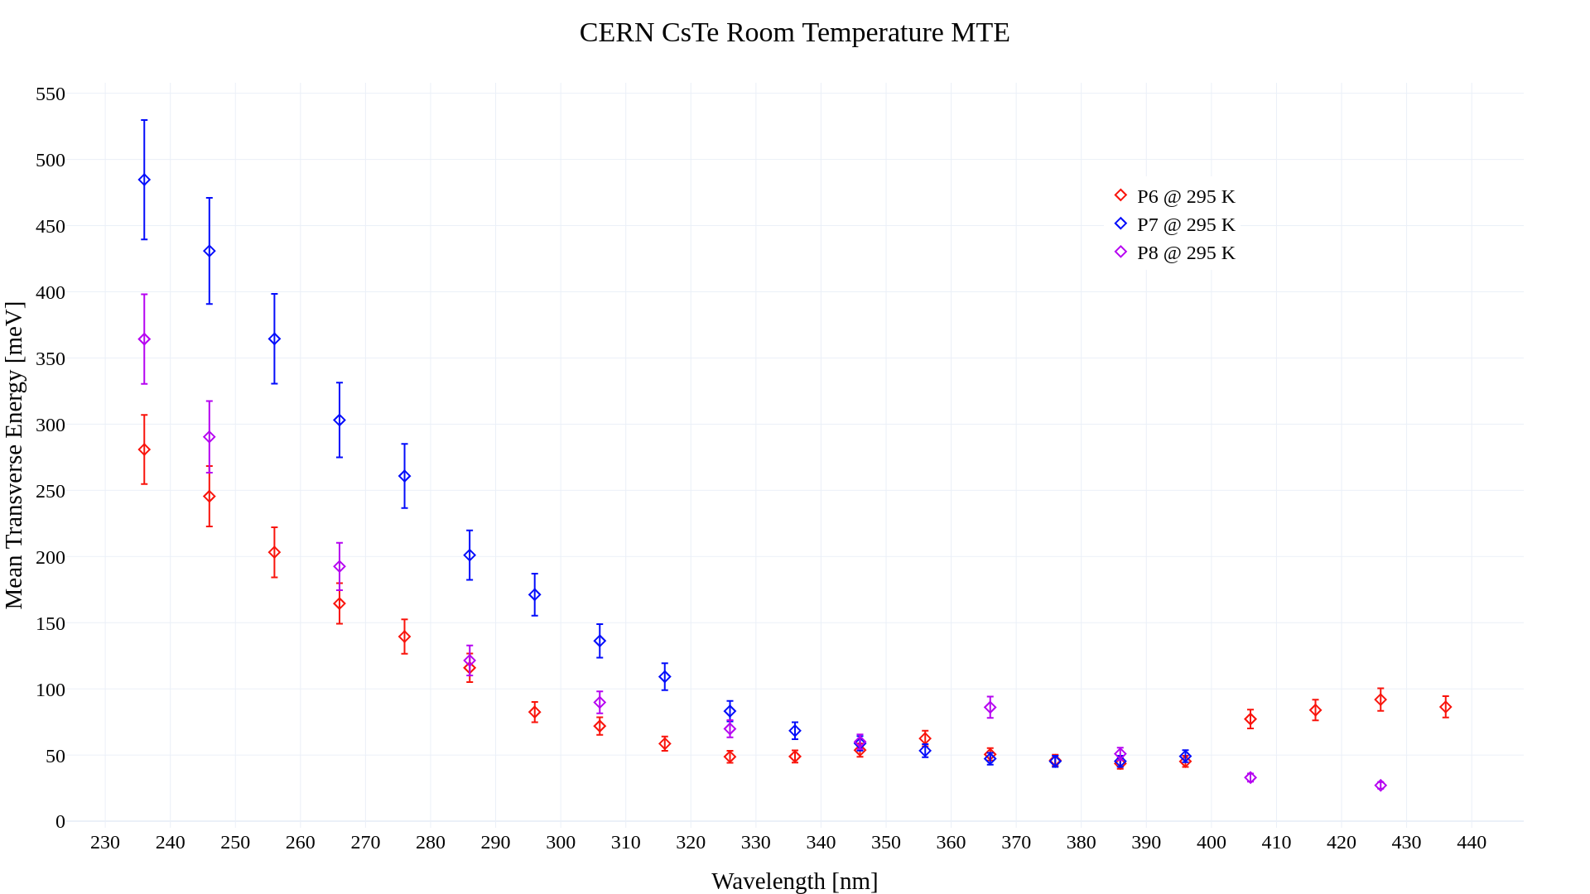
MTE - Room
Mean Transverse Energy of 3 Different Cs-Te Photocathodes
MTE at UV wavelengths show a large range between all 3 cathodes
MTE diverges once going into the visible wavelengths, with P8 reaching 26.7 meV, close to the thermal floor
All 3 cathodes have their MTE converge towards 346 nm – 396 nm

Slide 3
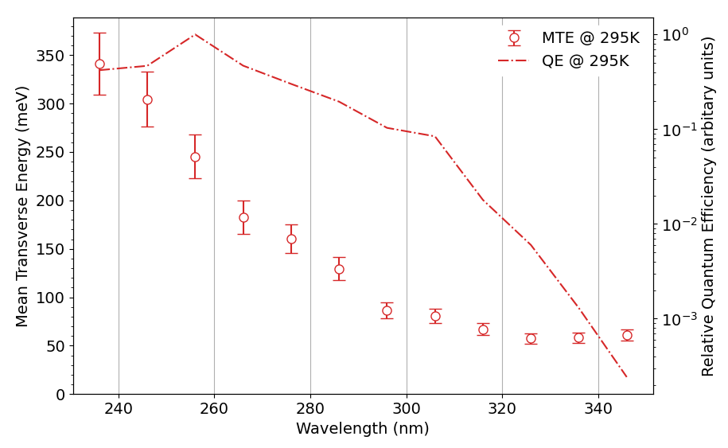
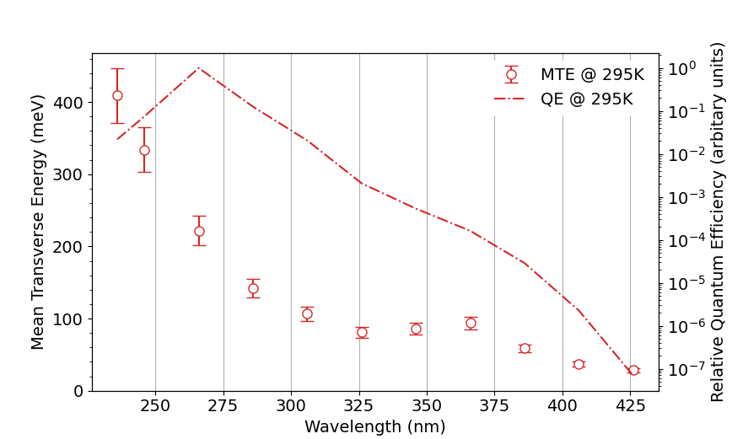
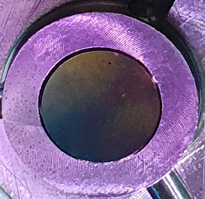
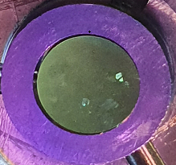
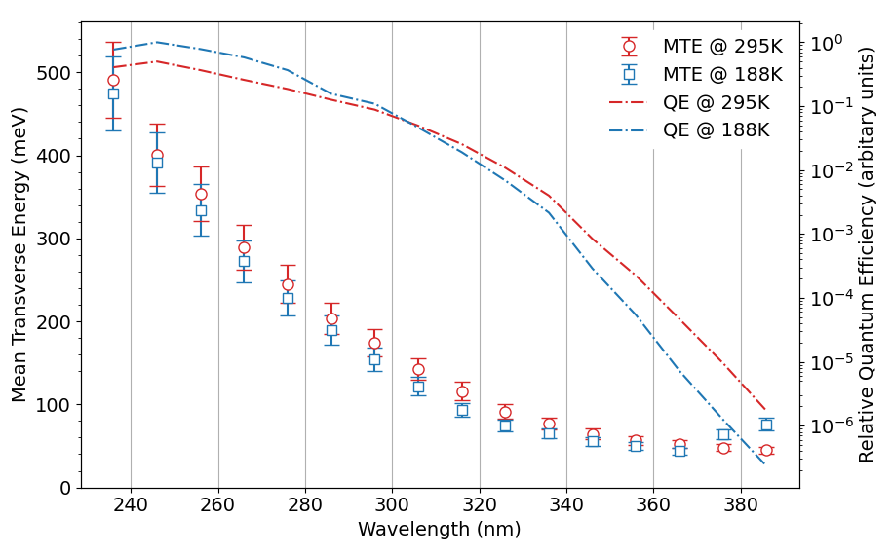
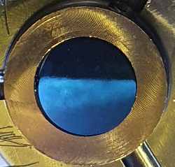
Cathode ‘P6’ – Cs:Te Ratio of 2.0 : 0.9
Cathode ‘P8’ – Cs:Te Ratio of 2.0 : 1.4
Cathode ‘P7’ – Cs:Te Ratio of 2.0 : 1.1
All 3 cathodes show a similar trend in their MTE and relative QE, with some differences being seen in exact values. The variation in the colour of each cathode is indicative of the differences seen in the chemical stoichiometry and film thicknesses.
The relative QE in these measurements are produced from knowing a few key parameters of the detector, optical power and the intensity of the image.

Slide 4
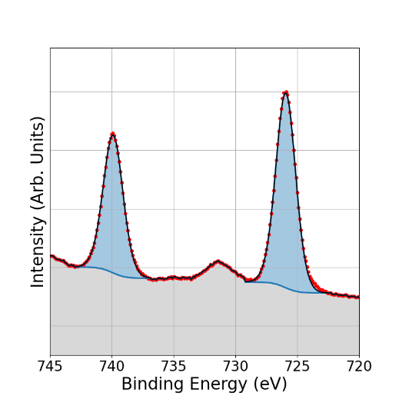
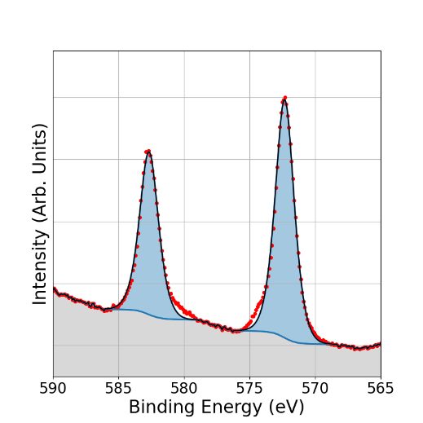
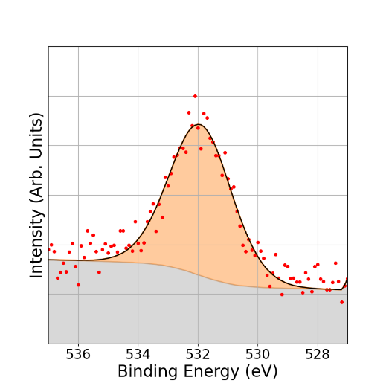
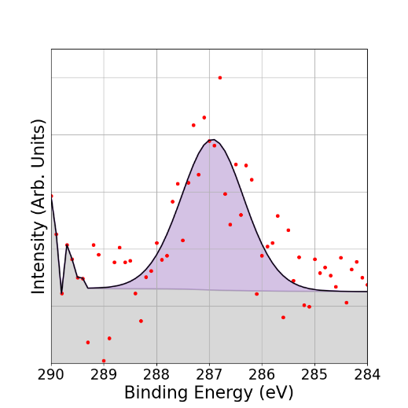
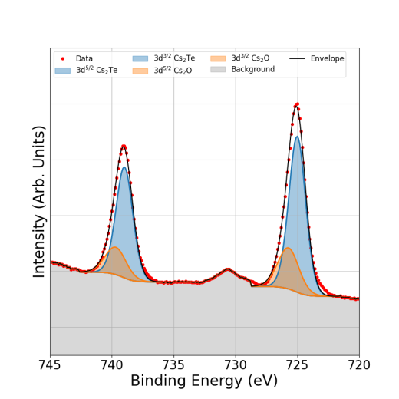
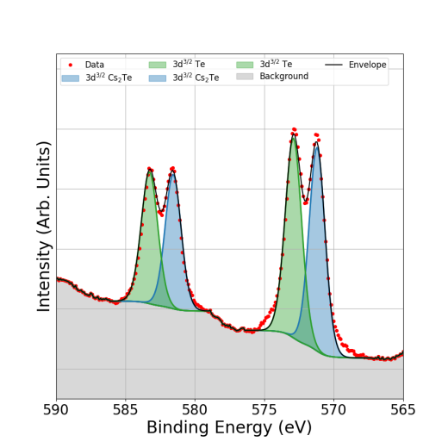
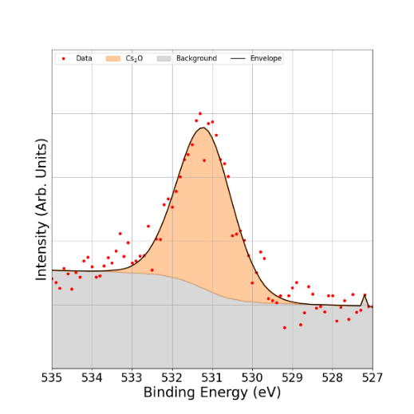
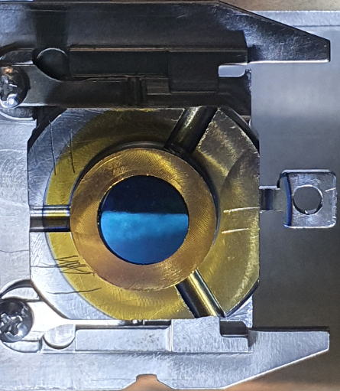
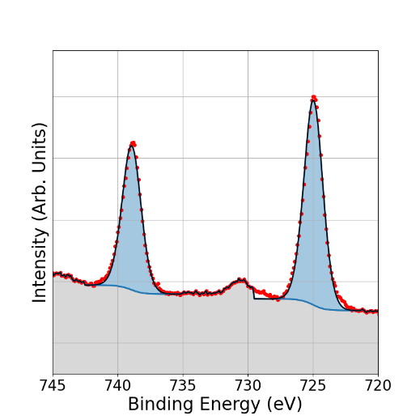
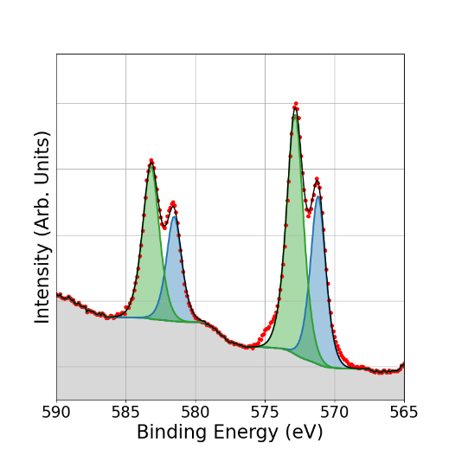
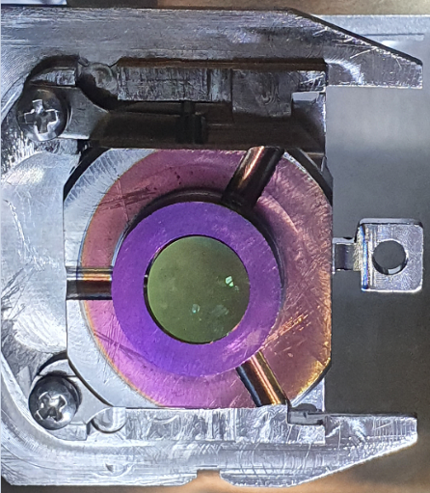
Cs:Te
Ratio
Cs 3d
Te 3d
O 1s
C 1s
~4% Cs₂O
C (Organic)
2:0.9
Cs₂Te
Cs₂Te
Te
2:1.1
Cs₂O
As shown previously, each cathode has a different chemical stoichiometry and also a different ratio of Cs bonded to Te, with P7 and P8 being closer in terms of this ratio.
Contamination of O can be seen on the P7 surface, with an additional C contamination also present on the P6 surface. P8 shows no obvious contaminants.
2:1.4

Slide 5
In Summary…
This work demonstrates the impact that the variation of elemental ratios and bonding environments, established during cathode manufacture, have on the operational outcome of a cathode, helping to put current methods and practices into perspective.
By showing how differing ratios of Cs-Te affect the MTE of electrons emitted from Cs-Te photocathode sources as a function of illumination wavelength, we have gained an insight into the level of control required during deposition in order to consistently generate electron beams with the lowest possible emittance for particle accelerators.

