Slide 1
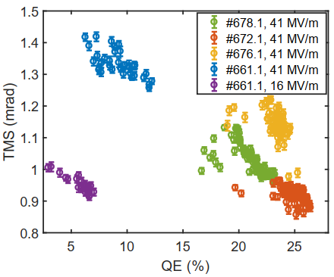
Anomalous correlation between quantum efficiency and transverse momentum spread in semiconductor cathode photoemission
P-W. Huang, H. Qian, Y. Chen, M. Gross, I. Isaev, C. Koschitzki, M. Krasilnikov, S. Lal, X. Li, O. Lishilin, D. Melkumyan, R. Niemczyk, A. Oppelt, H. Shaker, G. Shu, F. Stephan, and G. Vashchenko
DESY, Zeuthen, Germany
L. Monaco, P. Michelato, D. Sertore Università degli Studi di Milano e INFN LASA, Segrate, Italy
S. Lederer DESY, Hamburg, Germany
Experiments conducted at PITZ
P3 Workshop @ SLAC, 12.11.2021

Slide 2
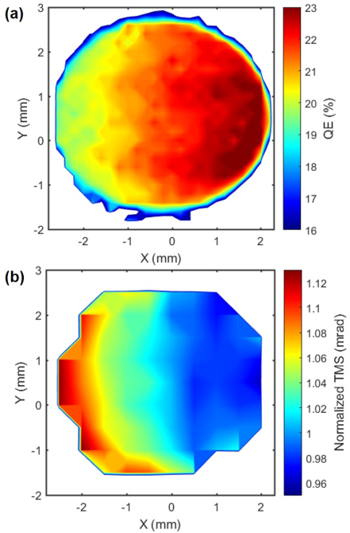
Thermal emittance vs quantum efficiency
For most of the cases, thermal emittance is improved with reduced QE
Positive correlation
Photon energy
Electron affinity
Applied electric field
Temperature
Negative correlation between thermal emittance and QE is observed through the correlation between the mapping studies.
Thermal emittance
Quantum efficiency

Slide 3
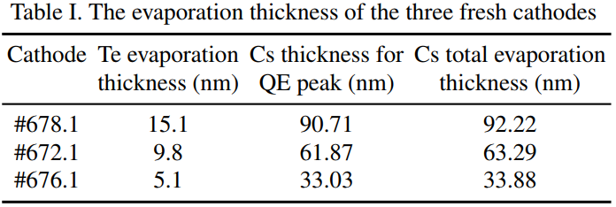
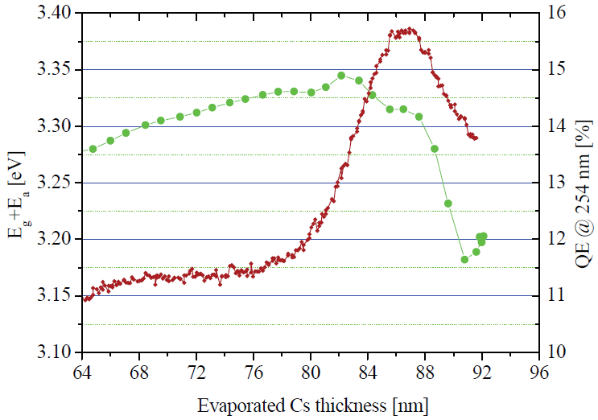
Thermal emittance map & QE map measured at PITZ
Typical images of thermal emittance map and QE map
The negative correlation is observed for four cathodes. These cathodes are fabricated with the same recipe with different Te deposition thicknesses and hence different sample thicknesses
The negative correlation is preserved under different applied electric fields

Slide 4
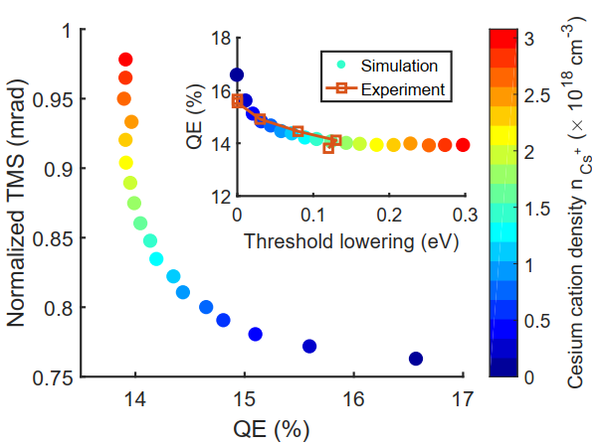
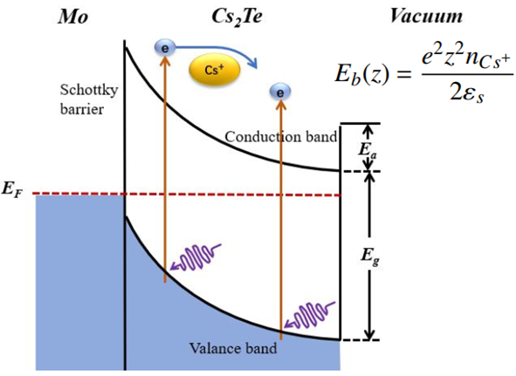
Theoretical models for negative correlation
Schottky barrier model
Cs-excess Cs₂Te – varied Cs⁺ density at different transverse position of cathode
The excess Cesium tends to offer free electrons to form the Schottky barrier. The depletion area covers the whole cathode film (~30 nm) and the build-in electric field accelerates electrons.
The electrons excited at the deep side of the film would experience higher loss rates due to scattering with Cs ions and reach higher excess energy due to the acceleration, and therefore, the number of emitted electrons reduces but their excess energy is higher.
Cs-Te compositions model
varied kinds of Cs-Te composites.
Some kind of Cs-Te composite has higher QE and lower thermal emittance than the others.
varied ratios of Cs-Te composites at different position of cathode
Cs-Te composites:
Cs₂Te, Cs₃Te₂, Cs₅Te₄, CsTe, Cs₂Te₃, Cs₂Te₅, CsTe₅,
$$Cs_{x3}{Te}_{y3}$$
$$Cs_{2}Te$$
$$Cs_{x1}{Te}_{y1}$$
$$Cs_{x2}{Te}_{y2}$$

Slide 5
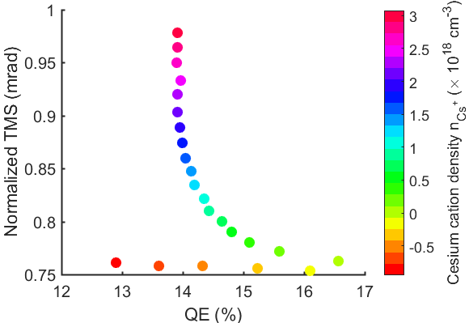
Further experiments
We plan to carry out the experiments on Cs-poor Cs₂Te cathodes at PITZ to distinguish the two possible models.
Schottky barrier model
Cs-poor: The Cs₂Te is p-type. The QE is a bit lower compared with the peak. The negative correlation is negligible. The QE and thermal emittance depend more on the local electron affinity. We would expect a negligible or positive correlation correlation from the mapping study.
Cs-Te compositions model
Cs-poor: As most of the Cs-Te composites have Cs to Te ratio less than 2, the fabricated Cs-Te film still mixes with different phases. The negative correlation is still expected.
Cs-Te composites:
Cs₂Te, Cs₃Te₂, Cs₅Te₄, CsTe, Cs₂Te₃, Cs₂Te₅, CsTe₅,
Cs poor

