Slide 1
Photoemission electron microscope(PEEM) for photocathode studies
Alimohammed Kachwala,^{1*} Oksana Chubenko,¹ Howard Padmore,² and Siddharth Karkare¹
¹Arizona State University, Tempe, AZ 8528, USA
²Lawrence Berkley National Laboratory, Berkley, CA 95720, USA
*Email : akachwal@asu.edu
Acknowledgement
This work is supported by the NSF Center for Bright Beams under award PHY-1549132, and by the Department of Energy, Office of Science under awards DE-SC0021092, and DE-SC0021213.

Slide 2
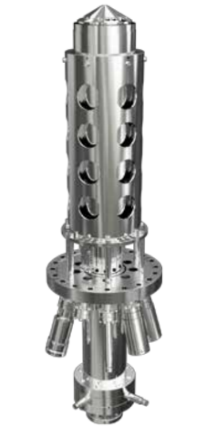
Introduction
Photoemission electron microscopy is regarded as one of the most promising approach to photoemission-based imaging techniques.
In PEEM, the sample is illuminated with light (UV-Hg Lamp or LASER) and the electrons emitted from the surface are imaged.
The FOCUS-PEEM has been installed at the photoemission and bright beams lab(PBBL) at ASU and will be connected to:
Alkali-Antimonide thin film growth Chamber
AFM with Capability of Kelvin Probe Microscopy
Electron Energy Analyzer Chamber (Which can measure 3D momentum distribution of electrons)
200kV DC electron gun with cryogenically cooled cathode
The FOCUS-PEEM sample holder is compatible with standard omicron paddle shaped holder which allows for large flexibility in terms of sample size.
Ref. PEEM-Brochure_2017_Rev8

Slide 3
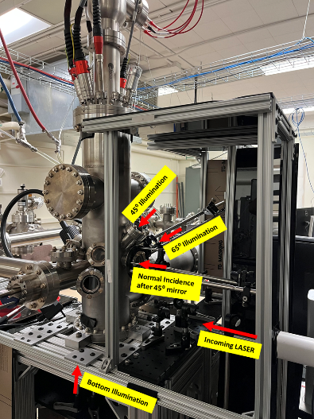
Instrumentational Aspects
IS-IEF-PEEM aspects
Real Space Imaging
Energy Filtered Real Space Imaging
k-Space Imaging (MTE measurement)
Energy Filtered k-Space Imaging
Angle of Incidence: 65⁰, 45⁰, 0⁰(top), 0⁰(bottom) to the normal of the sample
Excitation sources available in the lab
UV Excitation (Hg- Lamp 5.2eV)
20W, femtosecond solid state laser with a repetition rate up to 500 kHz (LightConversion PHAROS). The laser output is fed to an optical parametric amplifier (LightConversion ORPHEUS) to provide tunable wavelengths from 200 nm to 2000 nm
Resolution
Real Space: 38.4nm
k-Space: 7.4mÅ⁻¹
Energy: 62meV

Slide 4
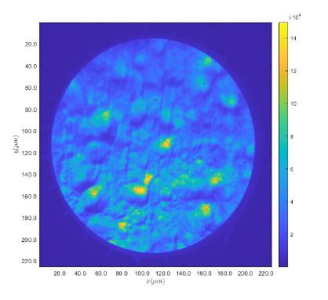
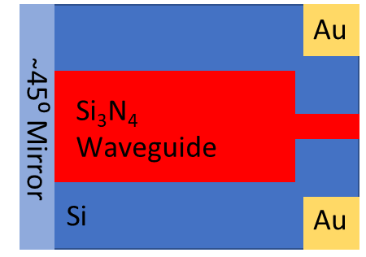
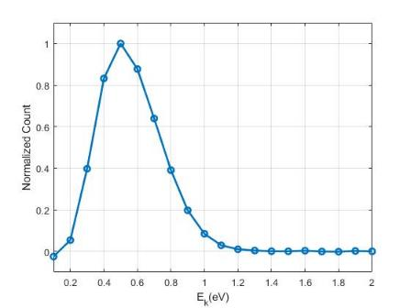
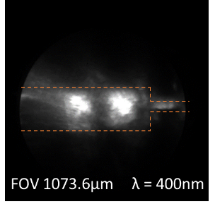
Ongoing Projects
Variation in Electron Emission
Emission from Diamond Tip
Photonics Integrated Cathodes
Source : Hg Lamp (5.2eV)
Polycrystalline Molybdenum
Acknowledgement: Evgenya I Simakov, Dongsung Kim
Acknowledgement: Rehan Kapadia, Ragib Ahsan, Hyun Uk Chae

Slide 5
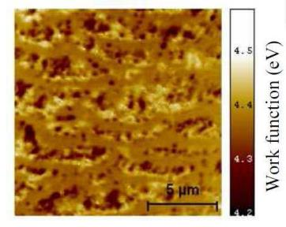
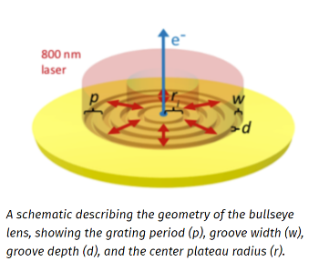
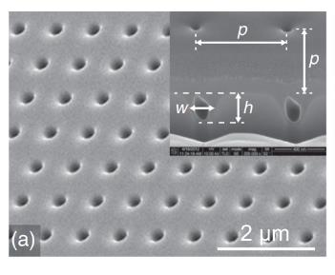
Possible Future Studies
Work Function Variation
Nano Sources
Plasmon Assisted Photoemission
Epitaxial Graphene on SiC(0001)
Ref. Mathieu, C., et al. "Recent Advances In 2D‐Band Structure Imaging By k‐PEEM and Prospects For Technological Materials." AIP Conference Proceedings. Vol. 1395. No. 1. American Institute of Physics, 2011.
Ref. Durham, Daniel B., et al. "Plasmonic lenses for tunable ultrafast electron emitters at the nanoscale." Physical Review Applied 12.5 (2019): 054057.
Ref. Li, R. K., et al. "Surface-plasmon resonance-enhanced multiphoton emission of high-brightness electron beams from a nanostructured copper cathode." Physical review letters 110.7 (2013): 074801.

