Slide 1
The NLC: a Next generation Linear Collider
A symposium honoring Nan Phinney
March 2, 2018
Tor Raubenheimer

Slide 2
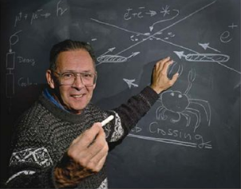
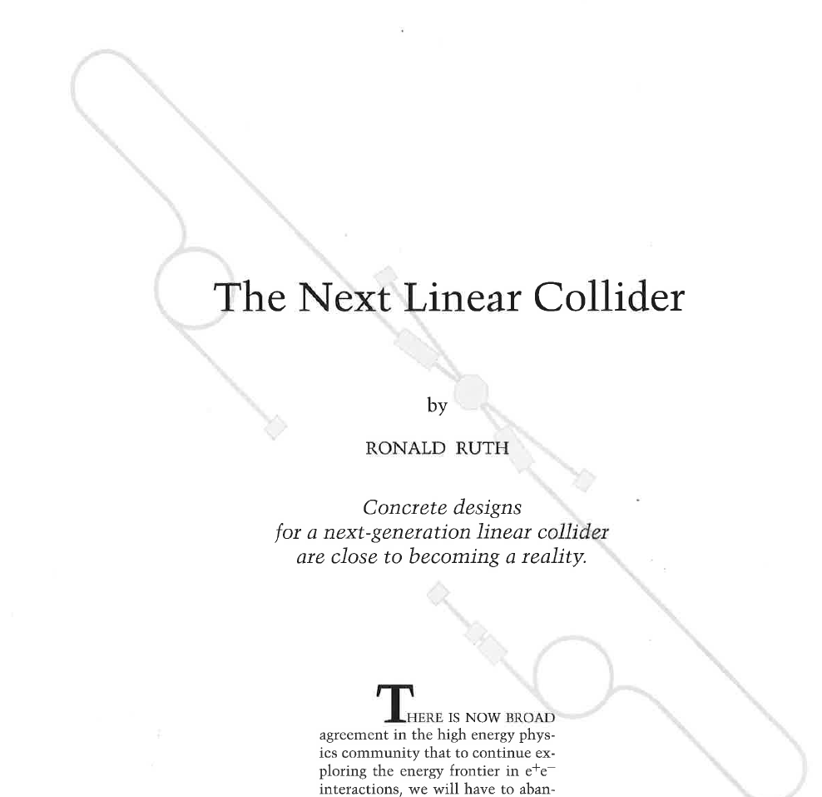
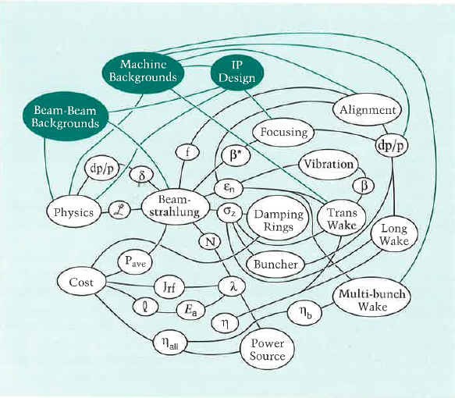
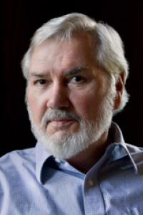
The Linear Collider Design Challenge
Multi MW multi-GeV beams
nanometer-scale spot sizes
LC Design principals

Slide 3
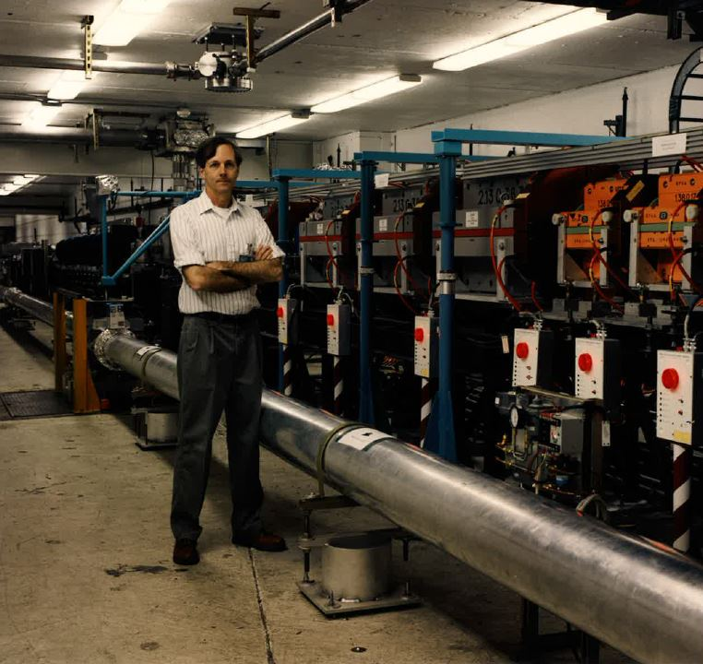
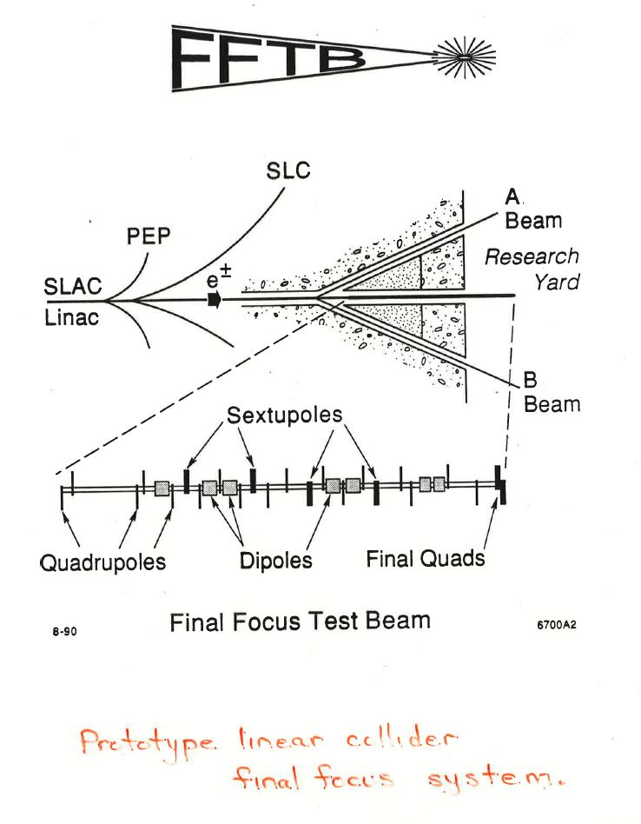
Final Focus System

Slide 4
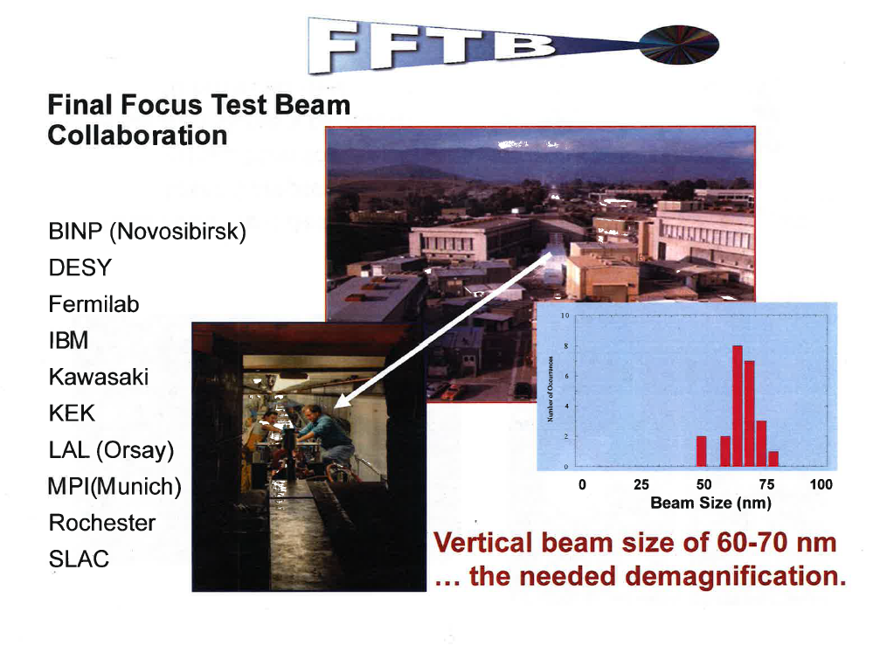

Slide 5
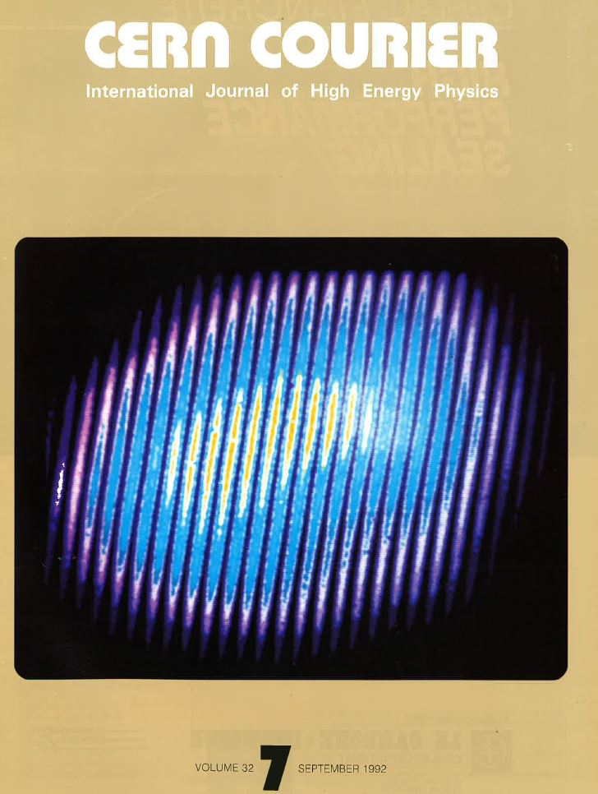
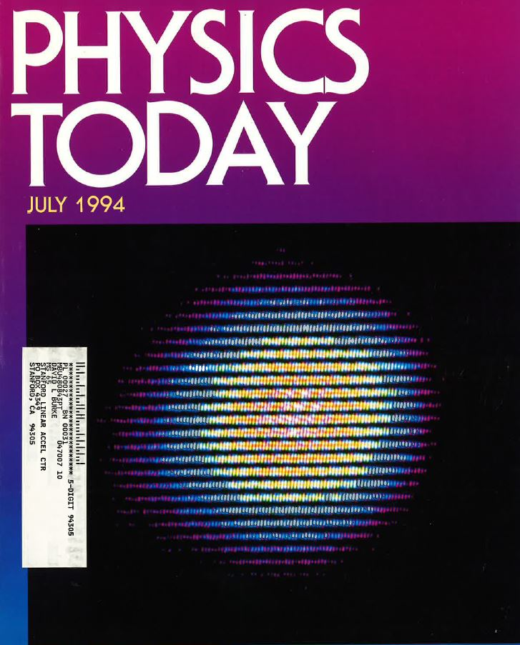
FFTB Results

Slide 6
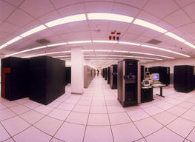
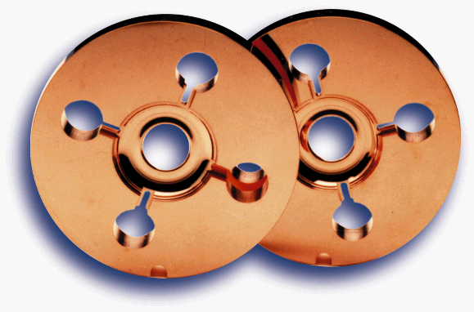
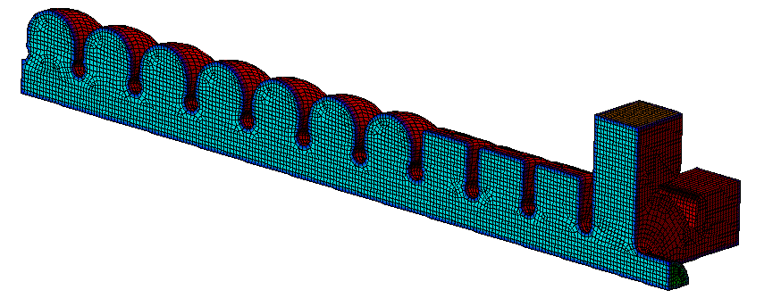
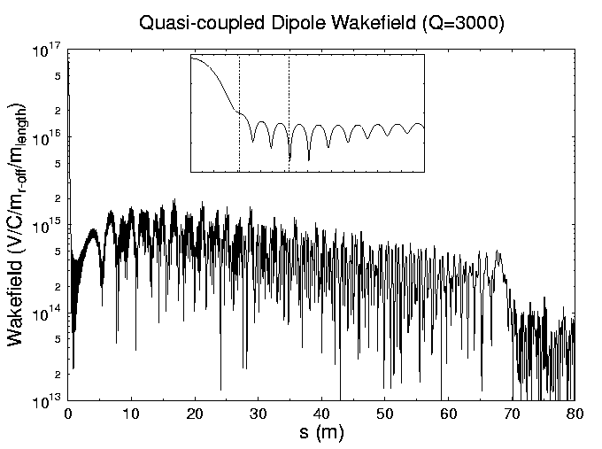
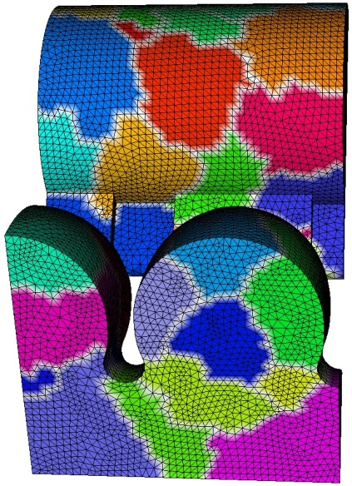
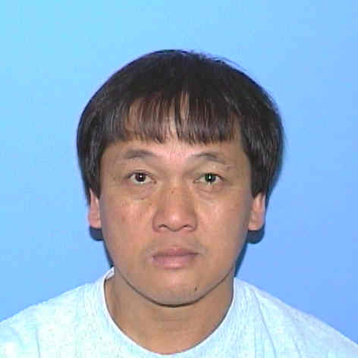
X-band Accelerator Structures

Slide 7

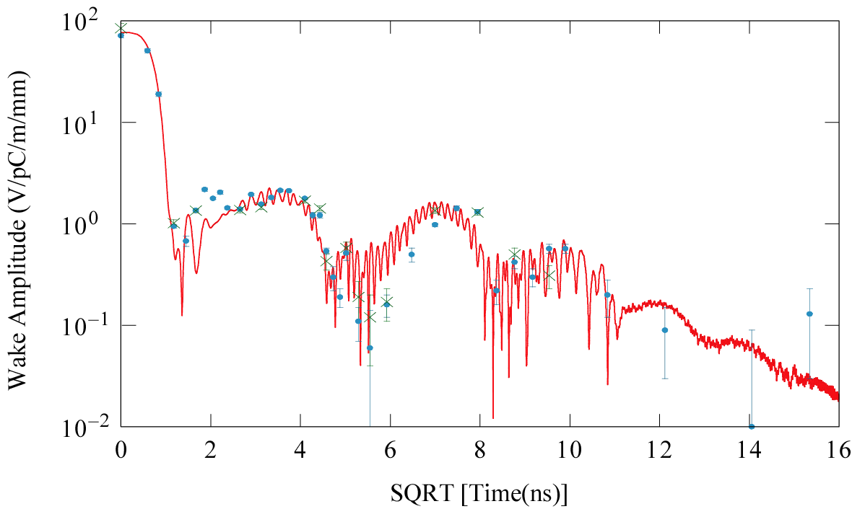
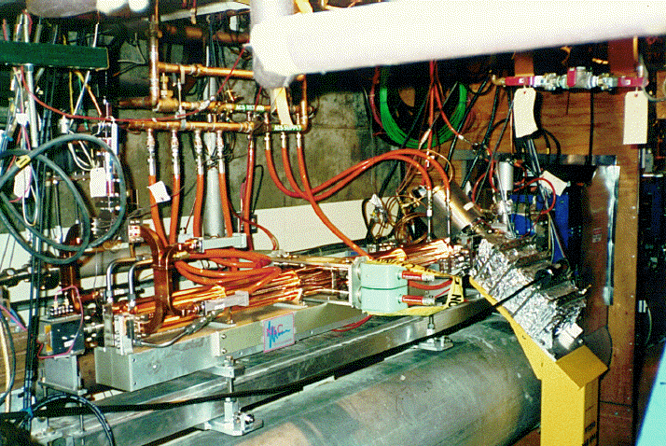
X-band Structure Testing

Slide 8

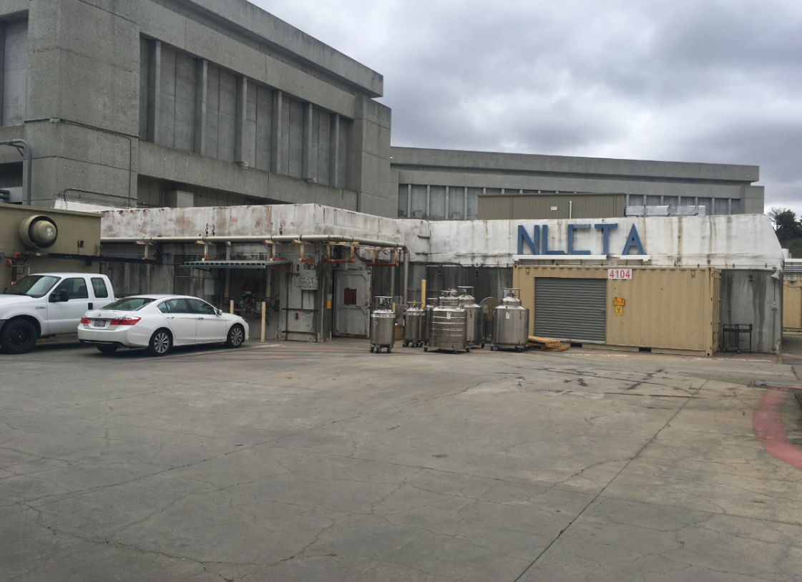
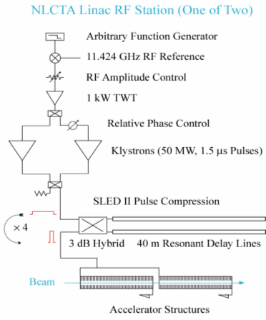
RF Systems Development
NLC Test Accelerator

Slide 10
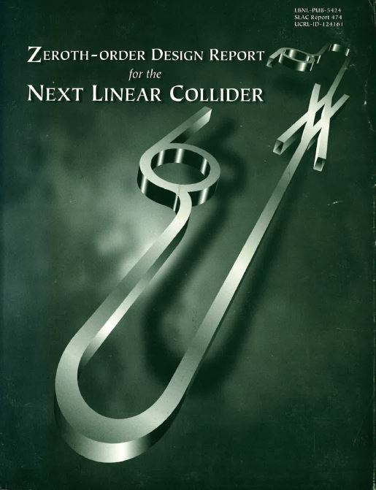

Slide 11
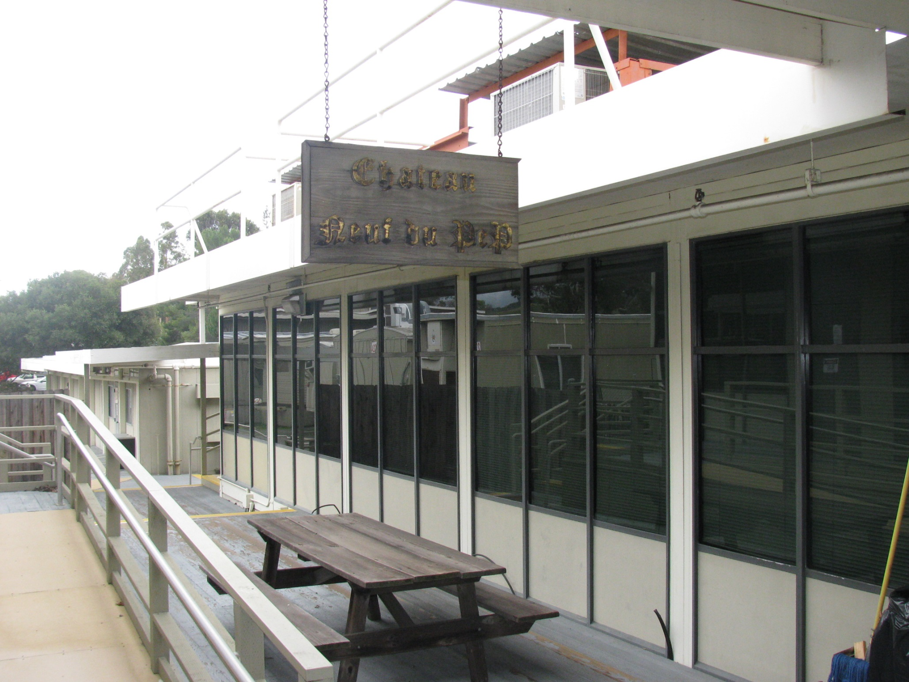
1998 - 2009

Slide 12
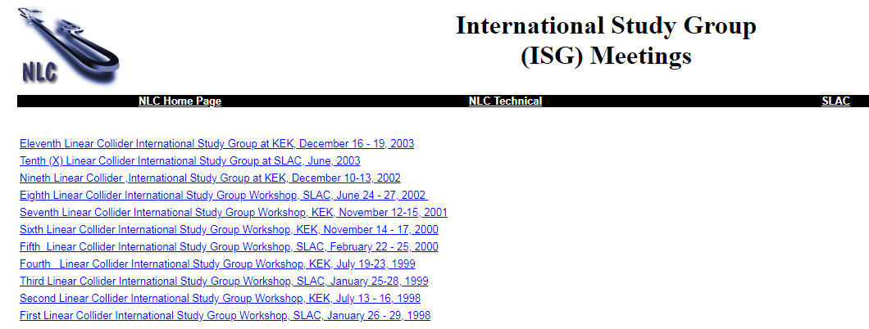

Slide 13
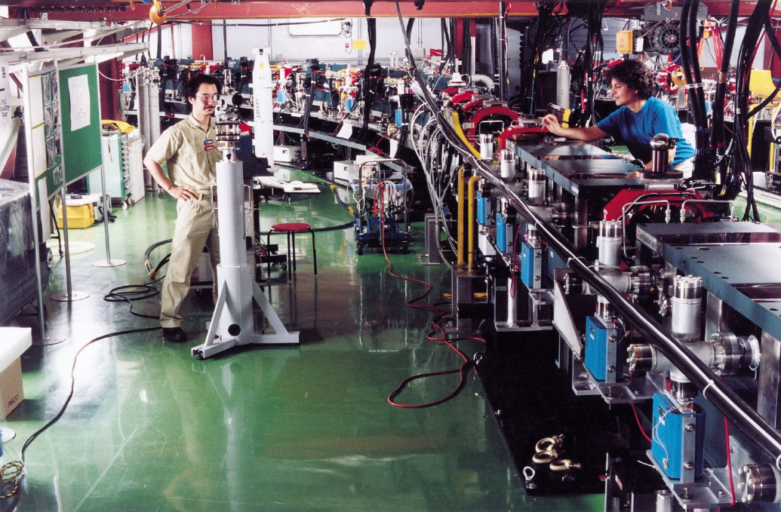
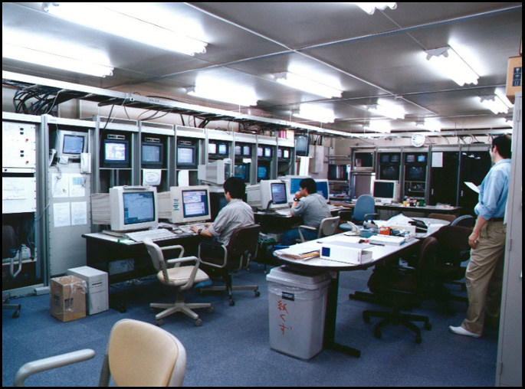
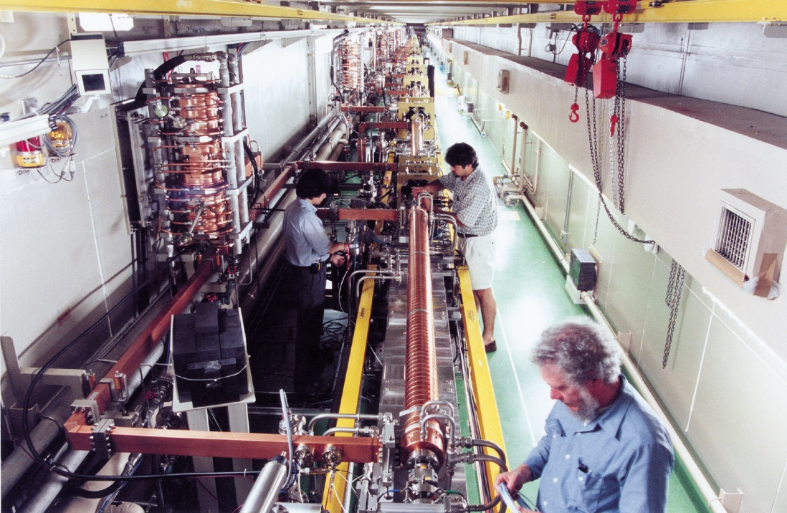
ISG Meetings
Working on the ATF
prototype damping ring

Slide 14
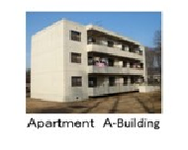
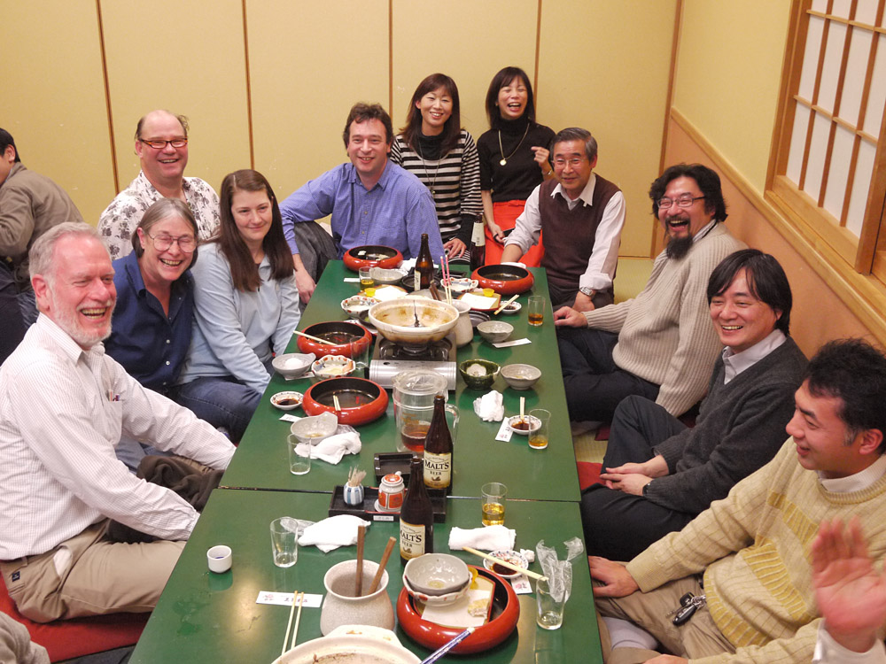
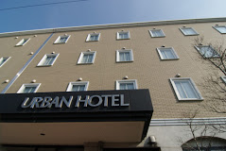
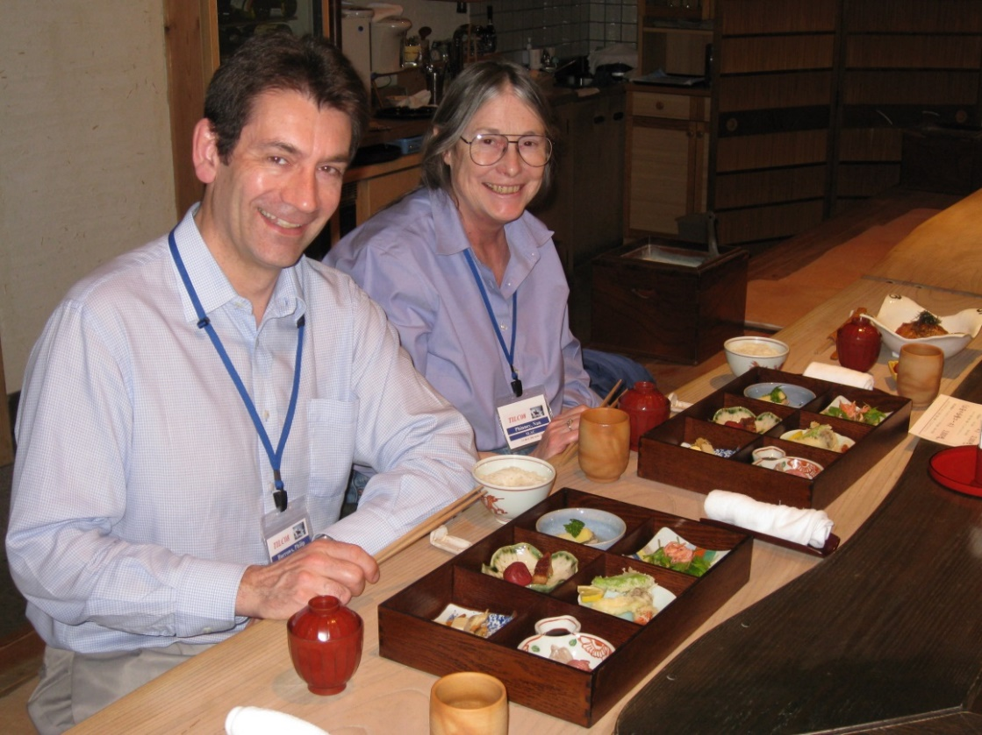
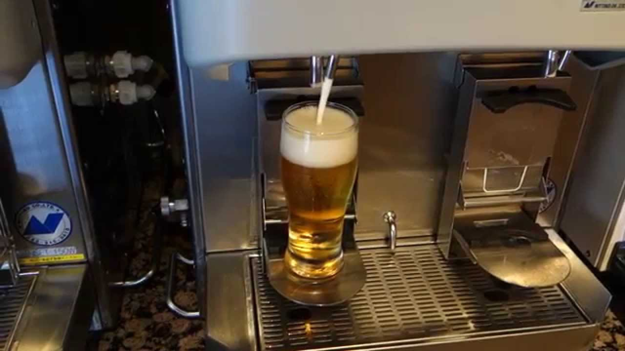
ISG Meetings

Slide 15
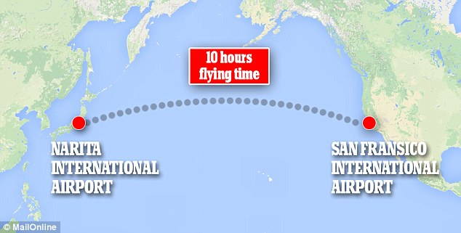


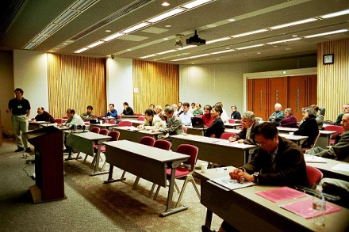
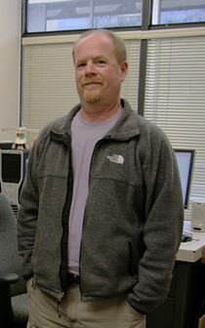
ISG Meeting Travel

Slide 16
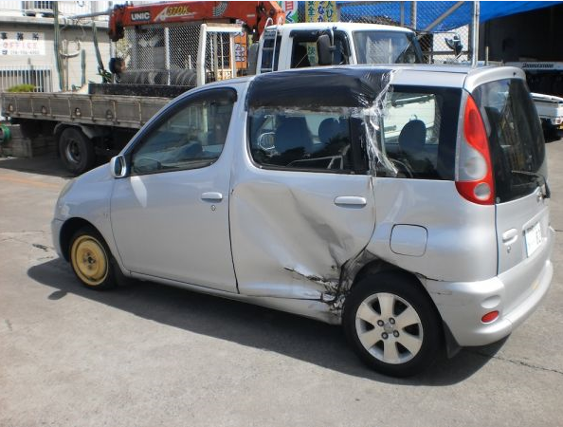


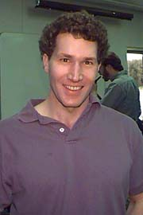
ISG Meeting Challenges
The passengers
The BAD driver

Slide 17

ISG Challenges
The
communicator!
The BAD driver

Slide 18

ISG Challenges
Honto ni gomen ne
The BAD driver

Slide 19
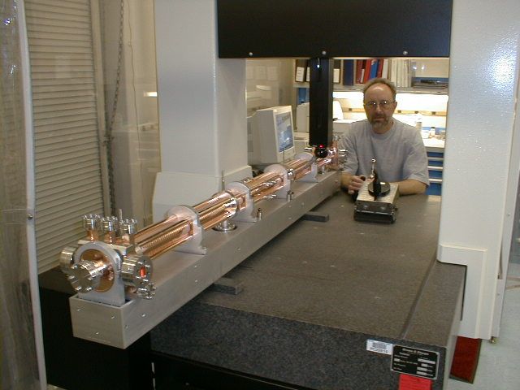
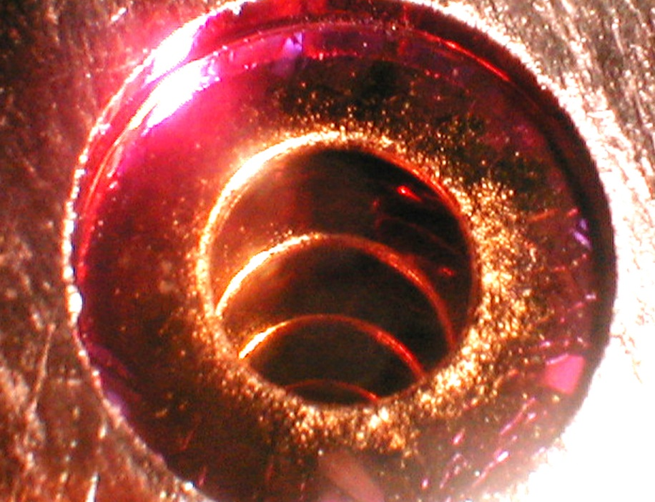
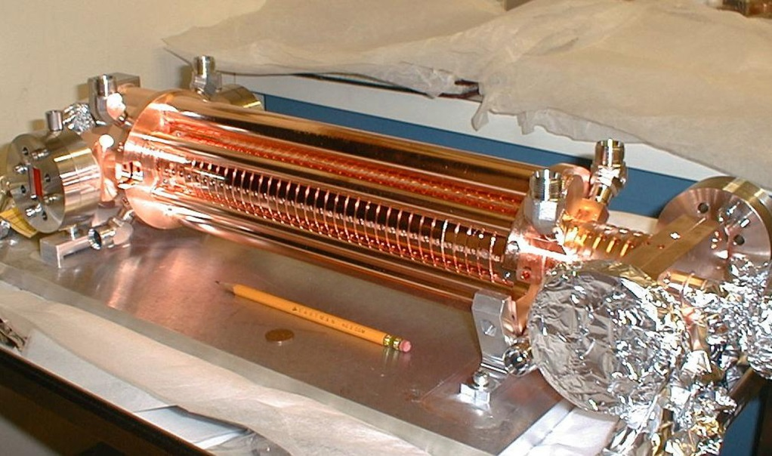
Gradient Limits – Oops!

Slide 20

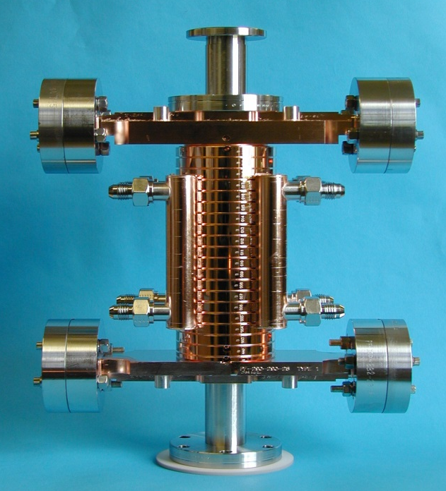
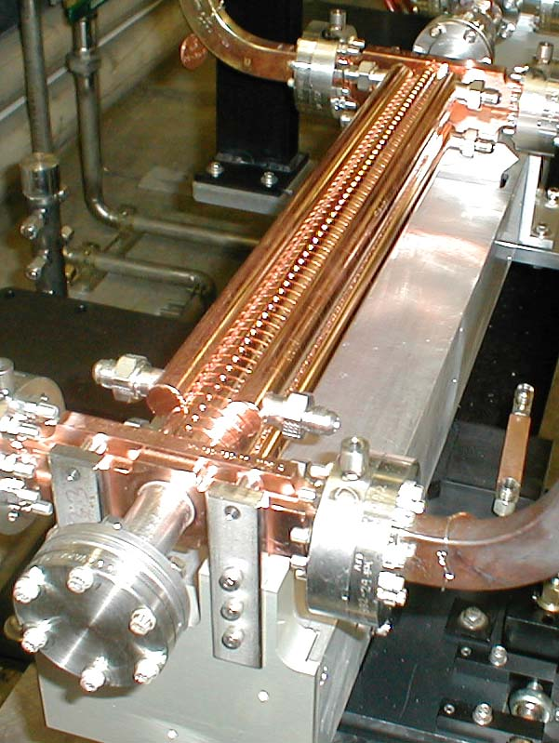
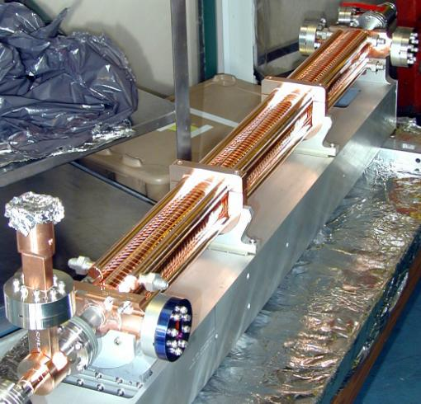
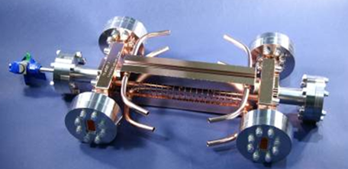
Structures, Structures, everywhere

Slide 21
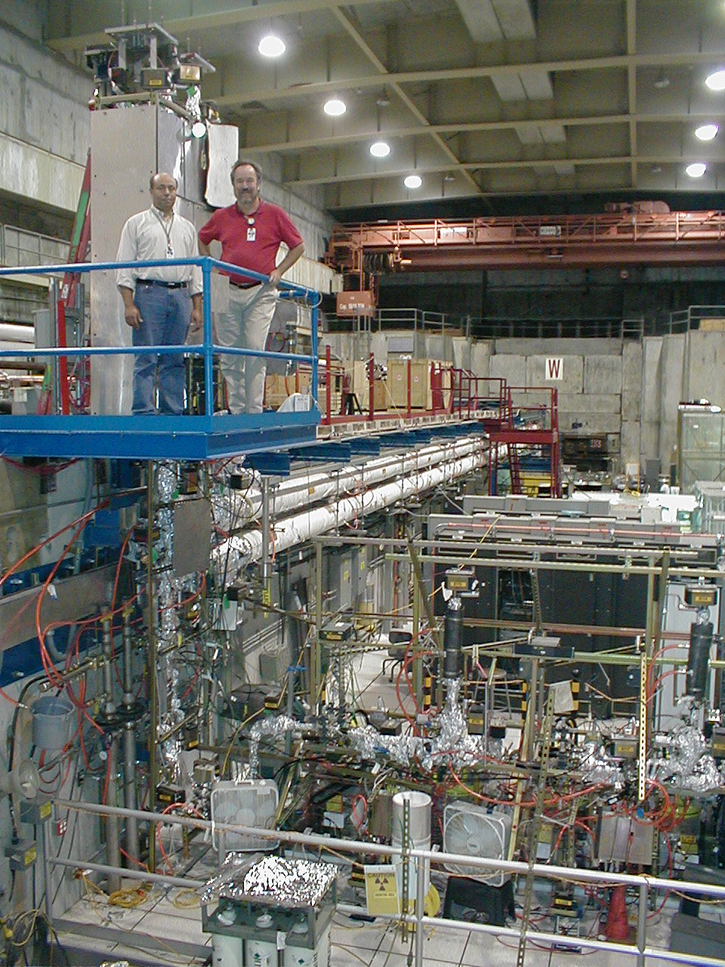
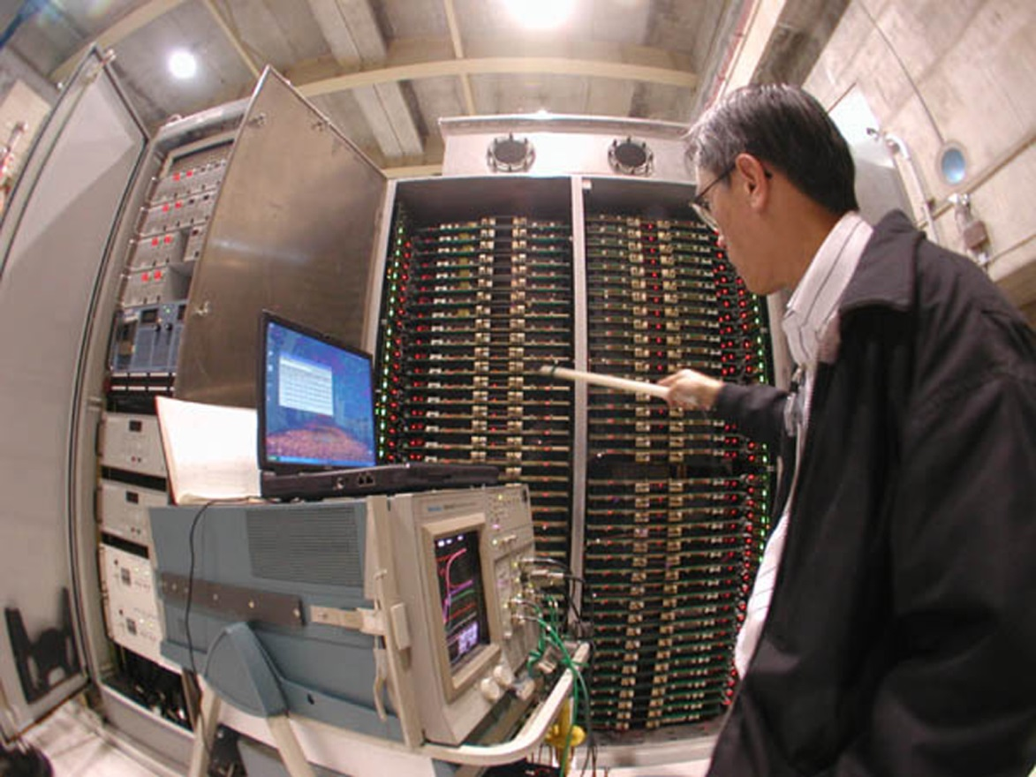
RF System Dev.

Slide 22
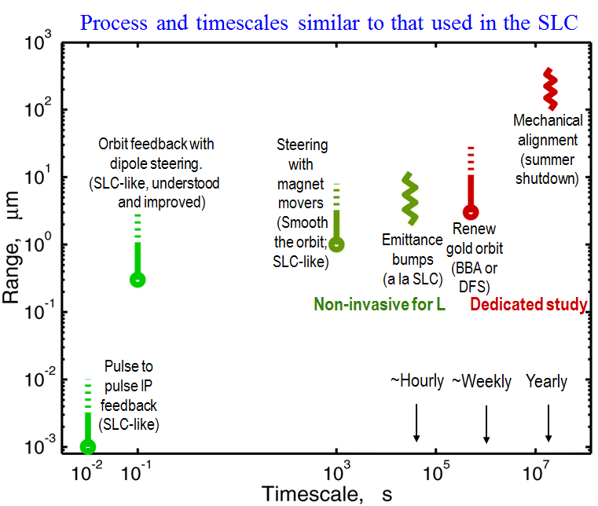
Designing for Machine Operation

Slide 23
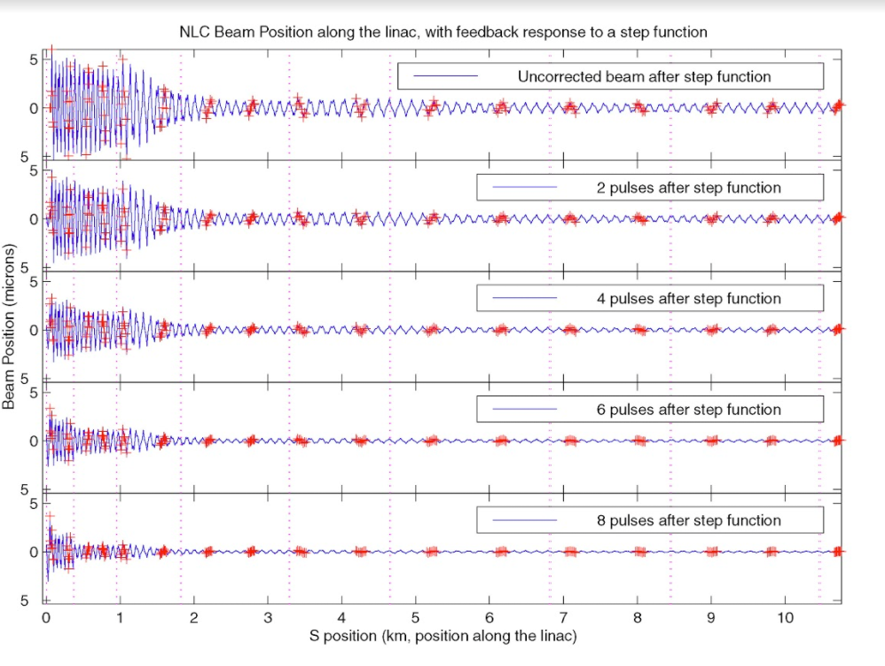
Feedback and Protection

Slide 24
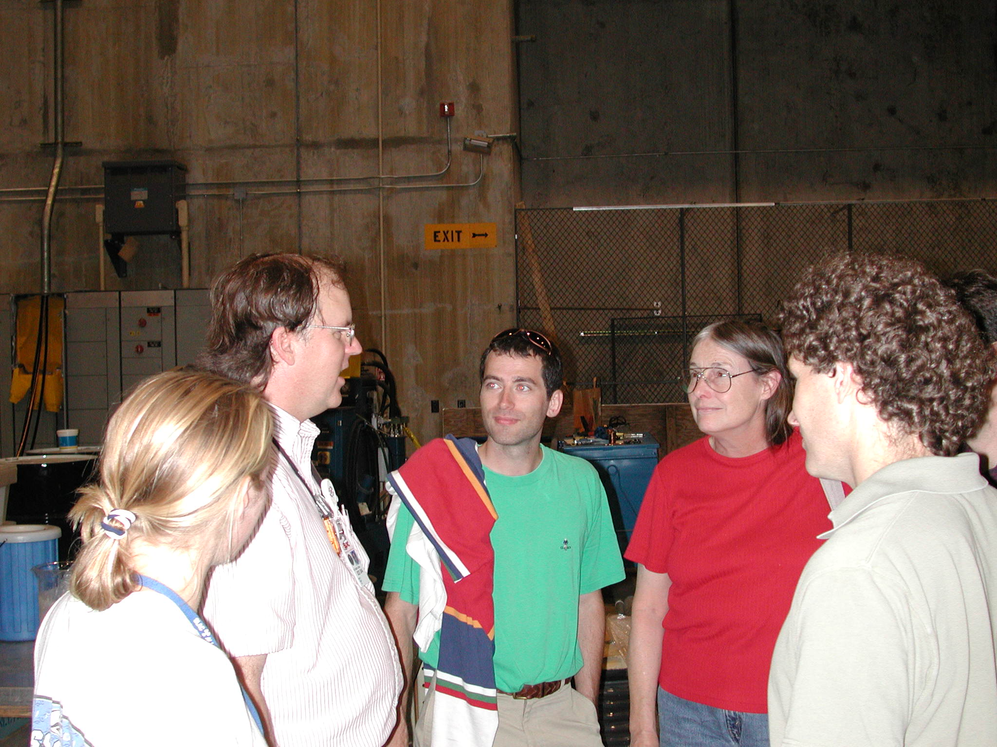
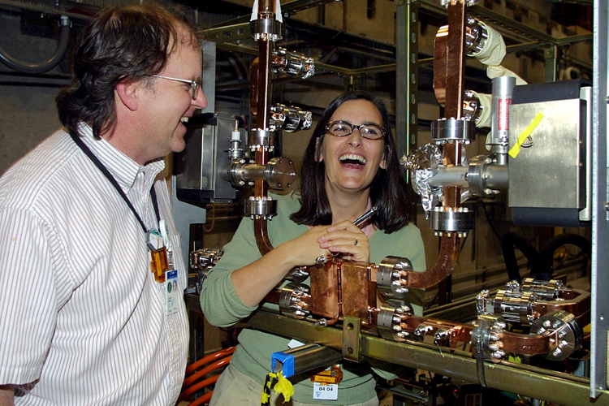
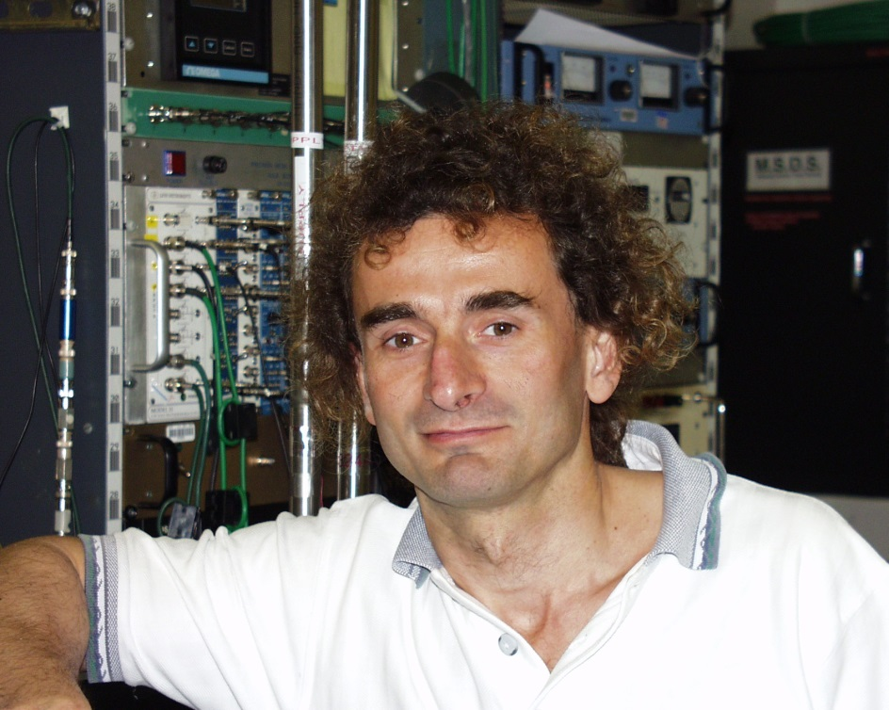
NLC Group

Slide 25
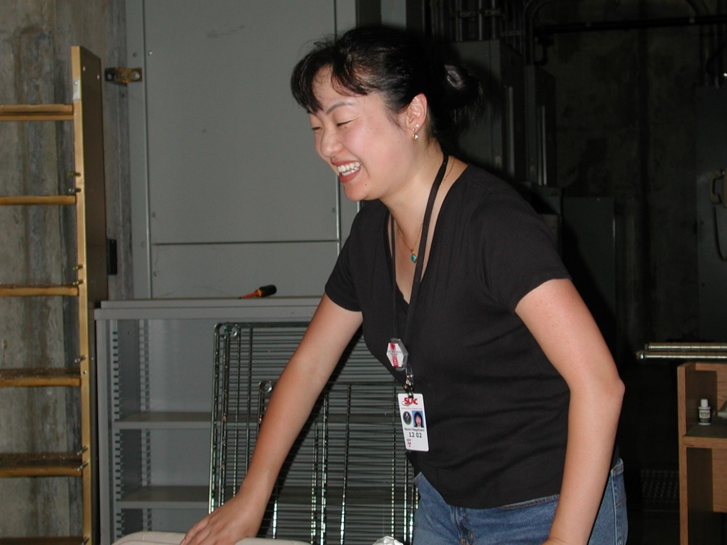



NLC Group

Slide 26
NLC Group

Slide 27


μm → mm

Slide 28

Nan’s Editing
Example is for illustrative purposes only and is not intended as real data

Slide 29



Slide 30


US NLC Collaboration

Slide 31



US NLC Collaboration

Slide 32




Slide 33
Reply All – oops!
[bds 216] Re: comments on BCD/ACD from Philip Bambade
Subject: [bds 216] Re: comments on BCD/ACD from Philip Bambade
From: "Phinney, Nan" <nan@xxxxxxxxxxxxxxxxx>
Date: Wed, 30 Nov 2005 23:27:43 -0800
Good work - go get the jerk!
-----Original Message-----
From: Raubenheimer, Tor O. [mailto:tor@xxxxxxxxxxxxxxxxx]
Sent: Wednesday, November 30, 2005 4:44 PM
To: bds@xxxxxxxxxxxxxx; Philip Bambade
Cc: Markiewicz, Thomas Walter; yamamoto222-ee@xxxxxxxxxxxxxxxx; T.Tauchi; Napoly Olivier; Angal-Kalinin, D (Deepa); karsten.buesser@xxxxxxx; Burrows, Philip; Grahame Blair; Tomoyuki SANUKI; Seryi, Andrei
Subject: [bds 212] Re: comments on BCD/ACD from Philip Bambade
Hi Philip.
I have not been following the details of your discussions but I certainly agree with your point #1. I think it is important to get feedback from the detector groups on the advantages and disadvantages of the different parameter sets including the high luminosity set.
The parameter range was established because the accelerator designers feel that a parameter range is necessary to optimize the collider operation. Every knob available will help achieve the design goals and will later allow the accelerator to perform optimally. The only statement that is likely to be true regarding parameters, is that the accelerator will operate best at someplace other than the 'design' parameter set.
This is stated in the parameters document that was distributed on February 2005: " ... the TESLA machine parameters had been chosen to achieve a high peak luminosity but with a high disruption parameter which left little room for operational optimization (http://lcdev.kek.jp/ILCWS/Talks/14wg1-2-walker-ilckek.pdf). Changes to ease operational constraints would likely cause the peak luminosity to decrease. It was suggested that a wiser approach would be to define an operating plane where a number of different machine configurations achieve the same peak luminosity. The specifications for the different subsystems would be determined by the most difficult parameters in the operating plane thereby ensuring some level of operational flexibility."
The parameters that were suggested in the document were guidelines to be used by the working groups to understand the limitations in establishing a range. The design teams need to know what systems fail, which cost more, and which are OK across the parameter range -- we would like to maintain as large a range as reasonable. With this knowledge the range can be refined into a final parameter space. An important element in this optimization is the performance of the various detector configurations as well as the different beam delivery systems across the parameter range. This information will be useful in understanding the advantages of different detector technologies as well as the accelerator design.
Cheers,
Tor

Slide 34


Slide 35


USLCSG Accelerator Chair
Pay-free work days

Slide 36

ITRP Decision: ICFA, Beijing 2004

Slide 37

ITRP Decision: ICFA, Beijing 2004

Slide 38


Slide 39





Slide 40


LCWS 2004
ILC Global
Design Effort

Slide 41


LCWS 2004

