Slide 1
Dynamic X-ray Scattering
Instrument Overview
Hasan Yavaş
On behalf of the DXS Team

Slide 2
Outline
  Motivation & Science drivers
  Relevant techniques and
  short introduction to inelastic X-ray scattering
  DXS parameter space & major components
  Monochromator concept
  Spectrometer concept

Slide 3

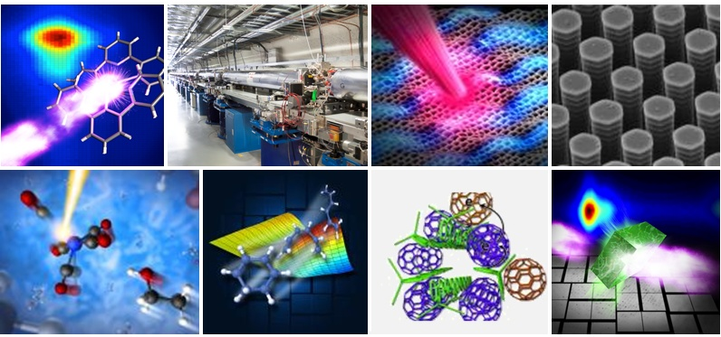
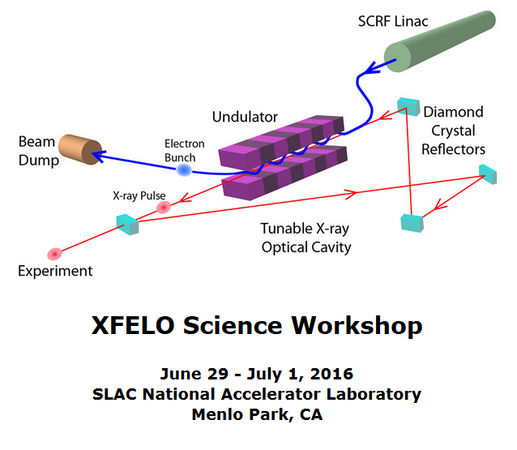
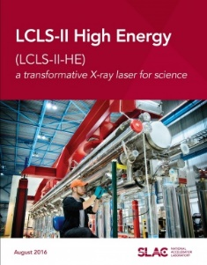
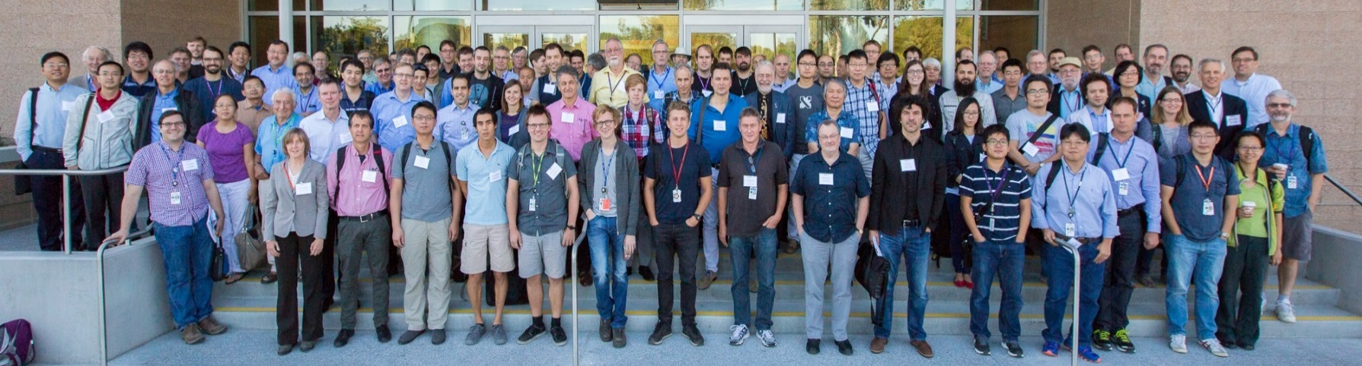
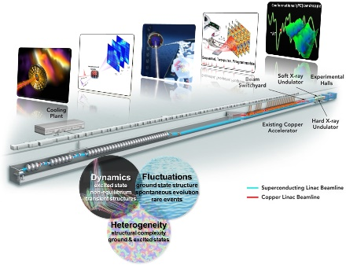
LCLS-II-HE science drivers & instrumentation needs have been developed by the international community over many years
LCLS-II Scientific Opportunities Workshops
February 9-13, 2015
Research Opportunities in Photochemistry, Solar Energy & Advanced X-ray Methods
June 16-17, 2016
XFELO Science Workshop
June 29-July 1, 2016
Scientific Opportunities for Ultrafast Hard X-rays at High Repetition Rate: An Energy Upgrade of LCLS-II
September 26-27, 2016
LCLS-II-HE “First Experiments” Meeting: Chemistry & Materials Physics
July 20-21, 2017
LCLS-II-HE “First Experiments” Meeting: AMO, Biology, and Quantum Materials
Oct. 30-31, 2017
Advanced X-ray Methods & Instrumentation for LCLS-II-HE Science
Oct. 16-17, 2018
LCLS/SSRL Users’ Meetings
Ongoing LCLS Science & Instrumentation Reviews
>400 participants
>160 participants
>160 participants

Slide 4
Motivation
Science Opportunities
  Characterization of collective modes of metastable materials phases
  (e.g. via laser/field manipulations or other transient stimuli)
  (~1 ps to <100 fs) - Leveraging short/transform-limited pulses
  Characterization of collective modes in complex materials in the critical energy resolution range ~2-25 meV (~kT)
  Taking advantage of high spectral flux density
  Expected impact: quantum materials, condensed matter chemistry, and amorphous materials, as a result of the high-resolution capabilities being developed

Slide 5
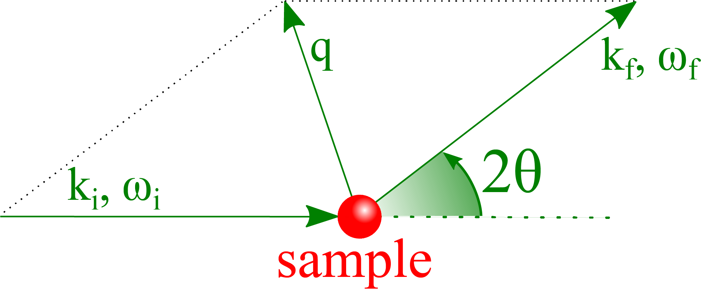
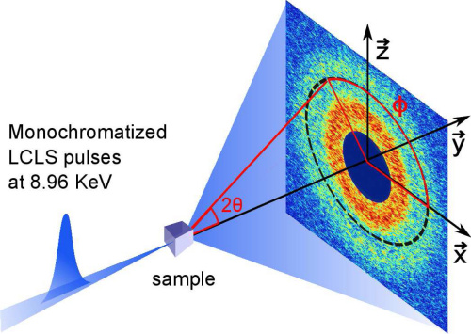
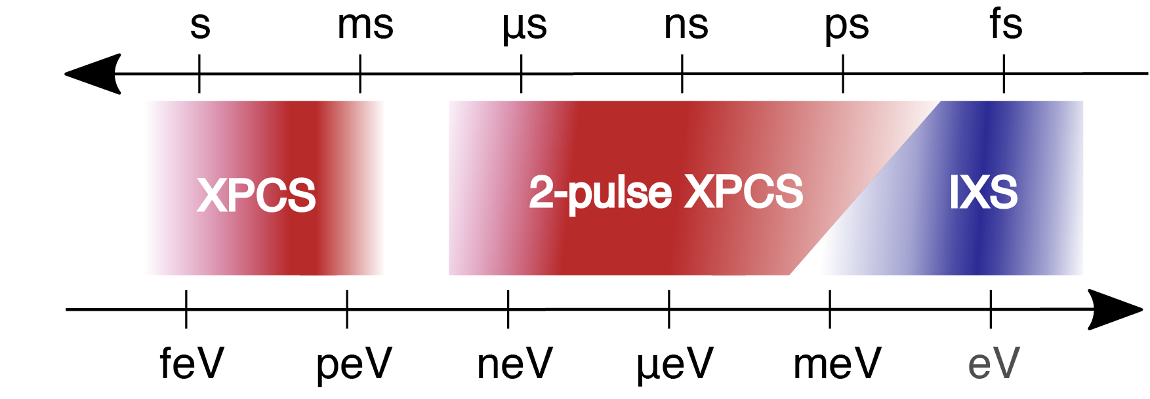
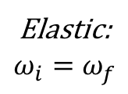
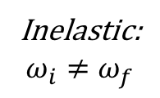
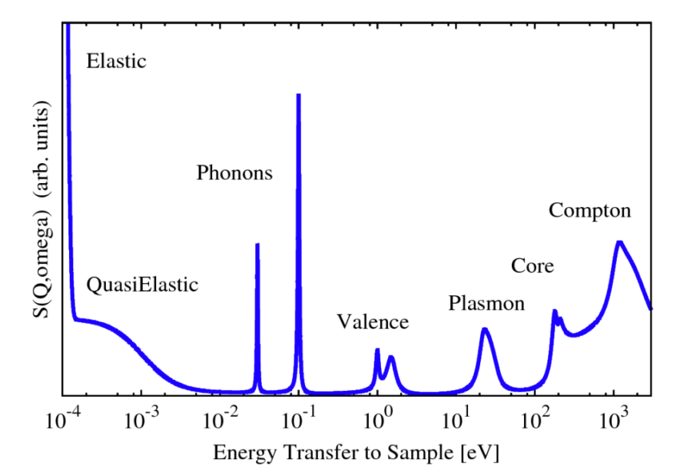
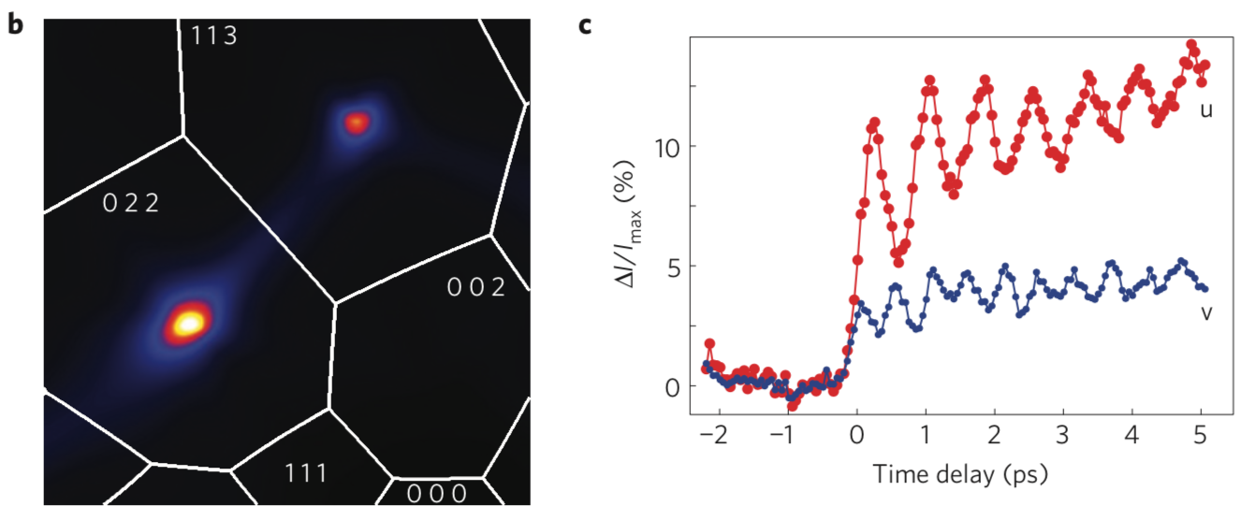
Relevant techniques (XPCS, FT-IXS, IXS)
Existing programs will be preserved (both at XPP and at DXS)
and benefit from high energy photons
M. Sutton (2002), S. Lee (2013), M. Trigo (2013), W. Schülke (2007), A. Baron (2020)

Slide 6
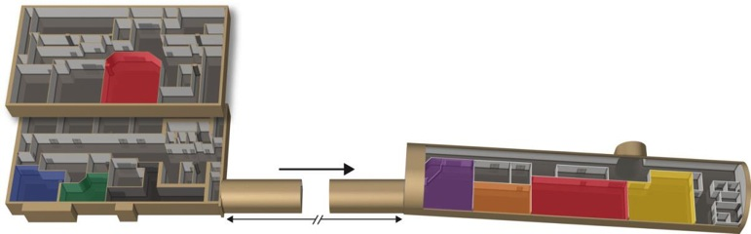
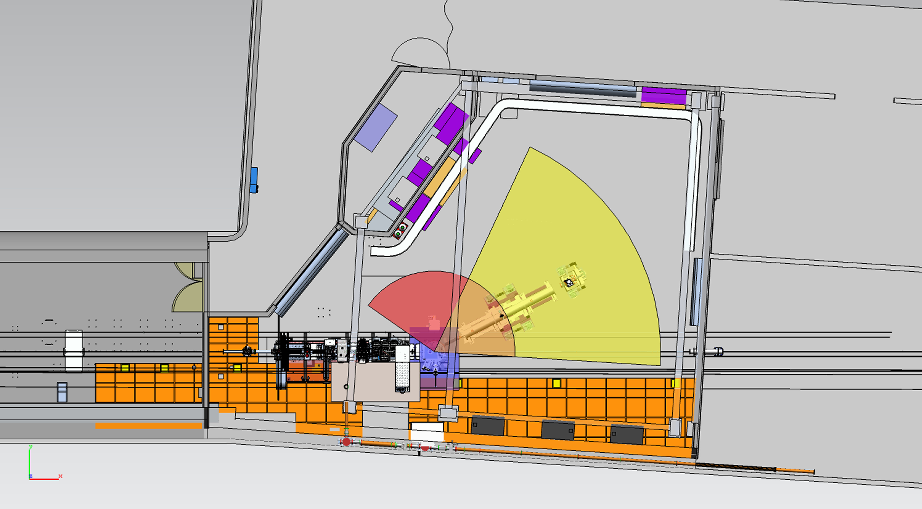
New IXS end station: major components & scope
Near
Hall
Far Hall
DXS
  New IXS end station
    High heat-load monochromator
    High-resolution monochromator
    Sample chamber
    Spectrometer arm with variable 2θ
    High-efficiency analyzer(s)
  Reorganizing the floorspace (existing XCS)
  to accommodate both XPCS and IXS
  Pump laser infrastructure
  High repetition rate detector
~ 200 m
FT-limit preserving
novel approach
~7 meters
Conventional
solutions

Slide 7
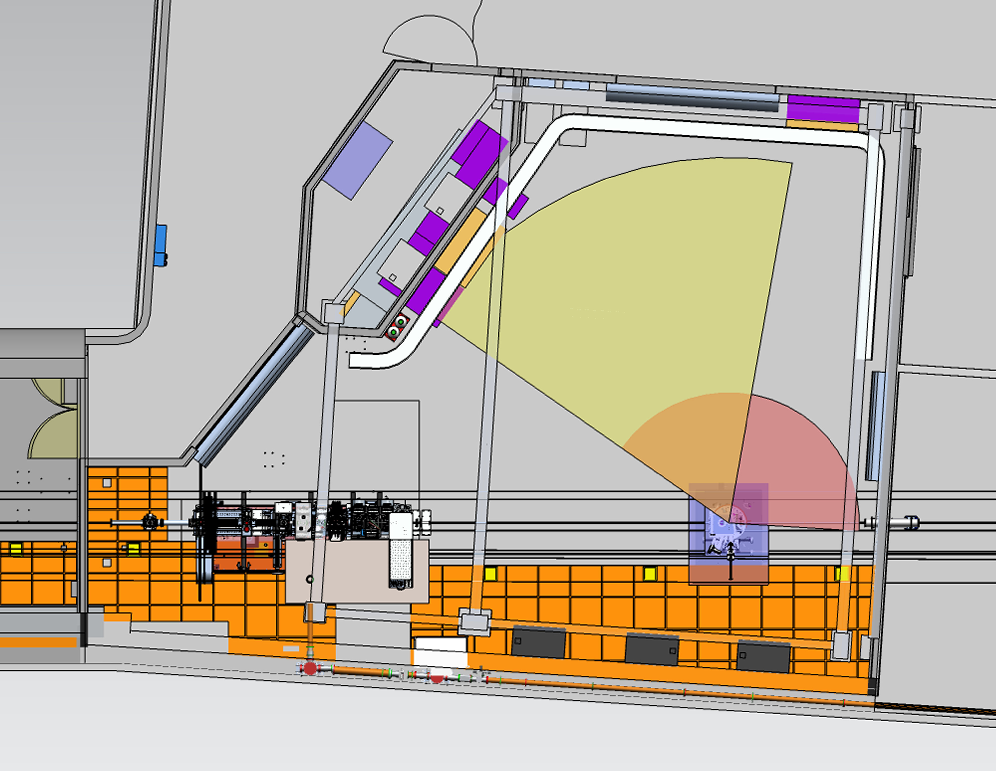
Parameter space & requirements
Parameter | Value
Photon energy | 6-18 keV – IXS (non-resonant and resonant) 6-22 keV (with harmonics) – XPCS
Target overall ΔE | ~ 5 meV (resonant and non-resonant)
Repetition rate | ~100 kHz (IXS), possibly higher (XPCS)
X-ray spot size | 5-500 µm
End Station(s) | Open floor without rails (dance floor) for flexibility of configuration (up to Q ~10 Å⁻¹ )
Pump laser | ~100 kHz, OPCPA system with wavelength conversion
Temp. resolution | 0.1 to 1 ps dependent on mode of operation
~7 meters
Designed to be ready on day one, but also future-proof

Slide 8
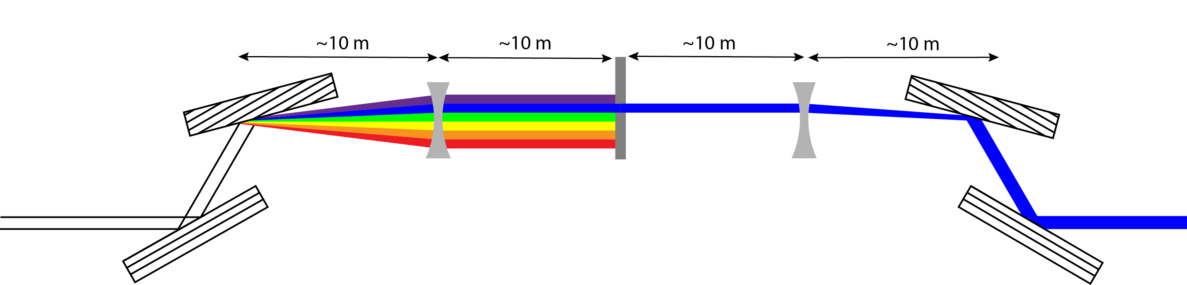
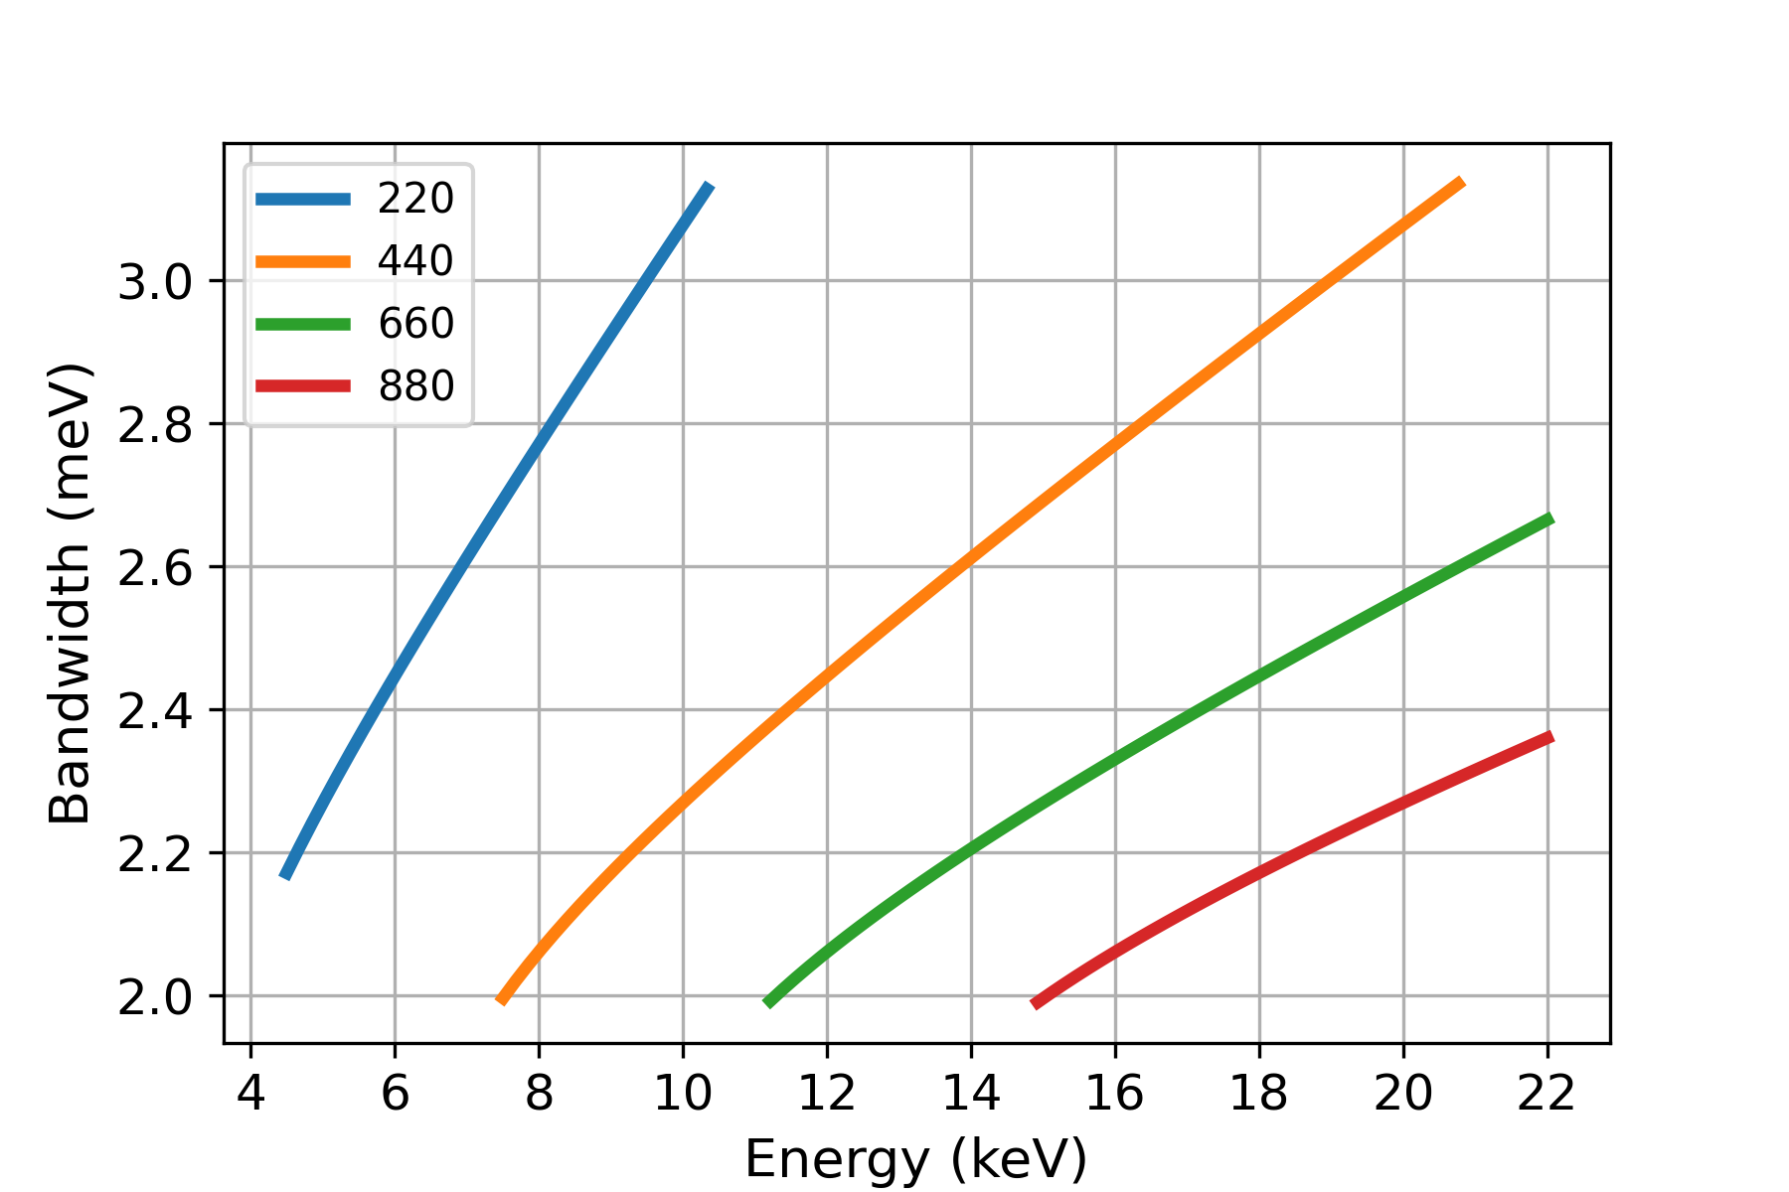
Enabling High-Resolution Monochromator at the FT-limit
4f-stretcher principle
Fully tunable, FT-limited pulses:
Tunable bandwidth and
tunable pulse duration
over a wide photon energy range.
Si(nnn) or
Si(nn0)
Focusing
Element
Slit
Resolution vs. photon energy
Resonant measurements of all 3d and 5d materials
Performance relies on geometry, not narrow rocking curves,
therefore, the design is more tolerant to thermal load of intense HE beam.
~2 meV the entire range (tunable for broader BW and shorter pulses) – clear path to improve towards 1 meV and beyond
An upstream telescope mirror pair tunes the “imaging” quality: tradeoff between narrow bandwidth vs low tails. It also enlarges the beam and helps manage the heat-load more effectively.
Ir-L₃
Cu-K

Slide 9
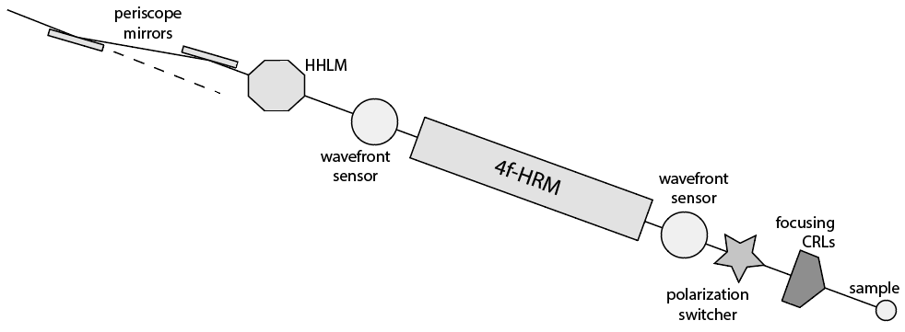
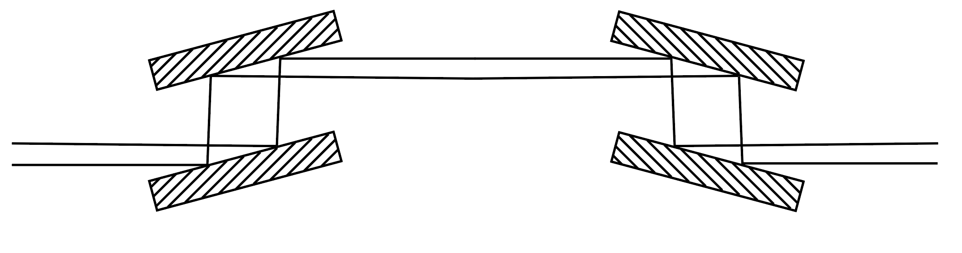
Optics layout – all in-line design
4f-High-resolution Monochromator - LN2-cooled
High-heat-load Monochromator
LN2-cooled, highly configurable
Periscope mirrors (telescope)
Enlarge the size and collimate the beam
Polarization Switcher (optional)
Source is vertically polarized
CRLs to focus the beam on the sample
~20m focal length

Slide 10
More about the performance
LCLS-II-HE upgrade: 2026/7
4 GeV to 8 GeV
0.25 to >15 keV at 1 MHz
DXS is 1 of the 5 new (upgraded) end stations
From IXS point of view
Horizontal axis: Figure of merit
Vertical axis: Lots to explore
Mode of Operation: SASE (∆E ~1e-3)
  E: 9000 eV, ∆E < 4 meV, ϕ ~ 4e12 phs/s
  Overall resolution < 5 meV
E: 11215 eV, ∆E < 4 meV, ϕ ~ 3e12 phs/s
Overall resolution < 5 meV
Mode of Operation: Self-seeded FEL
  E: 9000 eV, ∆E < 4 meV, ϕ > 1.5e14 phs/s
  Overall resolution < 5 meV
*E: 11215 eV, ∆E < 4 meV, ϕ > 1.5e14 phs/s
Overall resolution < 5 meV
*With low-emittance injector upgrade

Slide 11
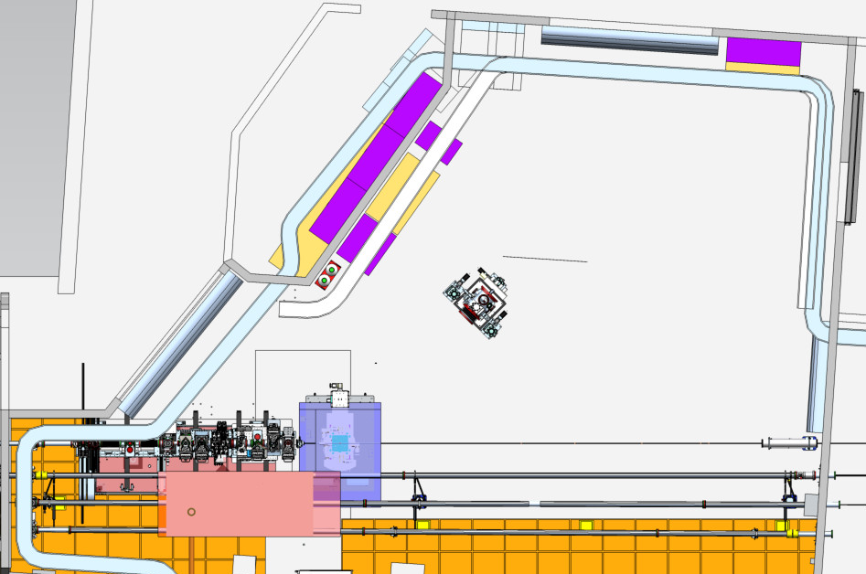
XPCS End Station
Revolutionary Detector:
SparkPix
1 MHz (for rare events with sparse signal)
50µm x 50µm
2 Mpix
Open “dance” Floor with laser tracking
Sample platform, ready to customize for user defined sample environment

Slide 12
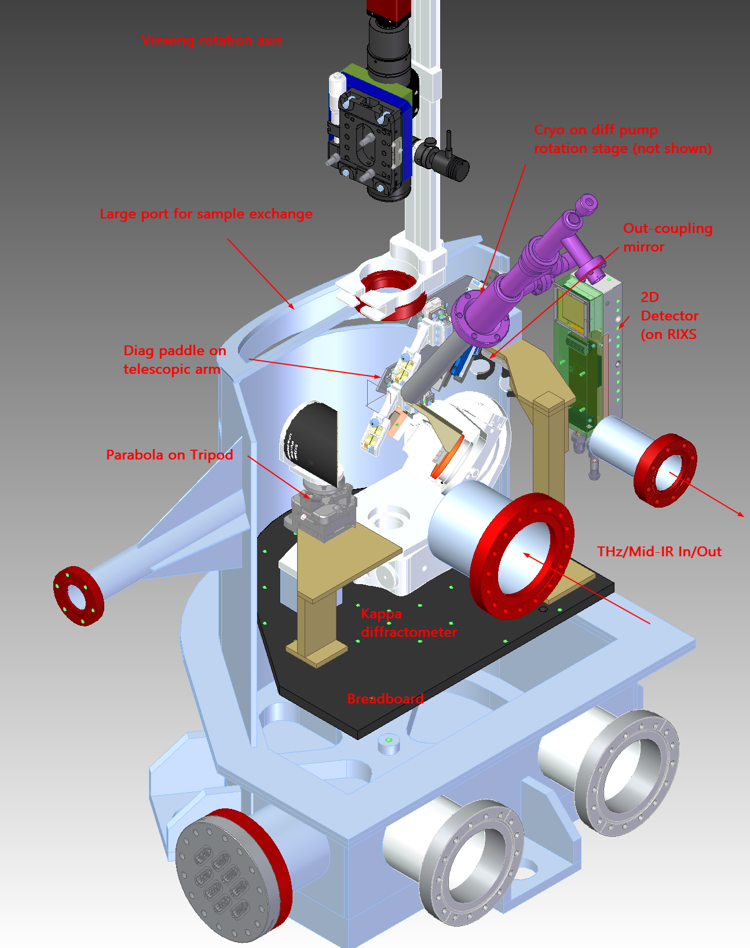
IXS End Station – sample chamber
In-vacuum Kappa diffractometer for single crystal manipulation
~20K to ~300K sample temperature
Multiple viewports for optical observation
IR, mid-IR, THz wavelength pump laser in-coupling
Retractable, in-vacuum diagnostic paddle
Be window for scattered X-ray beam (horizontal scattering plane*)
2D in-air detector for sample alignment, tr-XRD, and diffuse sctr.
Spectrograph style spectrometer at ~9 keV and 11.2 keV
  Collimating optics with ~2.5e⁻⁴ str (eqv. 100mm analyzer @5 m)
  Flat dispersive crystals (akin to gratings in optics)
  2D detection (energy transfer x momentum transfer)
*Polarization switching capability in the upstream optics for resonant measurements

Slide 13
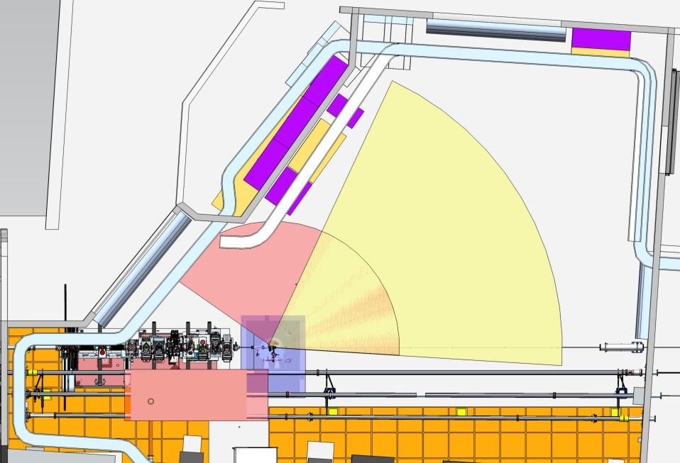
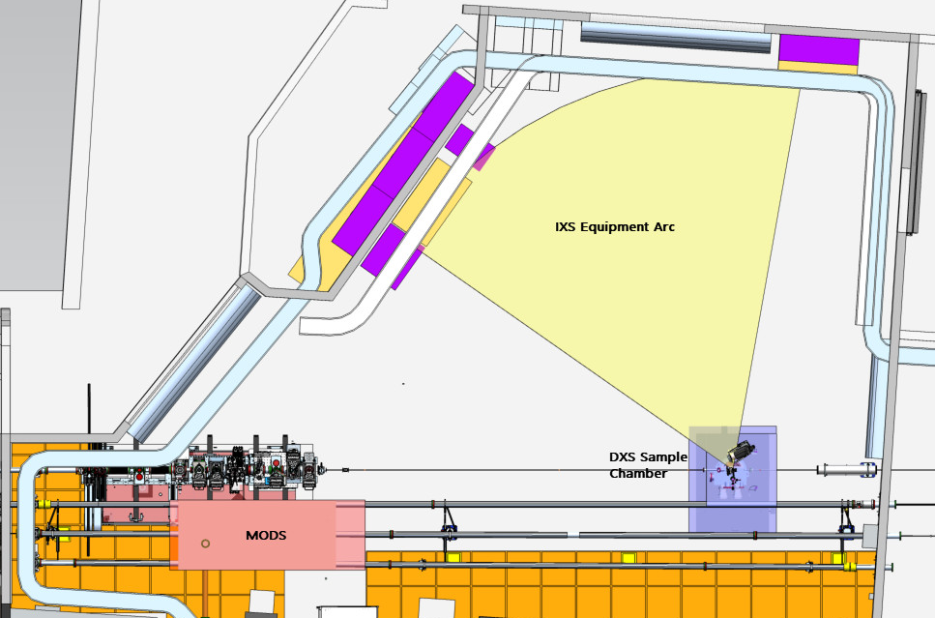
IXS End Station – 2 Interaction point possibility
Both resonant and non-resonant measurements
Options:
Diced spherical analyzer – moderate energy-resolution
Collimating optics + flat-crystal-based analyzer – ongoing studies

Slide 14
Backup Material

Slide 15
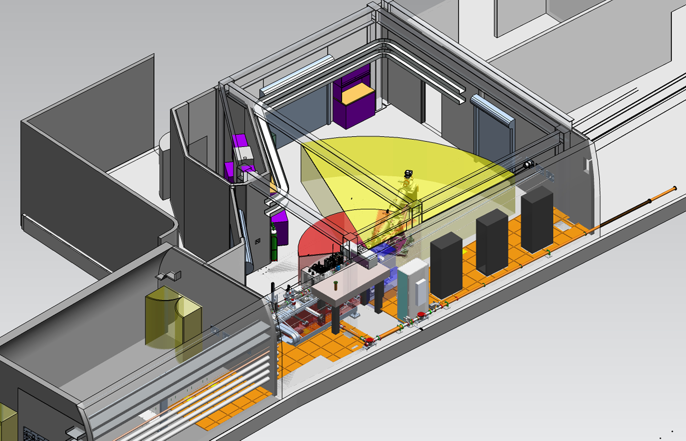
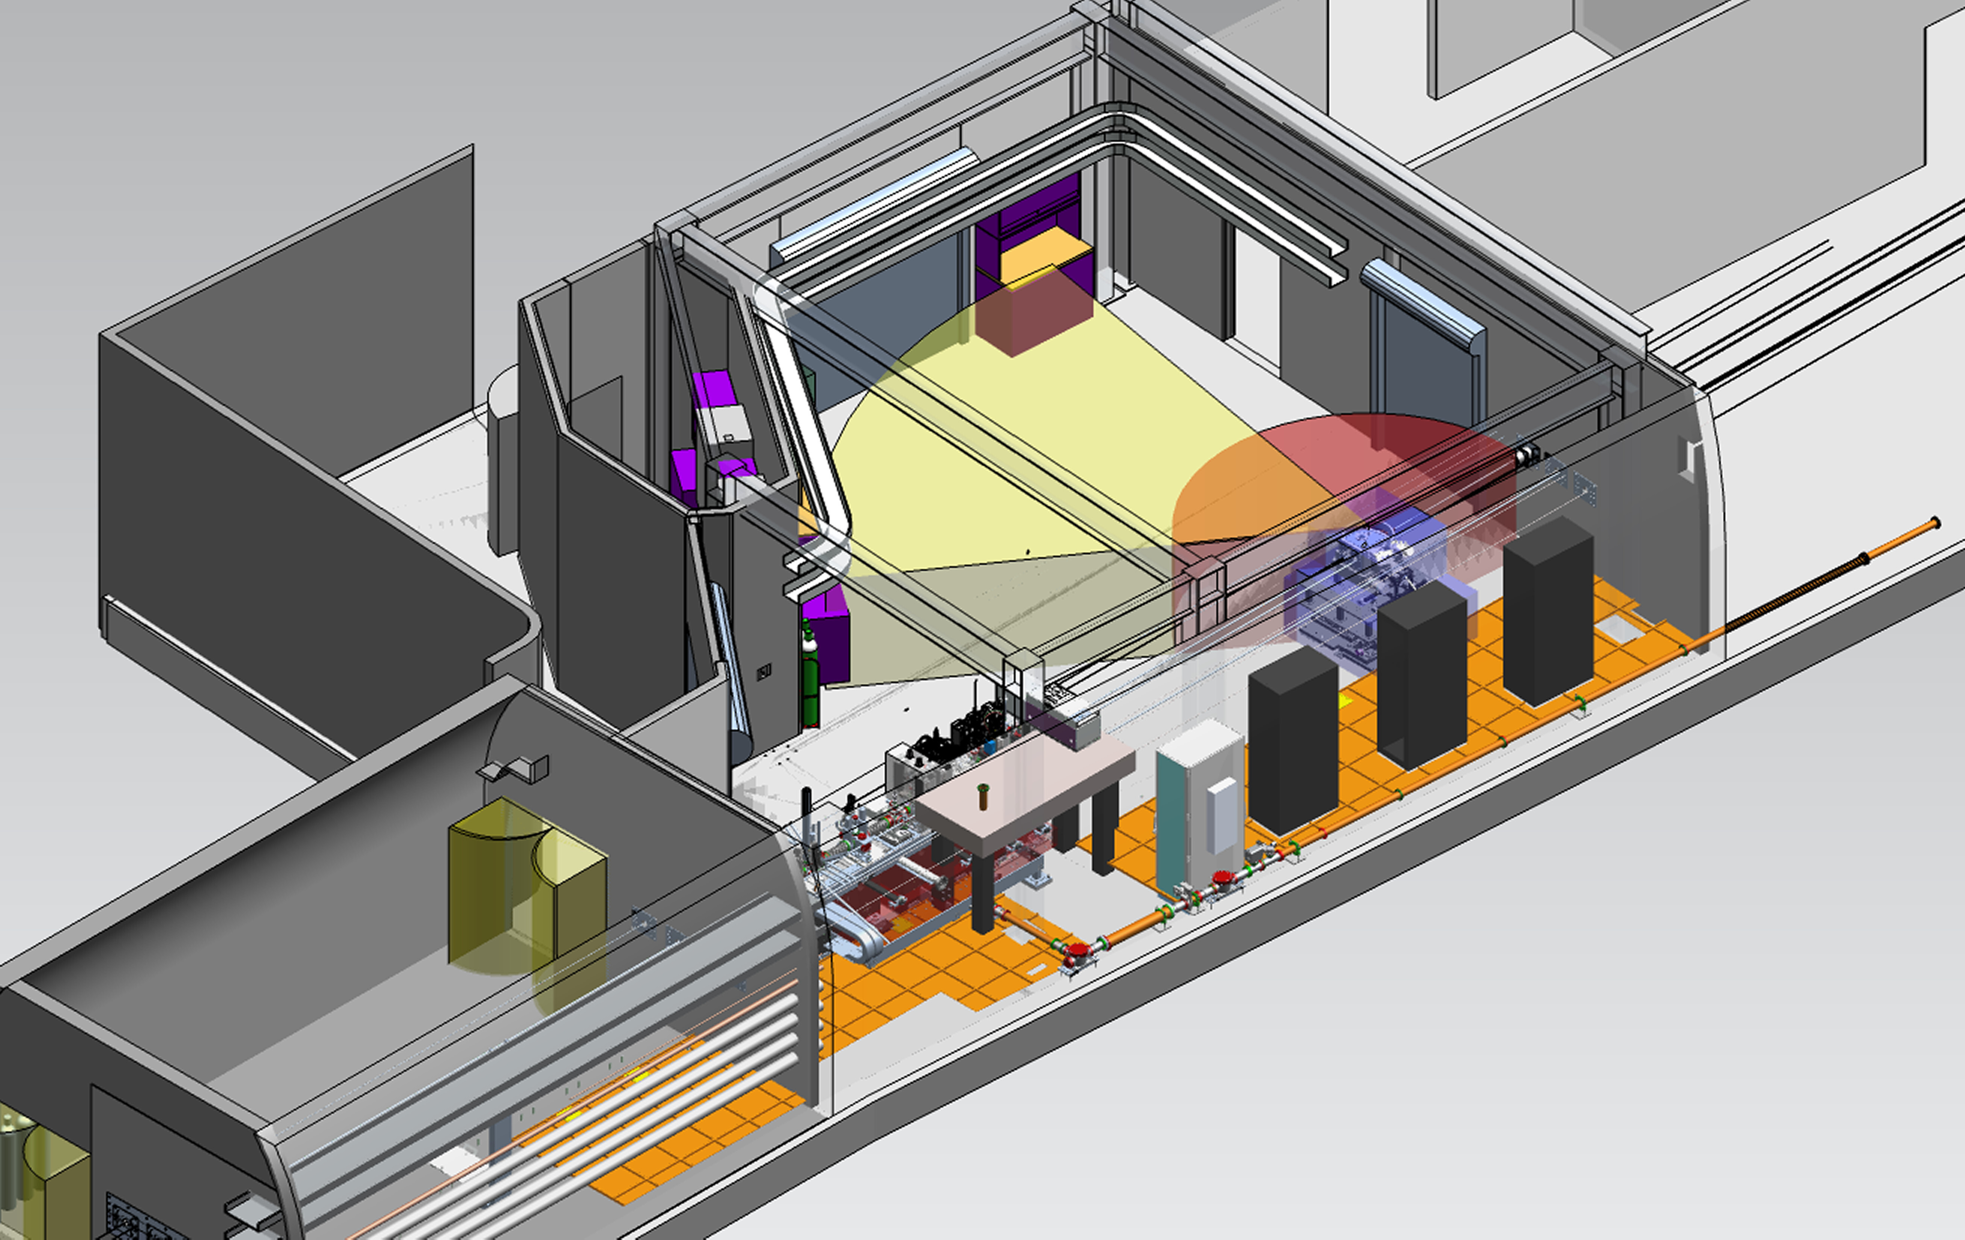
DXS Instrument Hutch

Slide 16
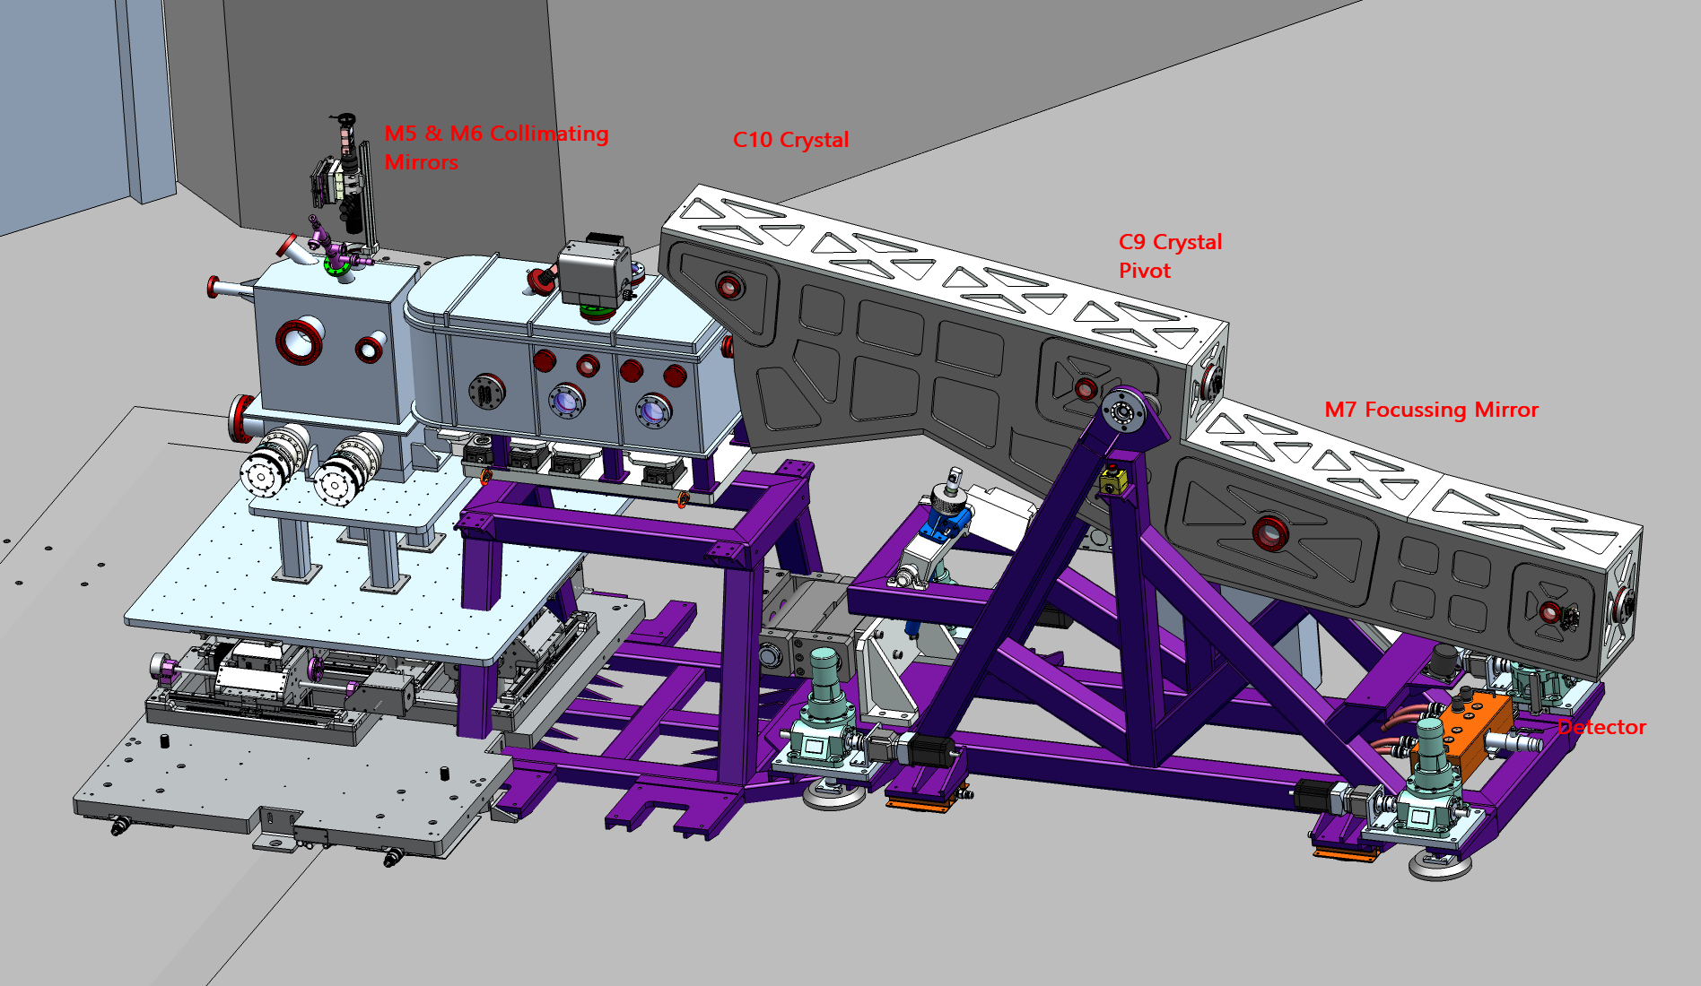
RIXS Spectrometer Arm
Movable spectrometer using air casters – hitch to sample chamber for rotation about sample
Levelling jacks/tilt sensors to account for floor variations

